Slide 1
Are you a teacher?
Would you like to use this PPT?
Please do! Take it, tweak it, share it – just please include “based on Unlocking Russian Pronunciation by Kimberly (Kira) DiMattia” in it.
In return, I would love it if you would share these two links with your students:
www.learnrussianwithkira.com
www.patreon.com/learnrussianwithkira
Спасибо!
Kimberly DiMattia, kiradimattia@gmail.com
Notes:
Use real-life hands! Participants can’t see the digital ones.

Slide 2
Welcome!
Gather items now
  Unlocking Russian Pronunciation (Kira’s book if you have it already)
  smart phone for recording yourself
  paper, pen/pencil
  water
Rename yourself on Zoom
  Click on Participants, hover over your name, choose Rename, and use your Russian name in Cyrillic (e.g. Кира)

Slide 3
Let’s say hello : )
Notes:
Use real-life hands! Participants can’t see the digital ones.

Slide 4
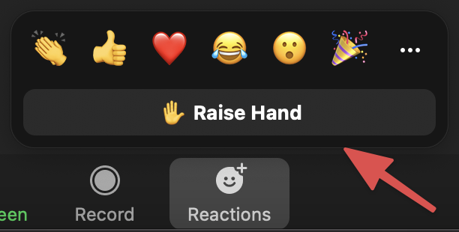
If you have a question, raise your electronic hand!
Notes:
Use real-life hands! Participants can’t see the digital ones.

Slide 5
Master Class with Kira
Kimberly (Kira) DiMattia
Week 1 – Sound & Identity

Slide 6
What is Master Class?

Slide 7
Learning & Teaching Lab
Up to 25 students
Up to 40 observers
Beginners to So. Many. Years.

Slide 8
Learning & Teaching Lab
We are all learning.
We are all at different points on the path.
We cheer each other on. : )

Slide 9

A Word About Ukraine
Notes:
Like the US, Russia is a former colonizer
Atm it is pursuing the recovery of a former colony, violating Ukraine’s independence & upsetting current world order
I have Ukrainian family, and I also have Russian friends whom I love dearly and many dear colleagues
It’s complicated, studying and teaching the language of a colonial power and current aggressor
It’s possible to love many aspects of Russian language and culture while opposing the agenda of the current dictator
Let’s study it and claim it as a tool and wield it for good, as much as we can

Slide 10
What is our goal?

Slide 11


Slide 12


Slide 13
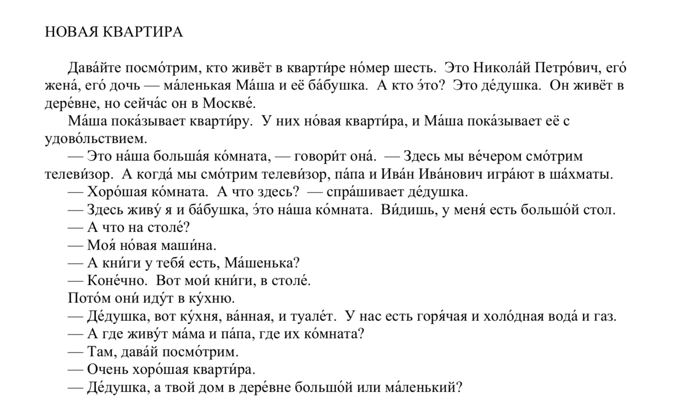

Slide 14
What’s the secret to moving the needle?

Slide 15


Daily homework!
Notes:
AND SOMETIMES AN EXTRA ASSIGNMENT that is not more than 15 min

Slide 16
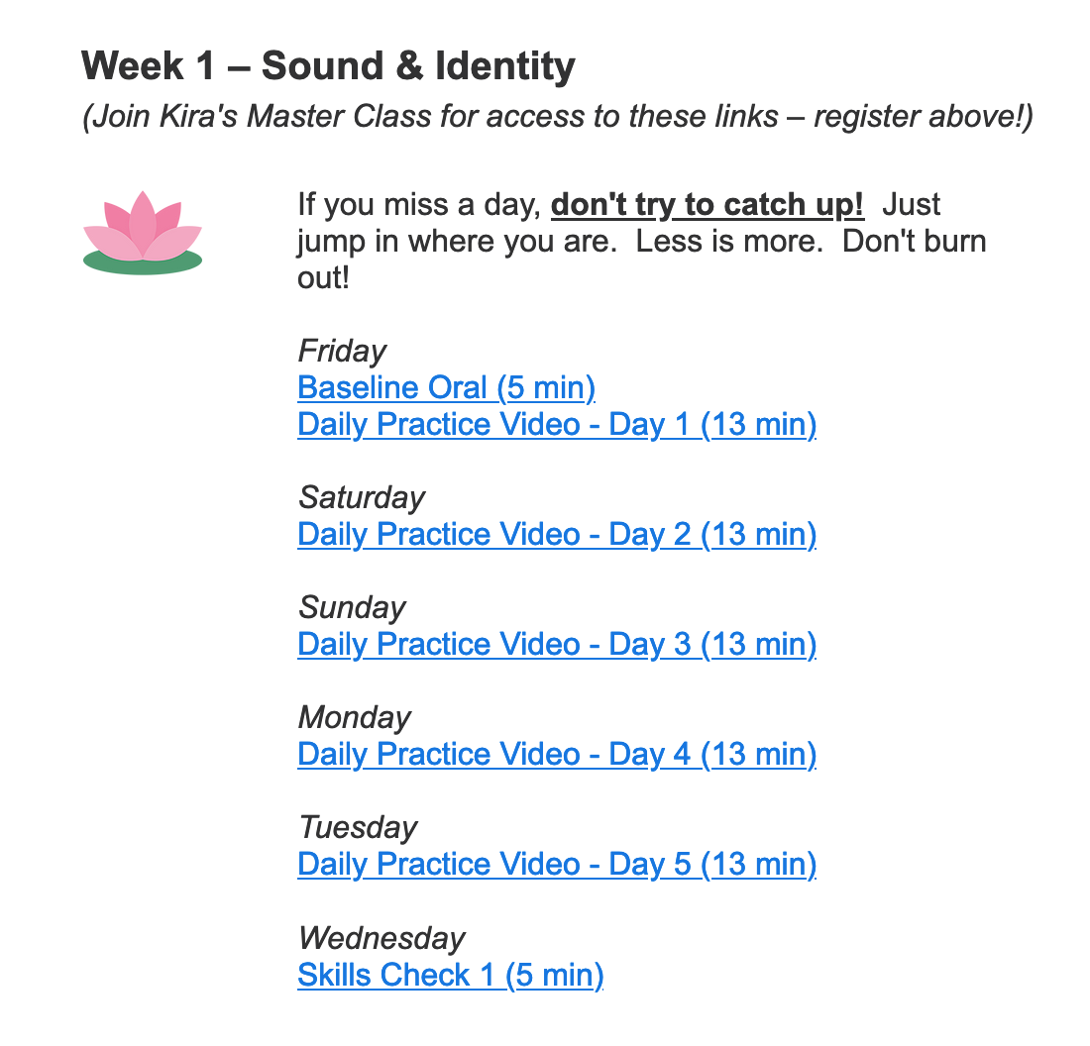
Daily Homework

Slide 17

Daily Homework

Slide 18
Daily Homework

Slide 19
Daily Homework

Slide 20
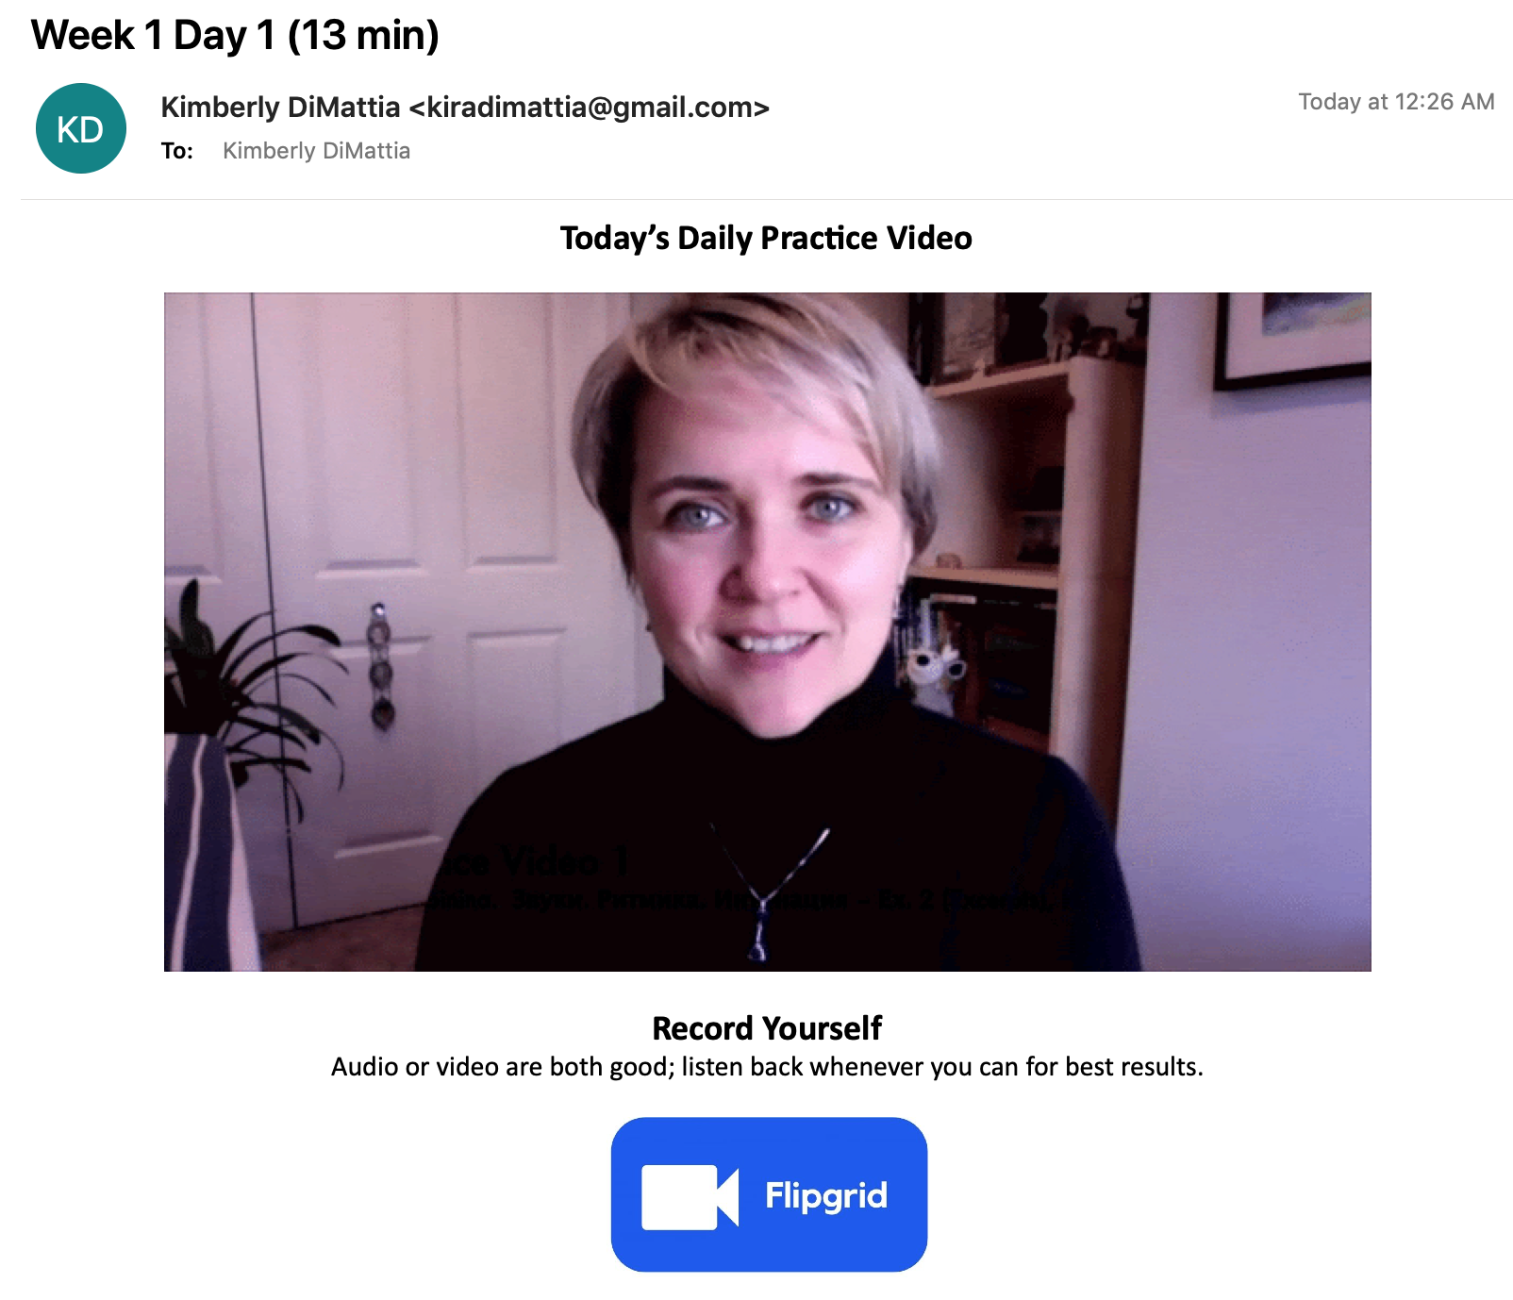
Daily HW Email

Slide 21
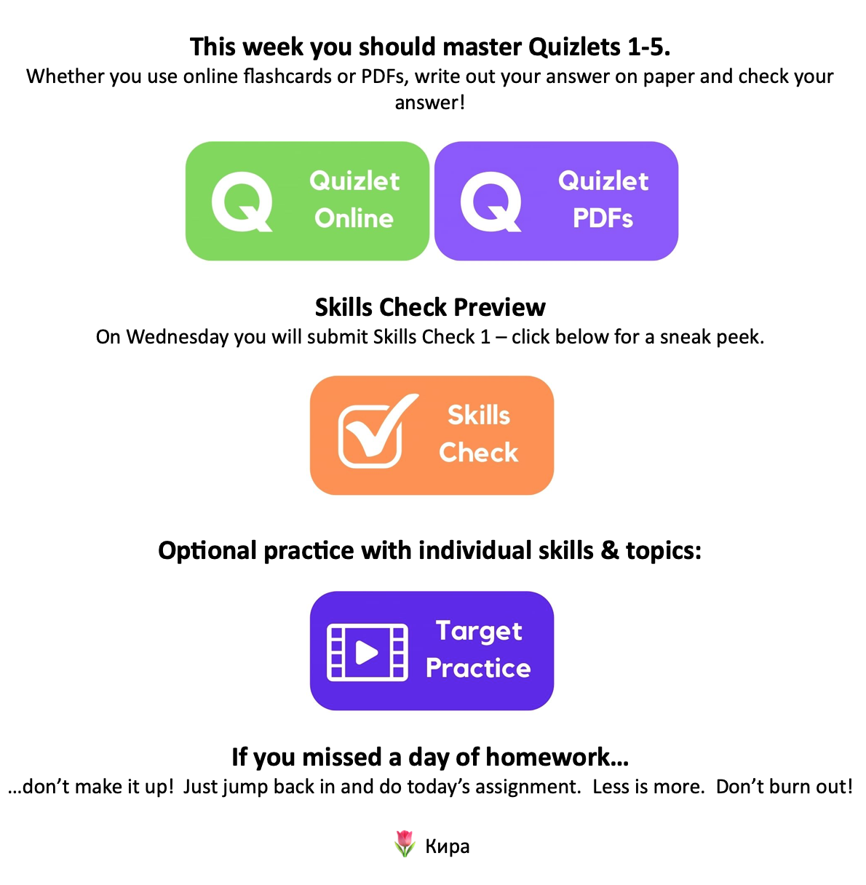
Daily HW Email

Slide 22
Daily Homework

Slide 23
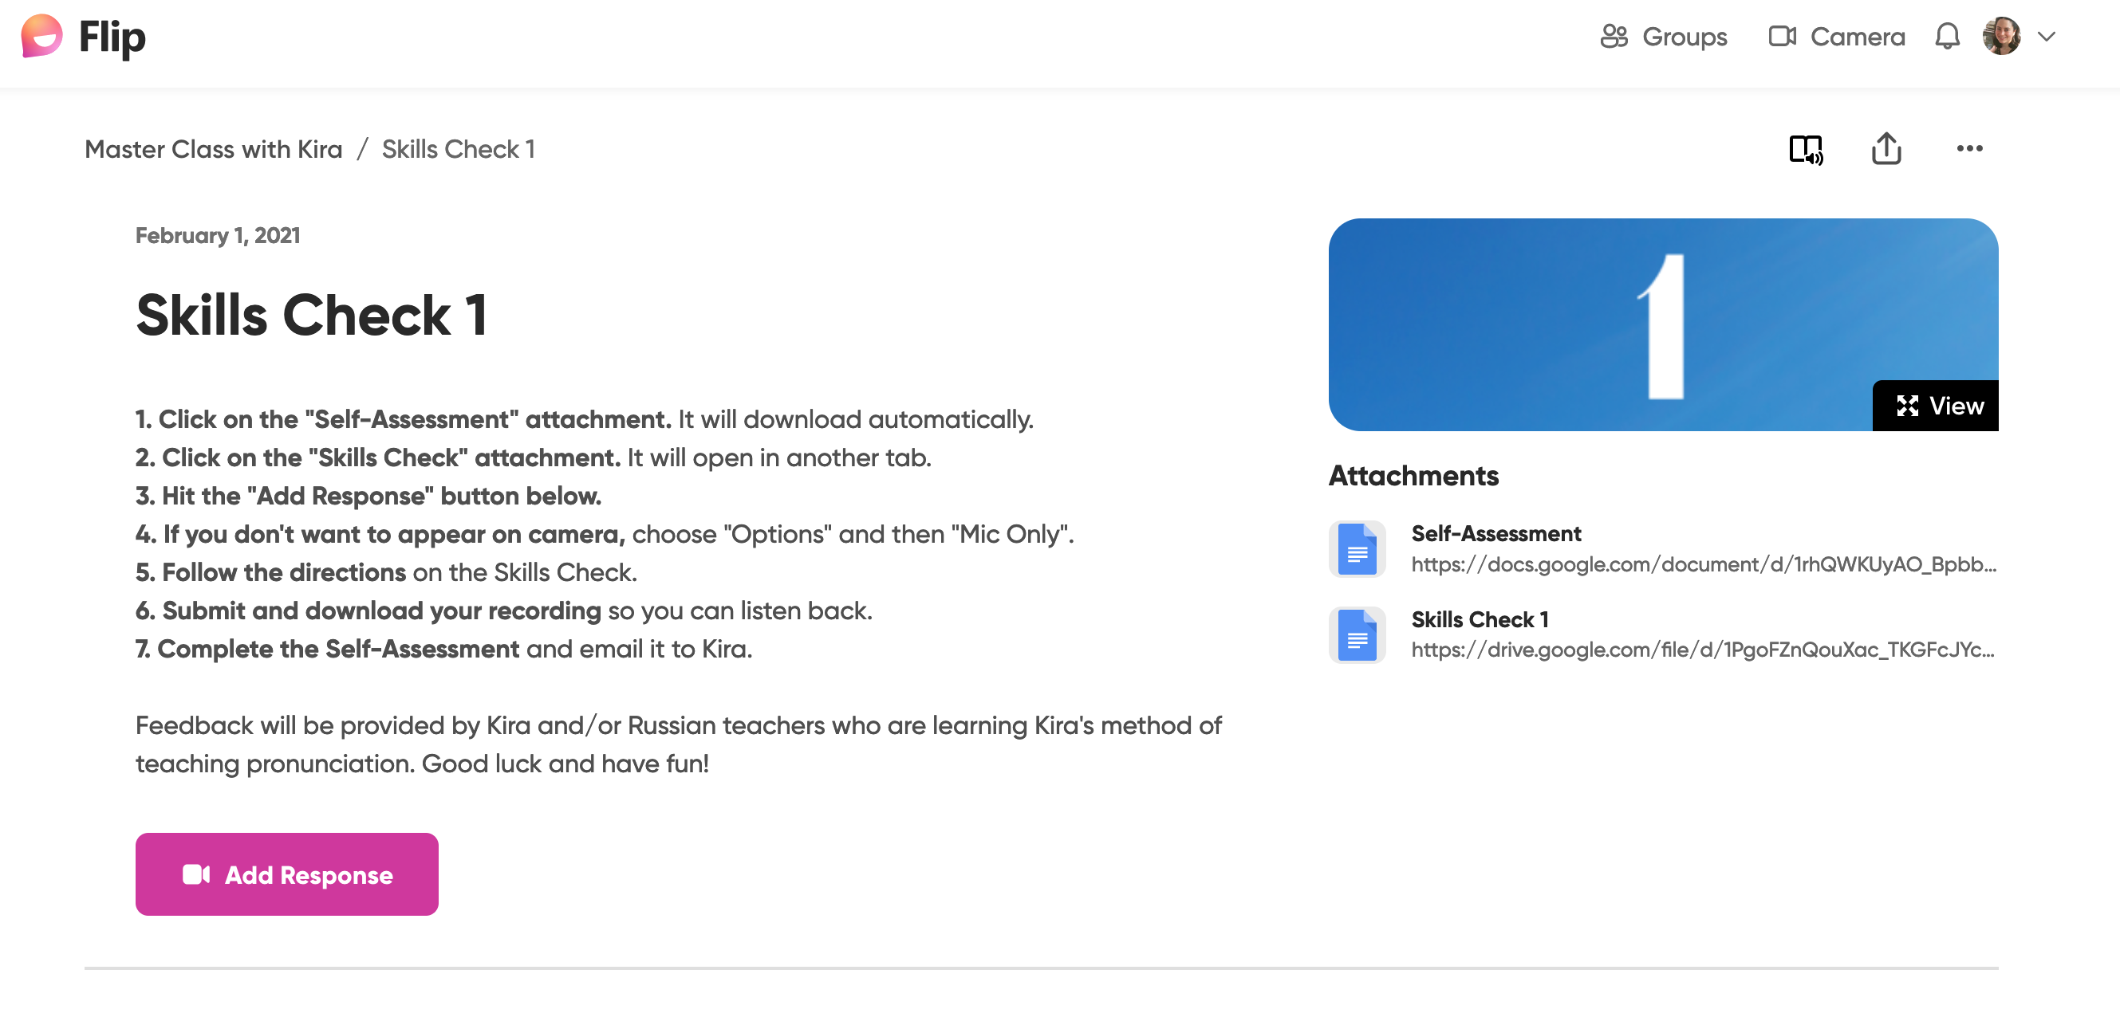
Notes:
You receive feedback

Slide 24
Want the hw emails?
Notes:
Put your email address in the chat now!

Slide 25
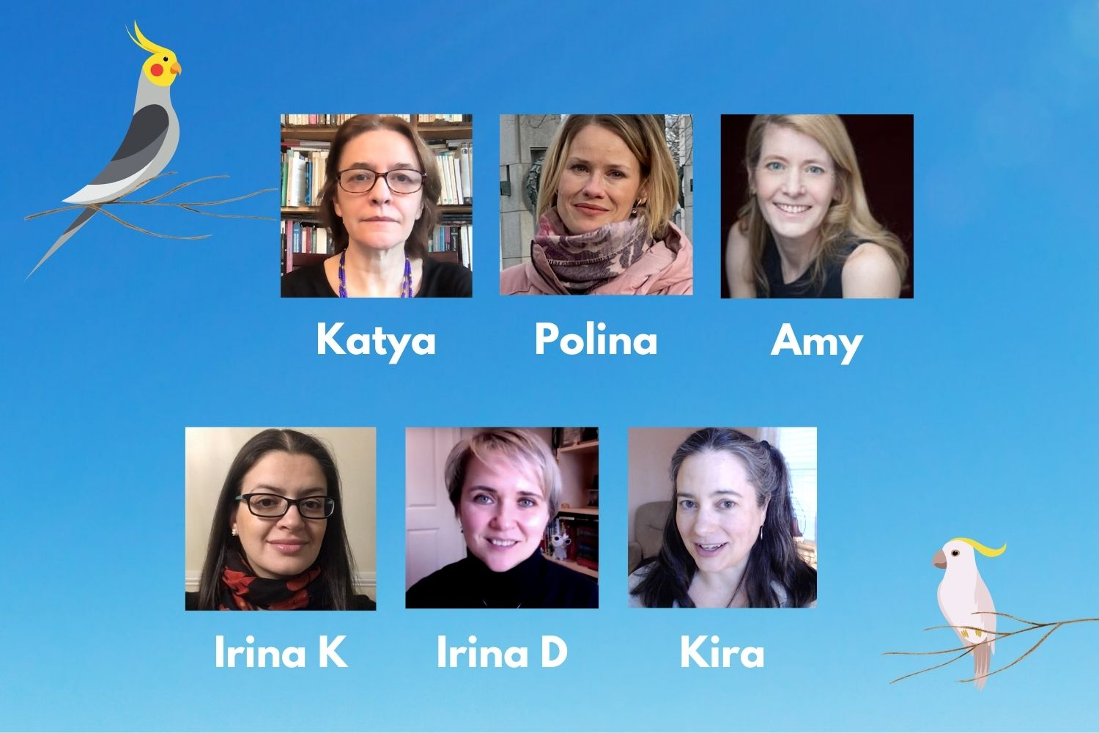
Meet the peeps!

Slide 26
Optional Check-Ins
Mondays 4 p.m. ET
Register now, come to any and all
https://us02web.zoom.us/meeting/register/tZMkfumhrjsvEtcfNFTO0I7veSrA6tBHtMYO

Slide 27
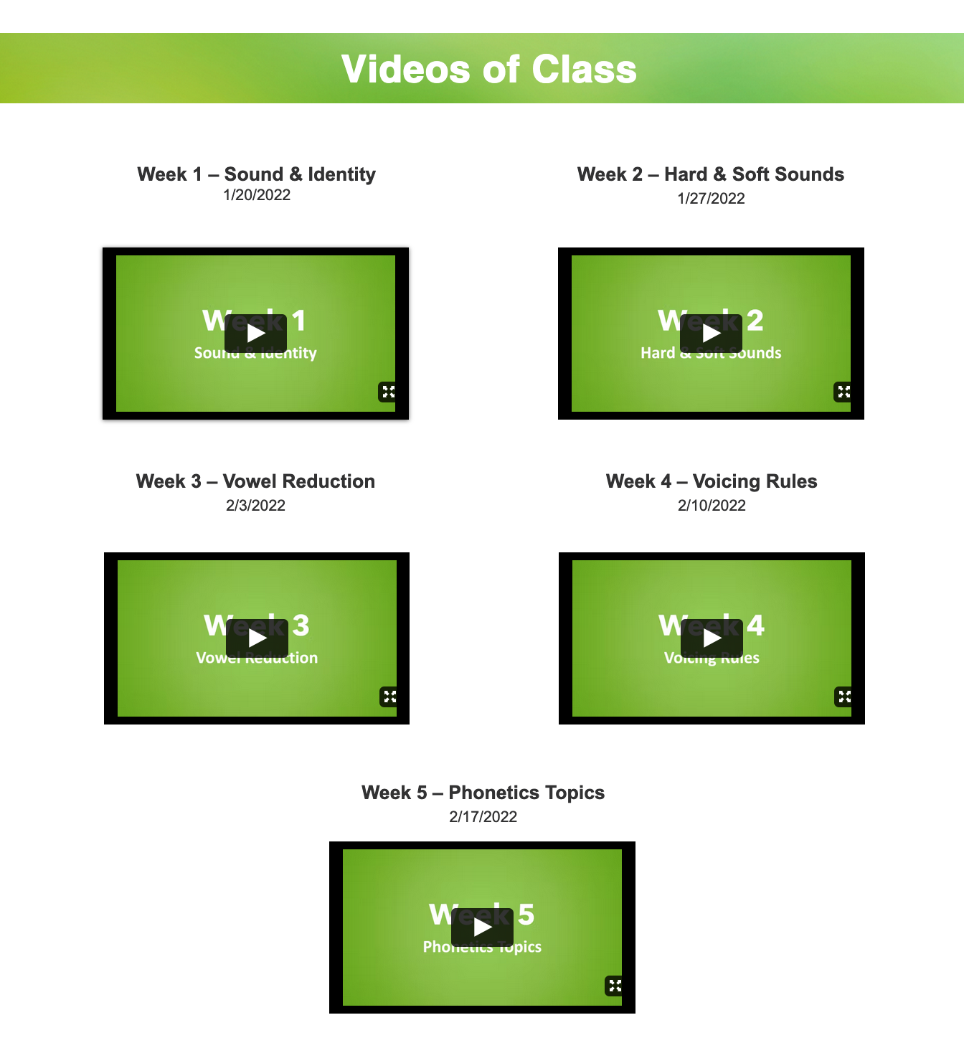
Class Website

Slide 28
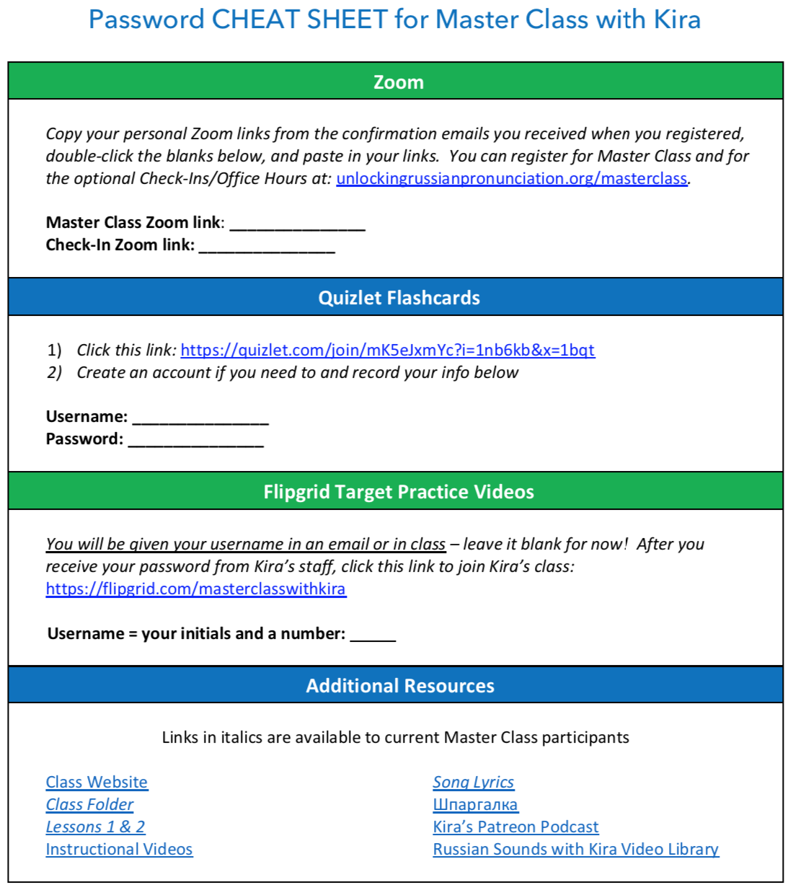

Slide 29
Today
Deep Psychological Moments
Default Mouth Position
Secret Code
8:30 / 9 p.m. EST

Slide 30
What am I looking for?
Right answers?
Epiphanies!
Perfection?
Vulnerability!
Amplify your visuals. : )

Slide 31
Deep Psychological Moments

Slide 32
Once upon a time...
Once upon a time...

Slide 33

Swarthmore

Slide 34
Swarthmore
Р

Slide 35

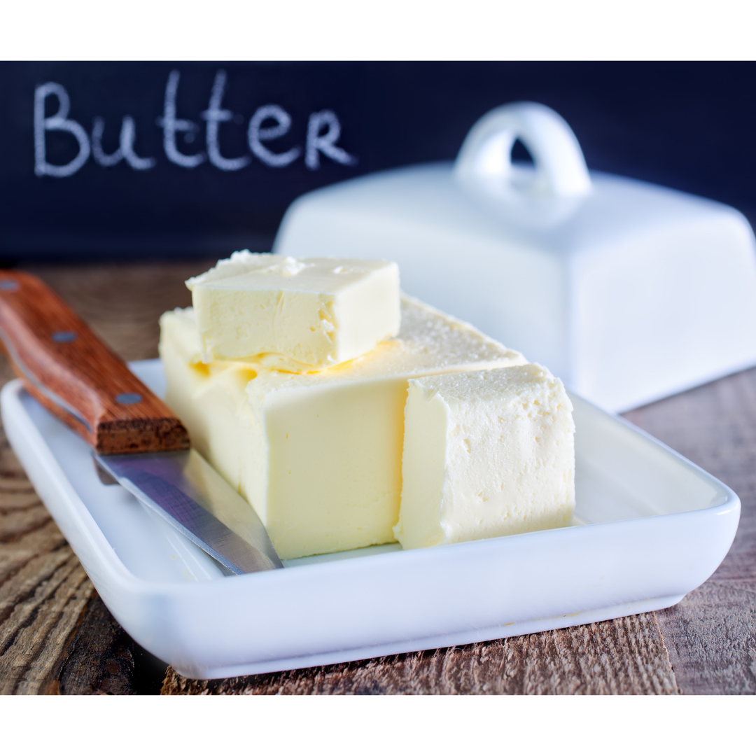
Р!

Slide 36



R
=
Р

Slide 37
Sounding Authentically Russian

Slide 38
Sounding Authentically Russian
Hint: it’s partly psychological.

Slide 39
Sounding Authentically Russian
SOUND IDENTITY!

Slide 42
Sounding Authentically Russian
In order to do this, we must play.

Slide 43

Notes:
When we first hear that we must play, we may feel like this...

Slide 45
Elizabeth Gilbert
“...perfectionism can murder creativity.”

Slide 46
Notes:
But this is really just a state...

Slide 47
Notes:
...and by relaxing and accepting that we are going to sound imperfect, we can shift our state towards something more like...

Slide 48

Notes:
...this! This is the kind of feeling we need to douse our brains in! The same feeling that we get from being with children.

Slide 49


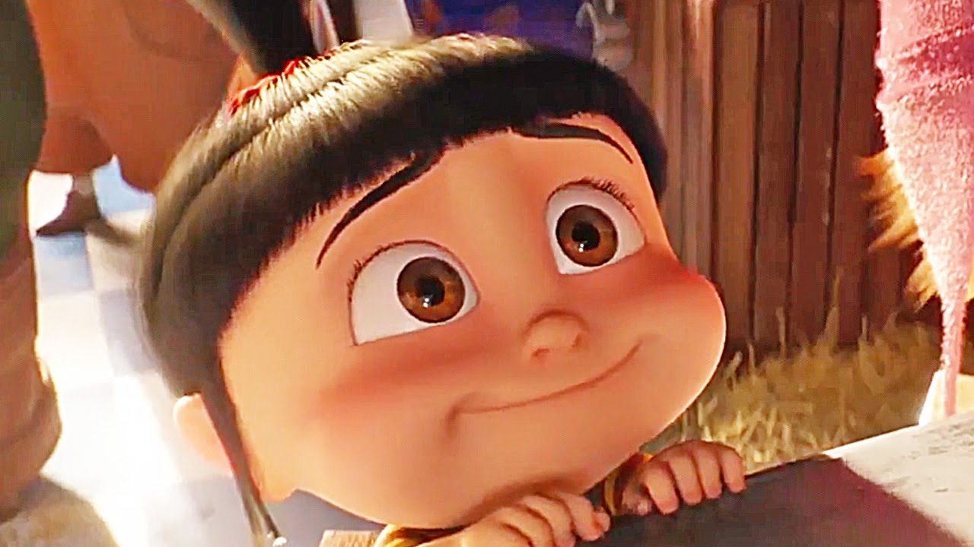
Notes:
This is the kind of energy we need. There’s delight and discovery. Connection over shared flaws and laughter at mistakes.

Slide 52

Notes:
This is the state where you are free to play around with new ideas.

Slide 53
Extra Phrases for Practice
(jaw – tongue – LEEPS!)
Hello, world!
Lake Baikal
Where is de snow?
Tolstoy
Dostoevsky
Notes:
Groups of 5 unmute at one time and I ask 3 people to repeat each phrase after me

Slide 54
Extra Phrases for Practice
(jaw – tongue – LEEPS!)
Don’t say no!
You must say yes!
Your face…is asking for a brick!
Let’s go save de world!
Don’t worry!
I’m not going to kill you!

Slide 55


Slide 56
Default Mouth Position
Notes:
So let’s play around!

Slide 57
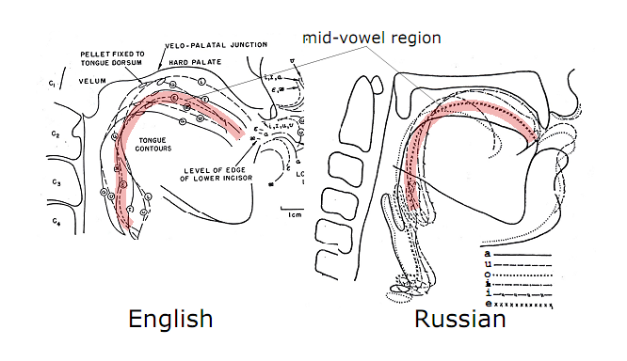
What is a default mouth position?
Many definitions (static/dynamic, one/many)
Артикуляцио́нная ба́за (Basis of Articulation, Honikman)
Е. А. Брызгуно́ва
Артикуляцио́нный укла́д (setup) (preparatory position)
И. В. Одинцо́ва
English vs Russian
Economy
Notes:
https://en.wikipedia.org/wiki/Basis_of_articulation

Slide 58
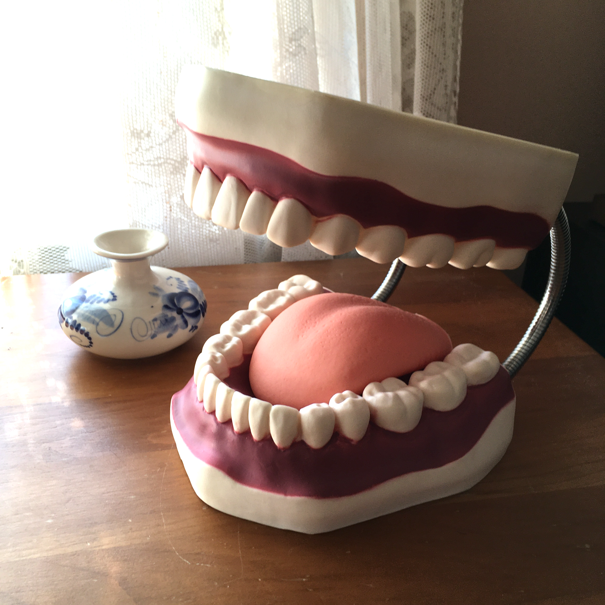
Russian Default Mouth Position
Jaw
Tongue
Lips
Notes:
KEEP IT CLOSED (BUT NOT TENSE) and a bit forward
English: the mouth is opened wider than in Russian
Russian: the mouth remains more closed

Slide 59
Russian Default Mouth Position
Jaw
Tongue
Lips
Notes:
TIP IS BEHIND BACK OF BOTTOM TEETH and FRONT AND MIDDLE IS RAISED TO THE PALATE
English: the tongue is retracted and has a widened and flatter position with the tip curved upward (the tongue lies deep in the mouth, not touching the palate)
Russian: the tip touches the back of the bottom teeth while the front and middle of the tongue are raised to the palate

Slide 60
Russian Default Mouth Position
Jaw
Tongue
Lips
Notes:
TIP IS BEHIND BACK OF BOTTOM TEETH and FRONT AND MIDDLE IS RAISED TO THE PALATE
English: the tongue is retracted and has a widened and flatter position with the tip curved upward (the tongue lies deep in the mouth, not touching the palate)
Russian: the tip touches the back of the bottom teeth while the front and middle of the tongue are raised to the palate

Slide 61

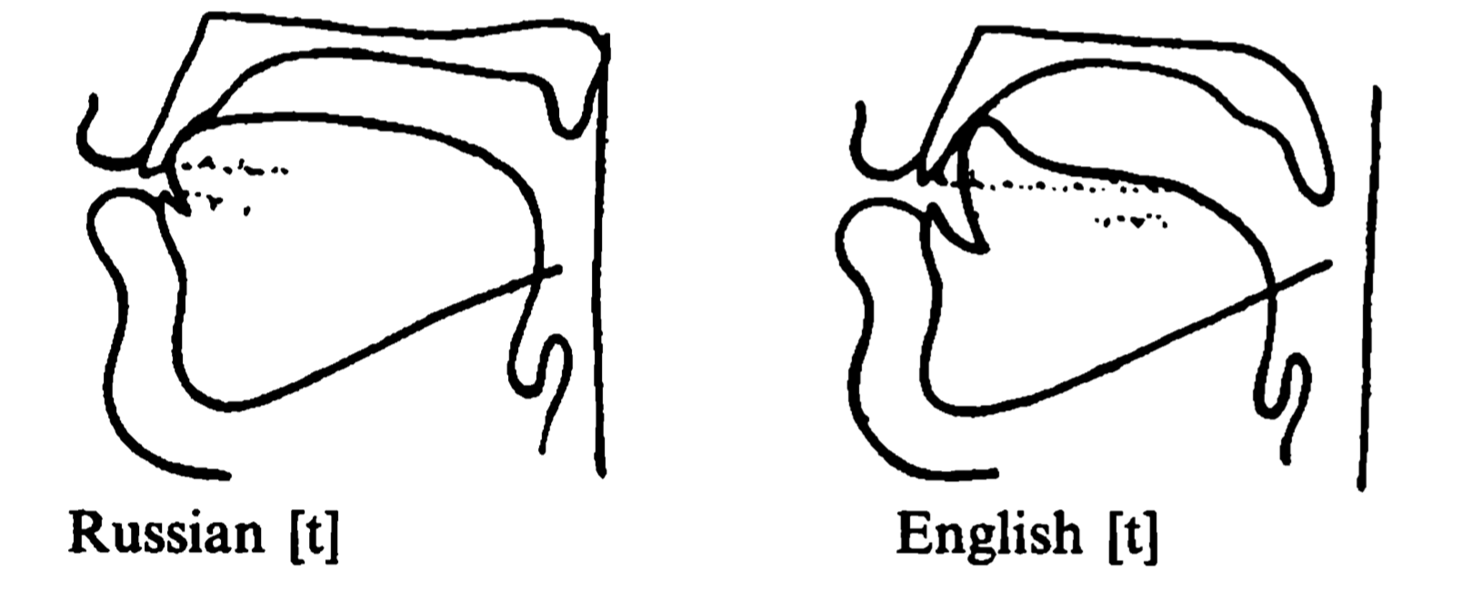
Russian Default Mouth Position
tip
Jaw
Tongue
Lips
part behind tip
tip

Slide 62
Russian Default Mouth Position
Jaw
Tongue
Lips
Notes:
LOOSE and PROTRUDED
English: the tongue is retracted and has a widened and flatter position with the tip curved upward (the tongue lies deep in the mouth, not touching the palate)
Russian: the tip touches the back of the bottom teeth while the front and middle of the tongue are raised to the palate

Slide 63
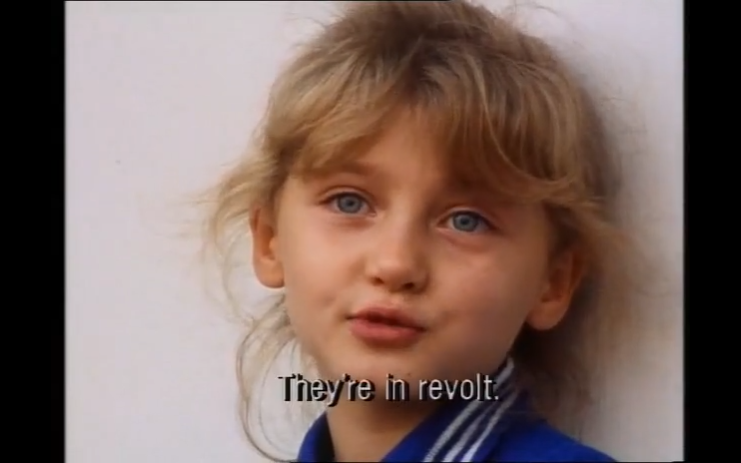
басту́ют

Slide 64
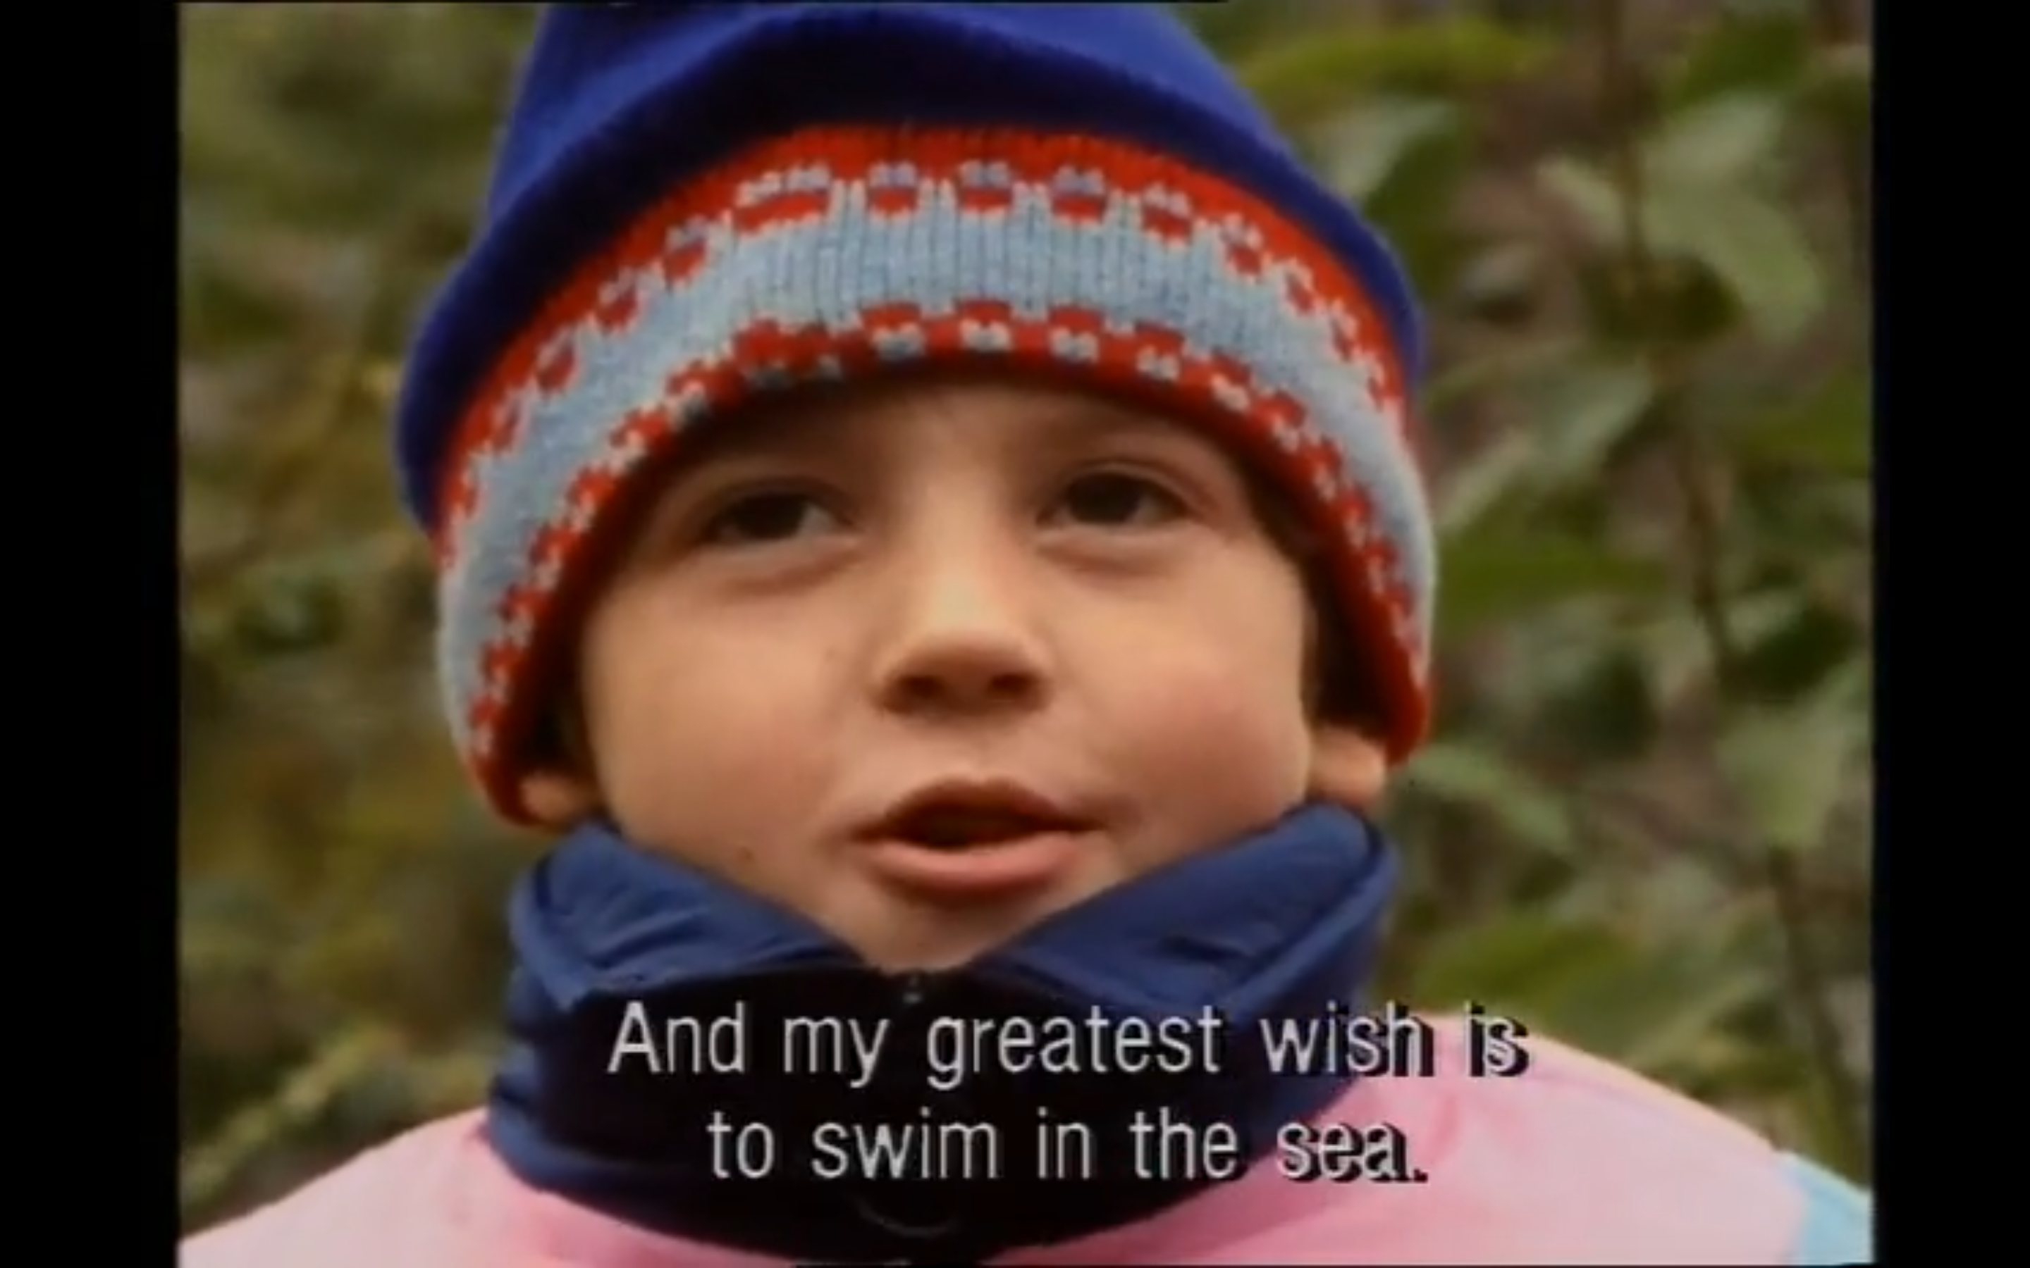
мо́ре

Slide 65
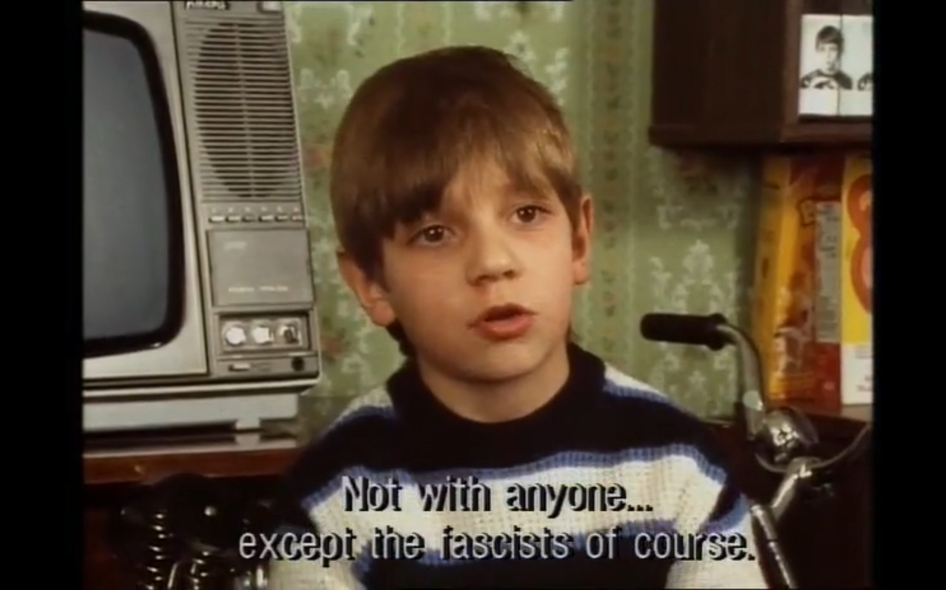
то́лько

Slide 66
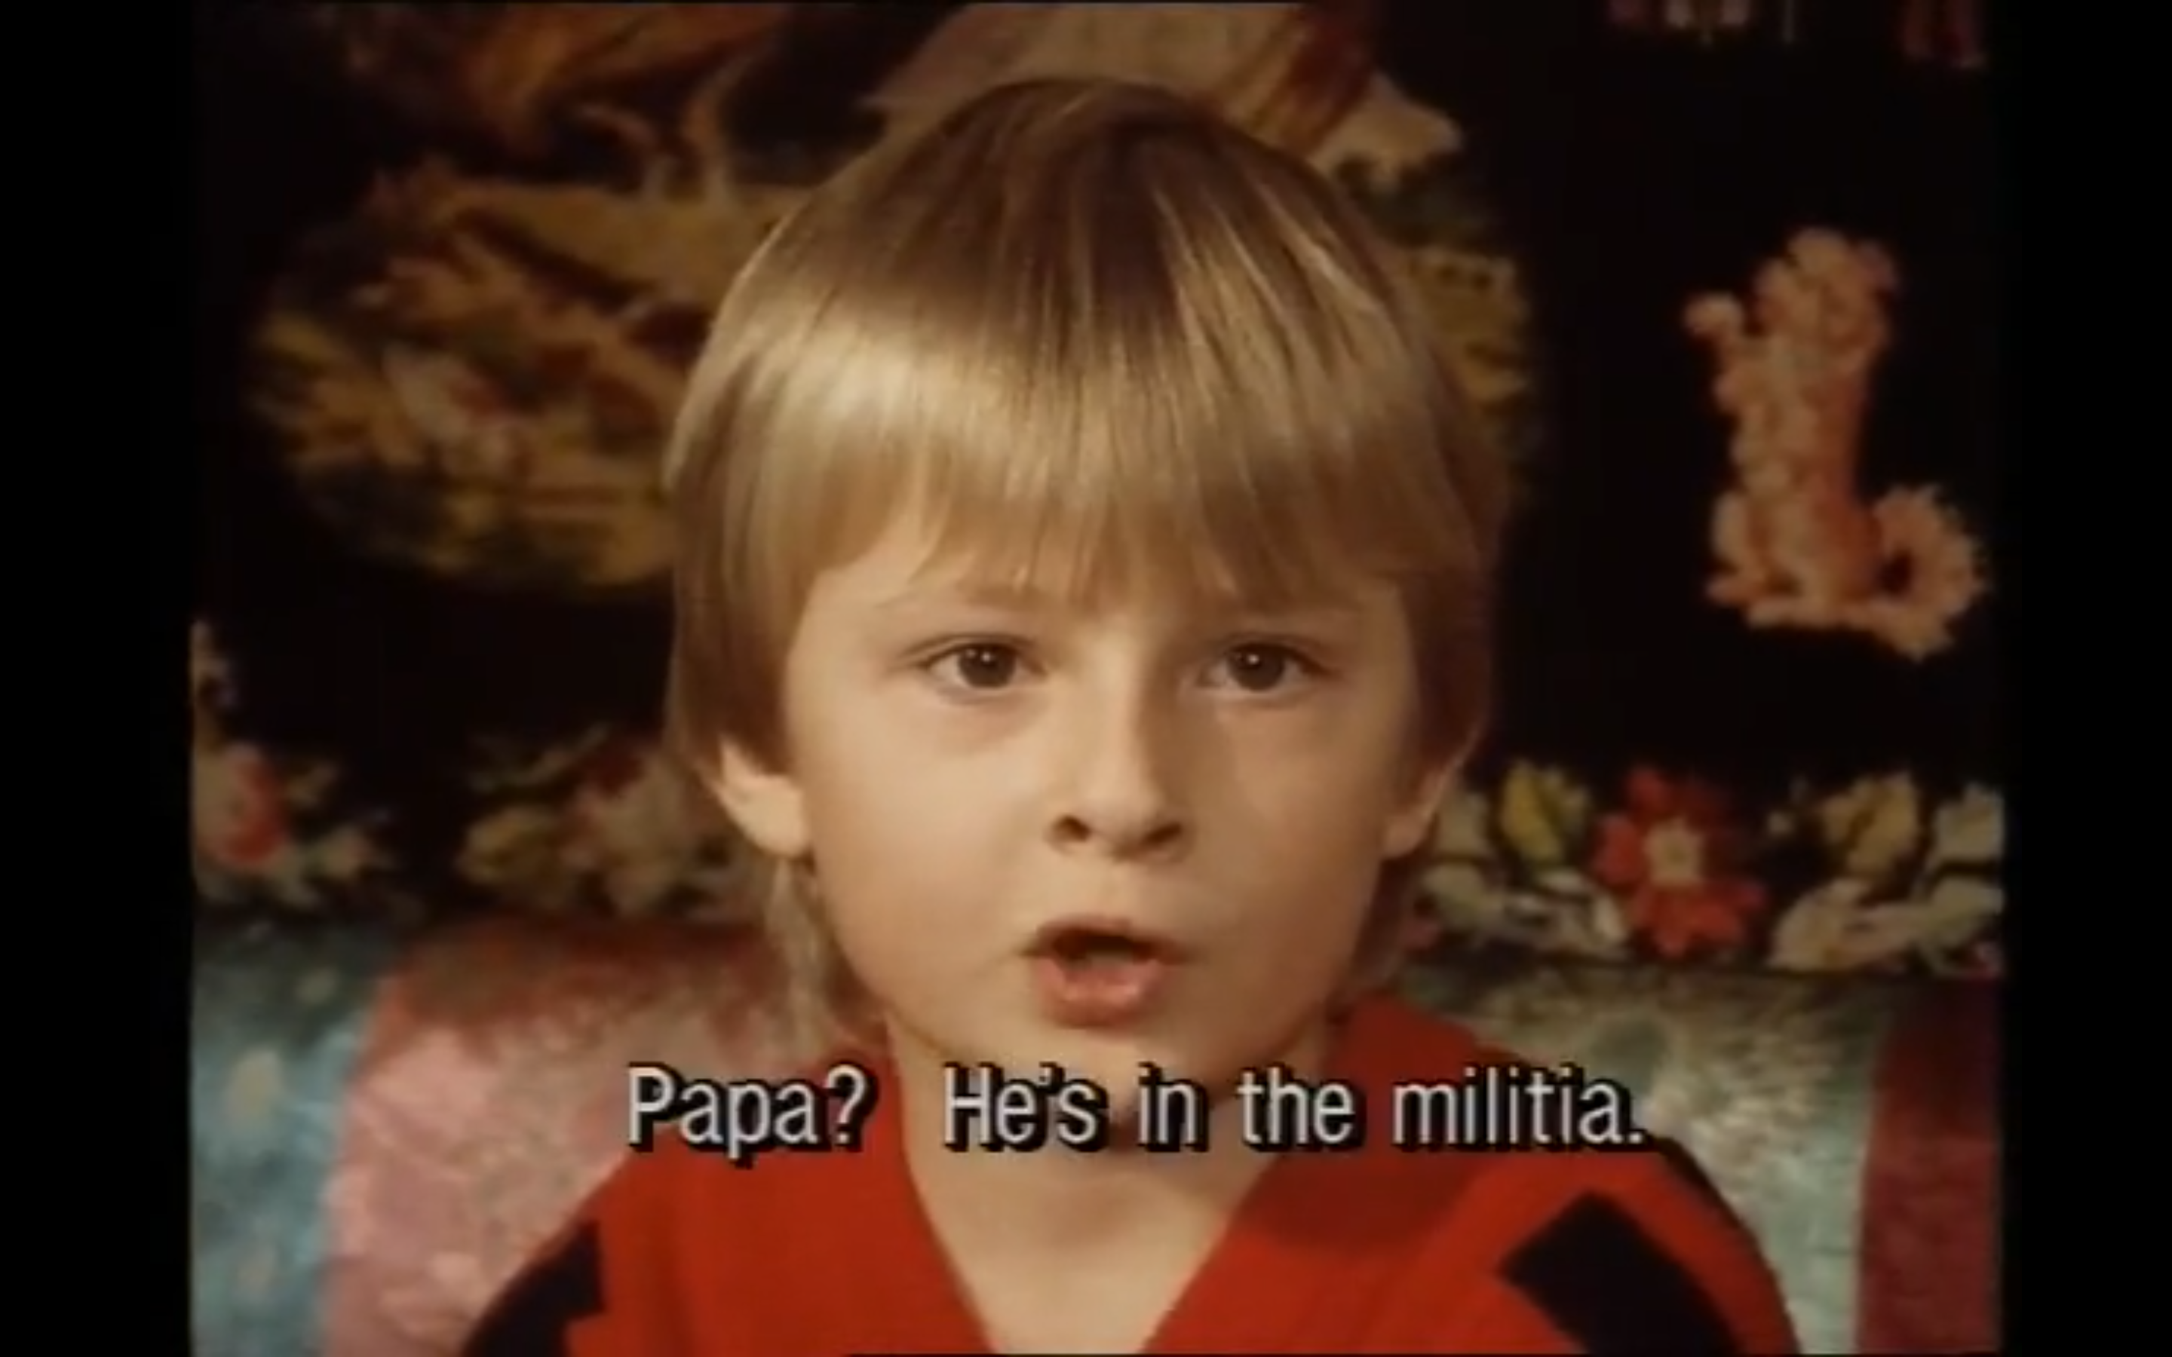
па́па

Slide 67
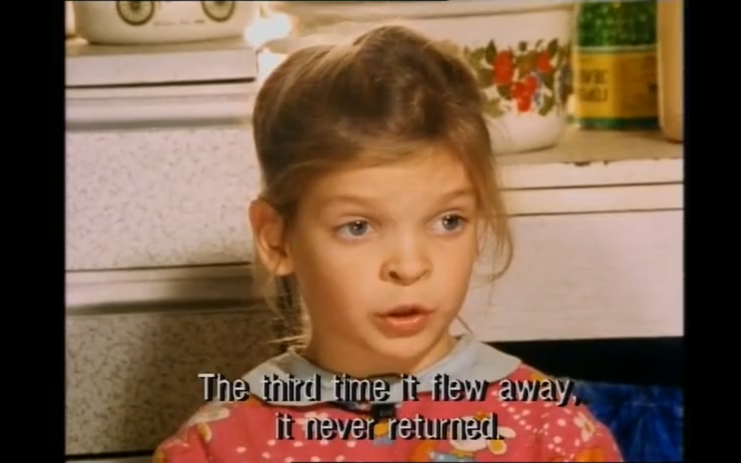
прилете́л

Slide 68
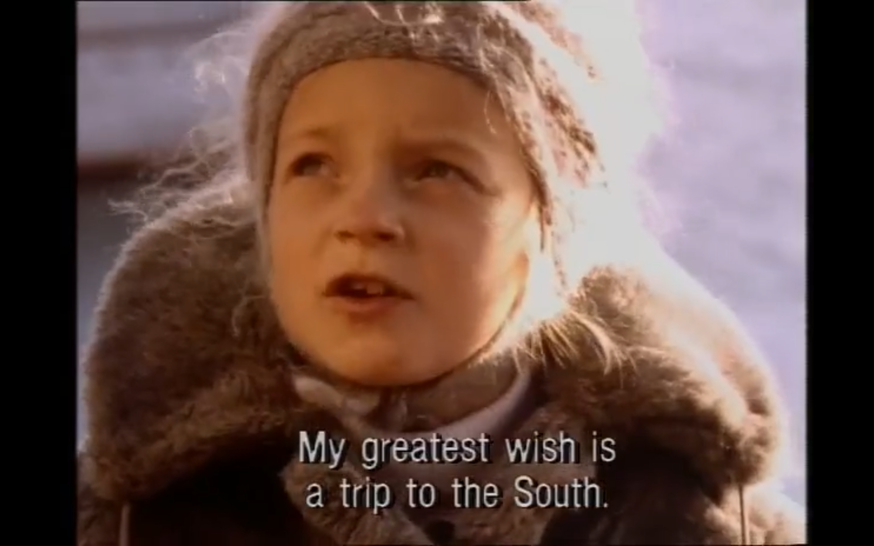
мечта́

Slide 69
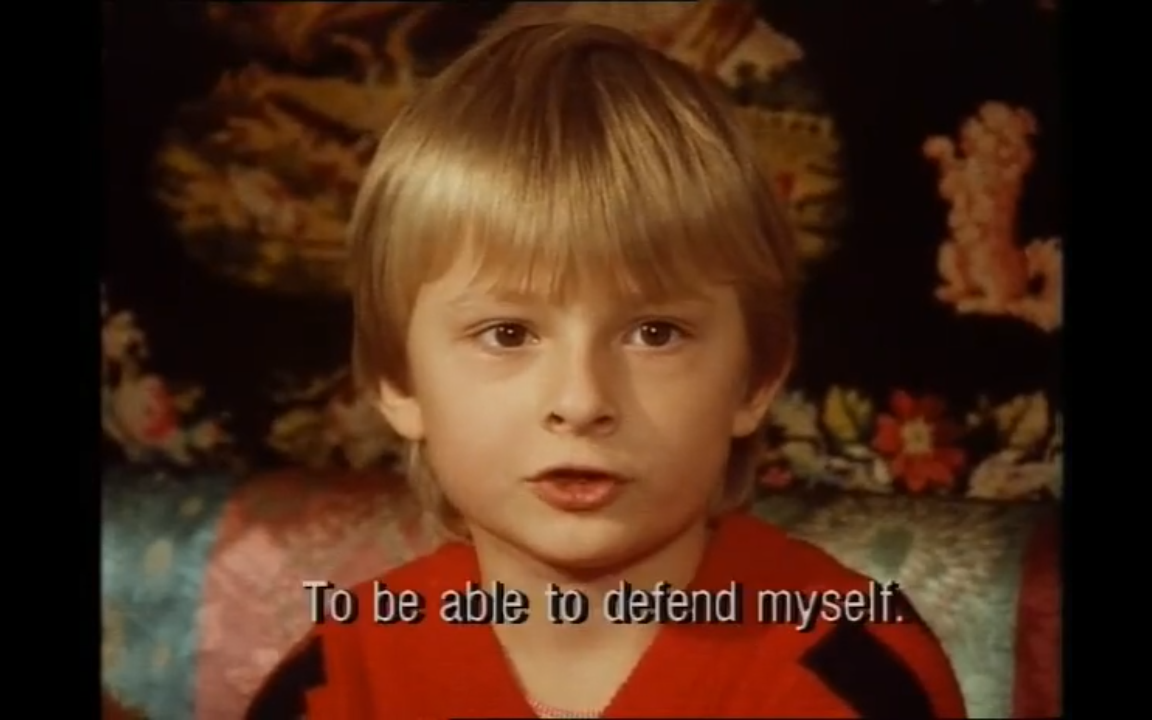
защища́ться

Slide 70
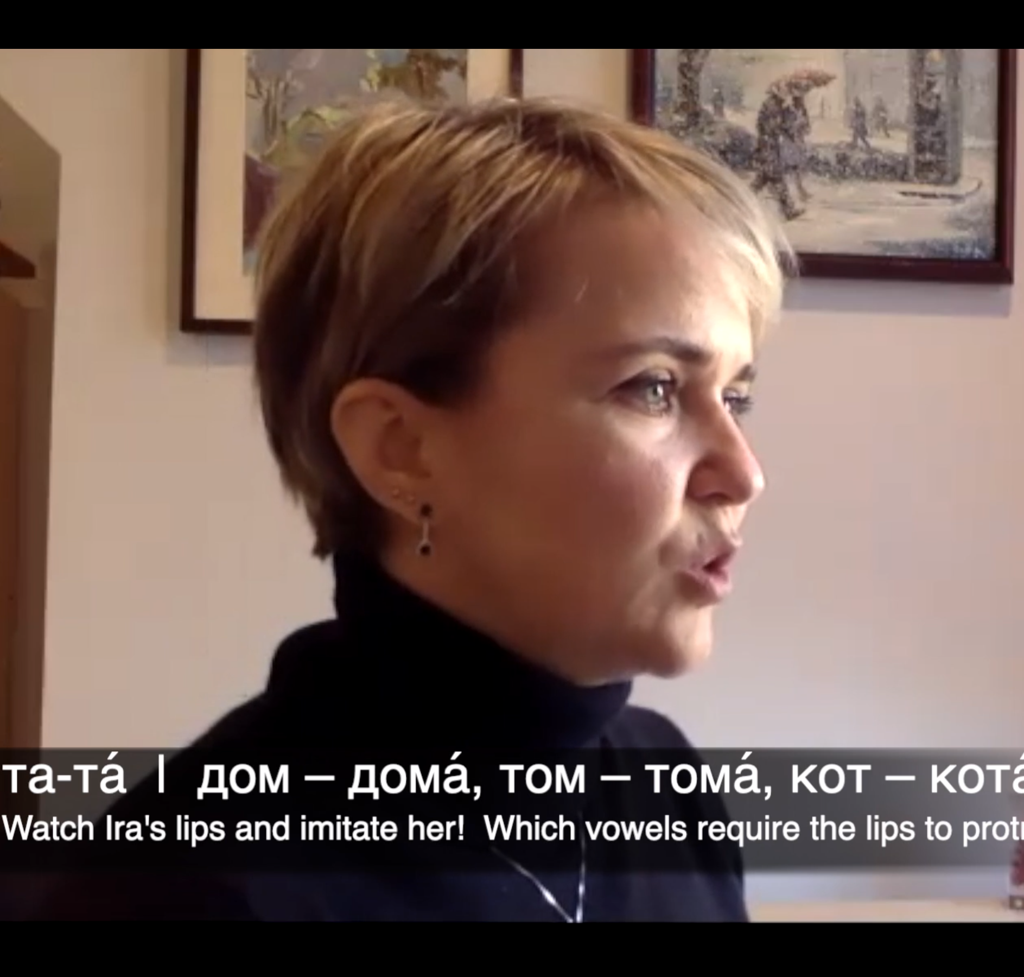
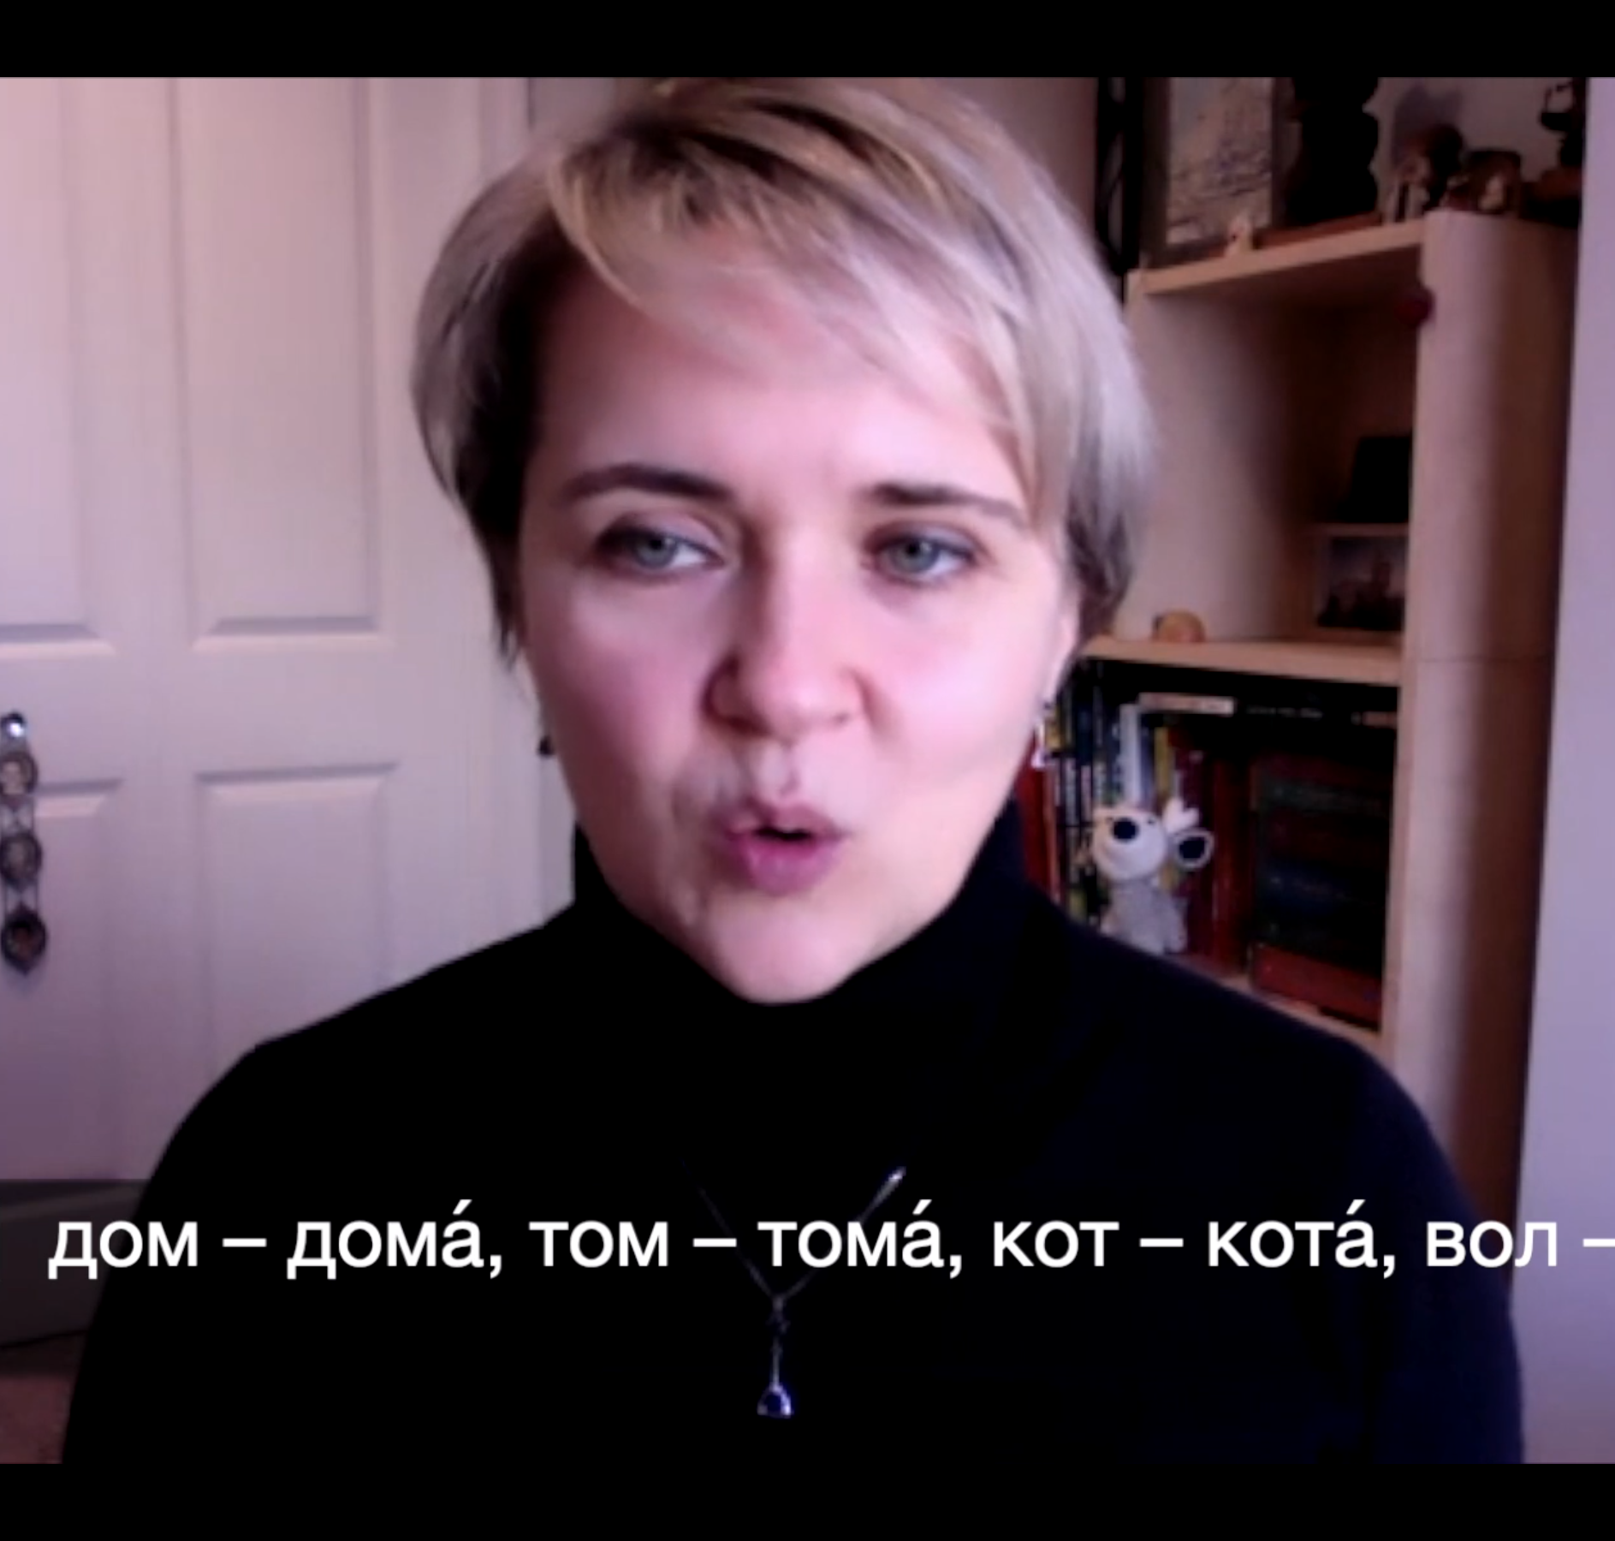
дом

Slide 71
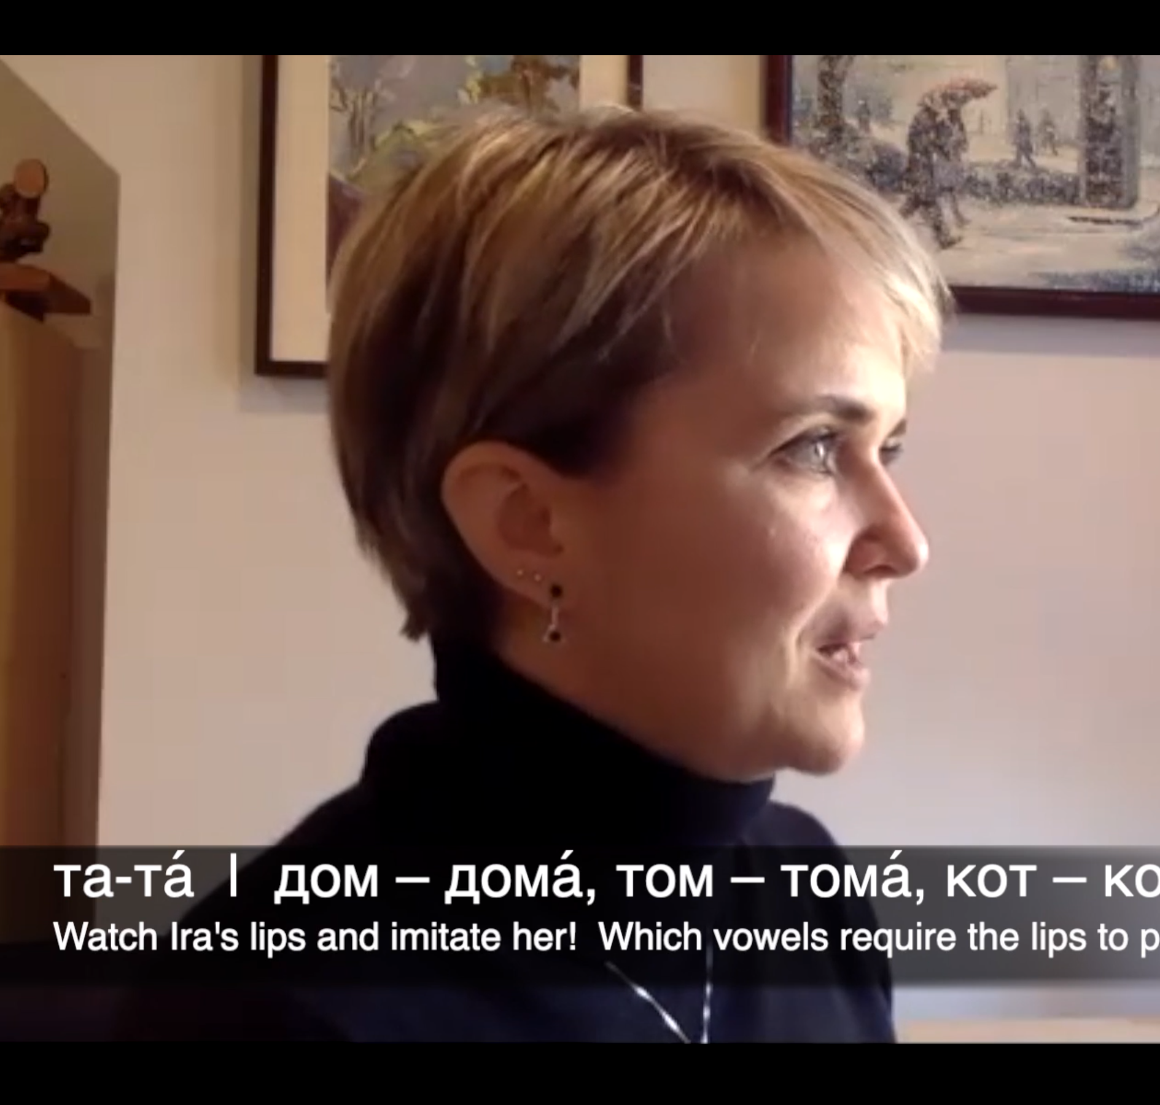
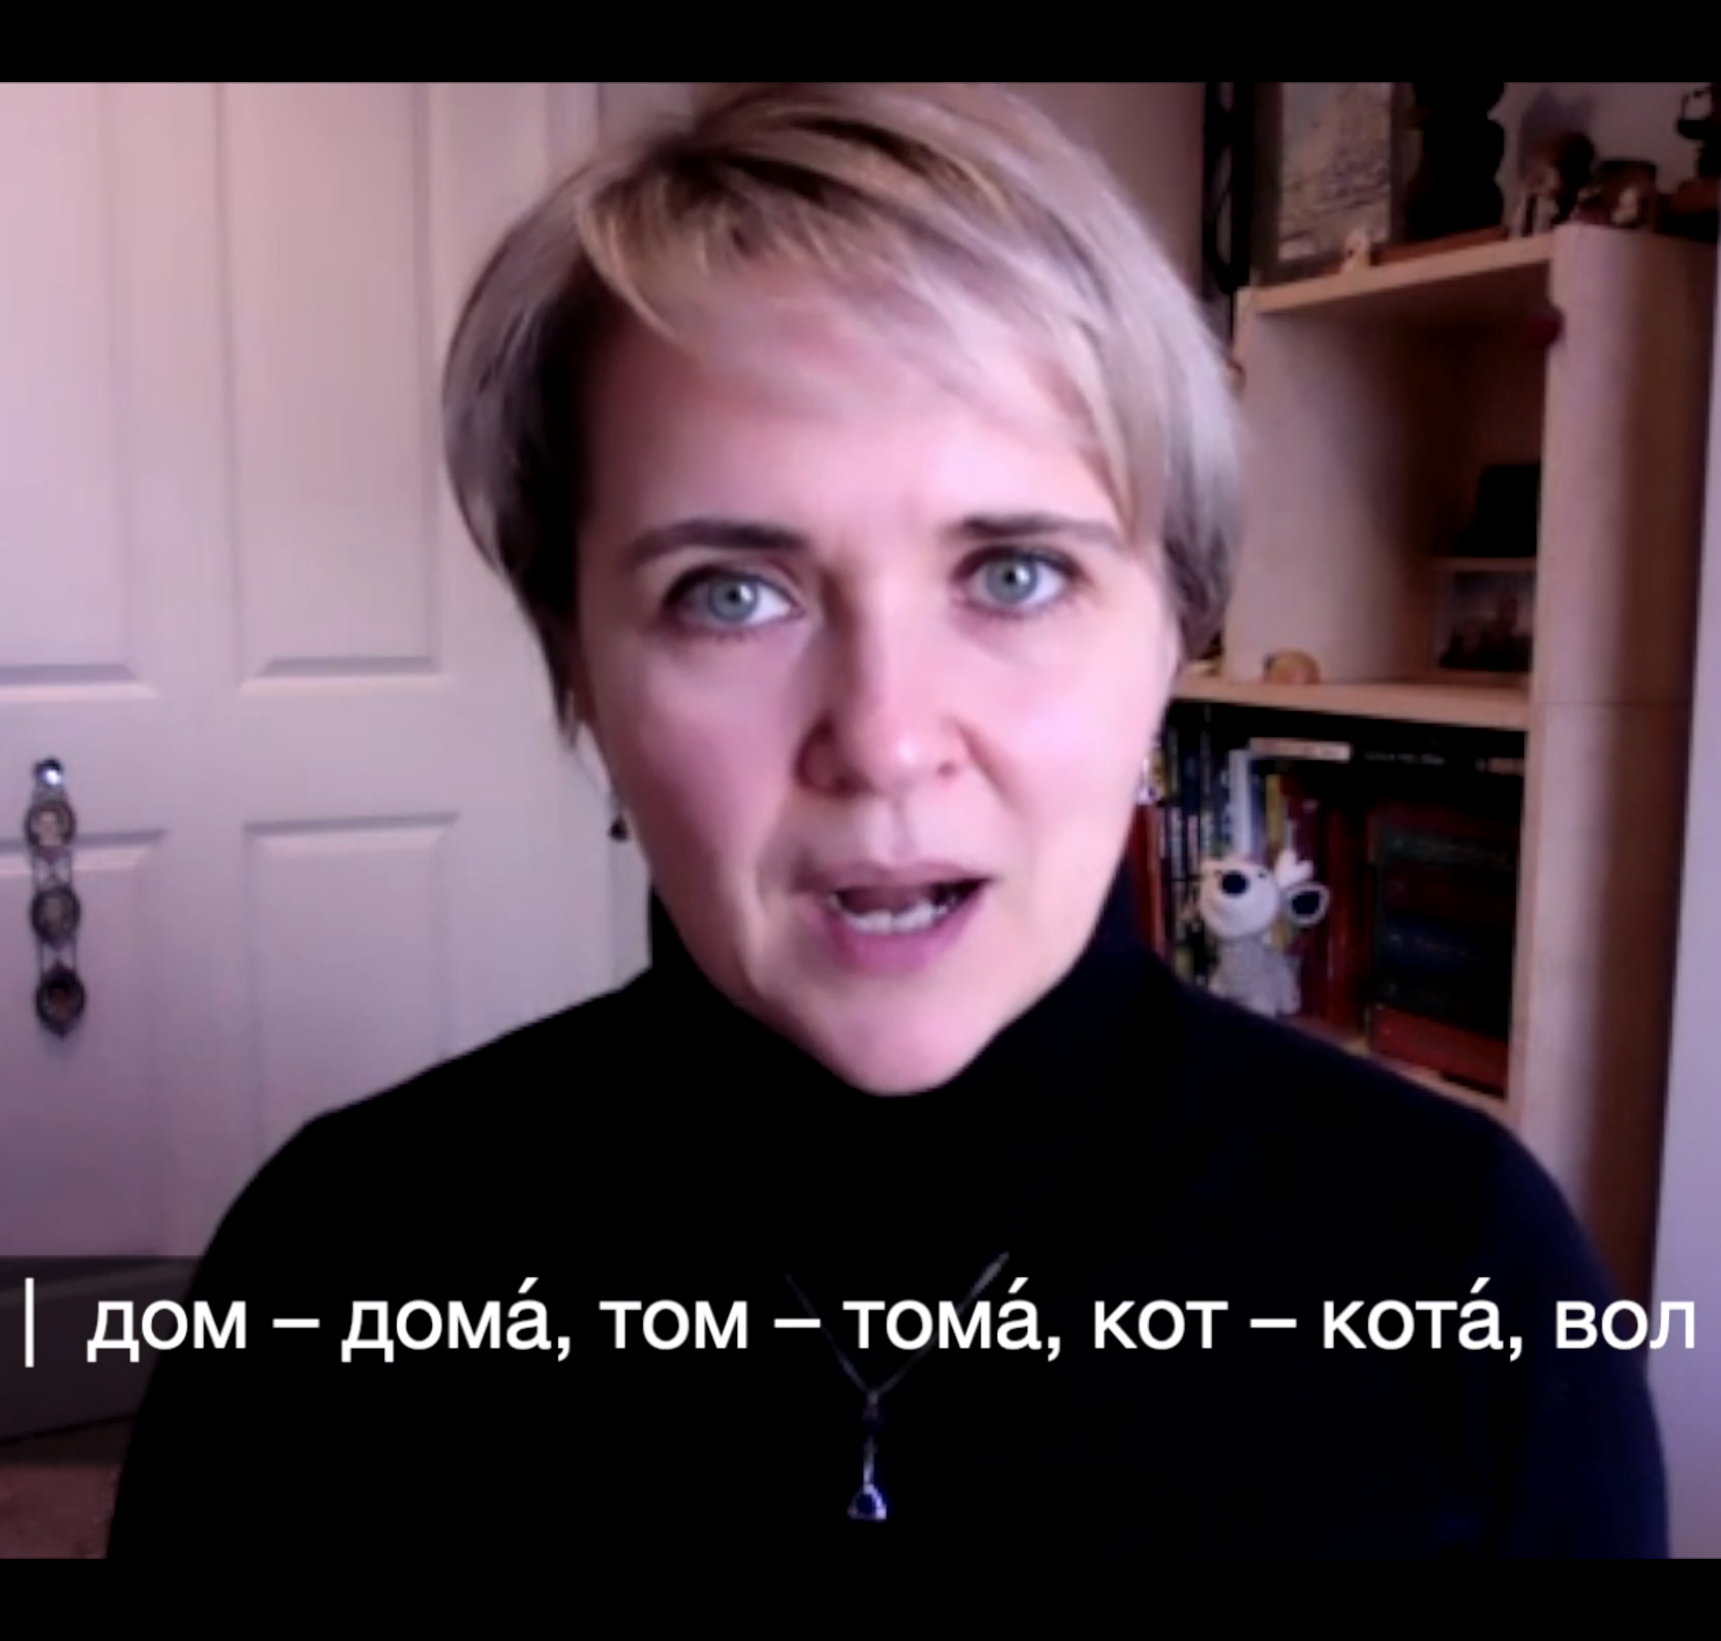
тома́

Slide 72


Get your phones!

Slide 73
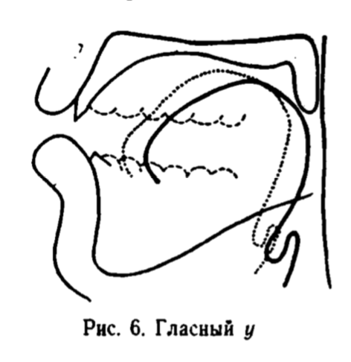
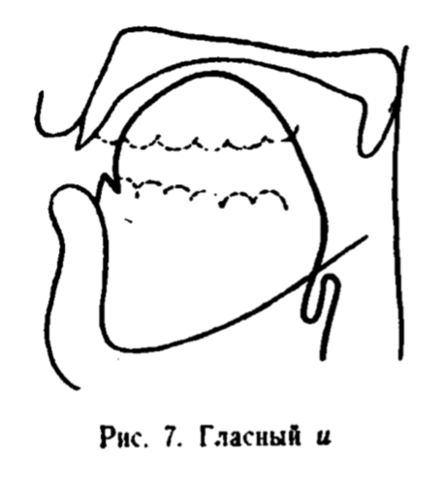
Let’s reset our DMP.
а о у
та то ту
там том ту́мба
да́ма до́ма ду́ма
ю е и
и и́ми и
и идти́ тип
и иди́ Ди́ма
Warm Up 1
No aspiration, tongue is back & low
Warm Up 2
Lots of aspiration, tongue is high & forward

Slide 74
Default Mouth Position
дай, давно́
там, так
ему́, э́ту
вот, год
эл, ал

Slide 75
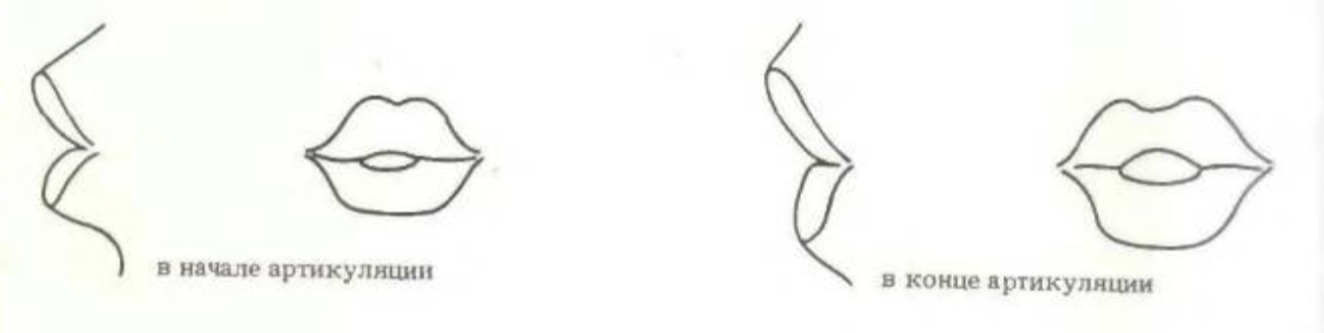
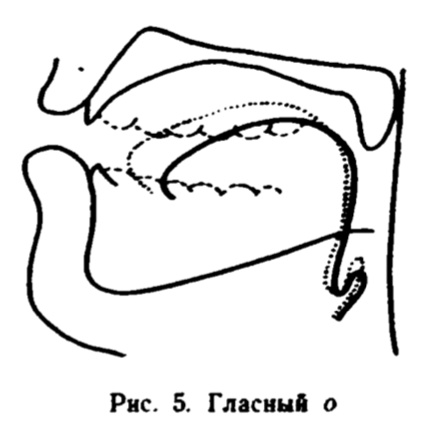
Default Mouth Position: о
вот
год
до́лго
зо́лото
молоко́
ло́дка
мо́ре
но
пол
beginning of articulation
end of articulation
Notes:
Любимова, Н. А. (Нина Александровна). Таблицы по русской фонетике: Методическое руководство к комплекту учебных наглядных материалов (Methodological guide to a set of educational visual materials), 1990. Professor & Doctor of Philology at СПБГУ, http://rki.spbu.ru/lyubimova-nina-aleksandrovna.htm

Slide 76
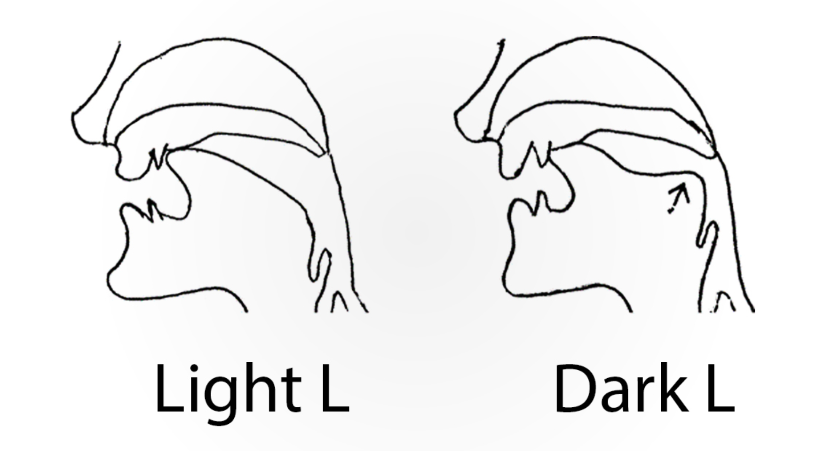
Default Mouth Position: л
эл
ал
ол
вол
мол
мул
пол
па́лка
вя́лый
English Letter L
late
like
lamp
look
call
school
tell
people

Slide 77
2 вопроса!

Slide 78
Definitely check this out! ☺
www.learnrussianwithkira.com

Slide 79
My Goals for You
Default Mouth Position
Unstressed Syllables
Individual Phonemes
Practice Routine
Secret Code
Phonetics Topics

Slide 80
My Goals for You
Default Mouth Position
Unstressed Syllables
Individual Phonemes
Practice Routine
Secret Code
Phonetics Topics

Slide 81
My Goals for You
Default Mouth Position
Unstressed Syllables
Individual Phonemes
Practice Routine
Secret Code
Phonetics Topics

Slide 82
Unstressed Syllables

Slide 83


Unstressed Syllables
melody
prosody

Slide 84
Unstressed Syllables

Slide 85
Get out your phones!

Slide 86
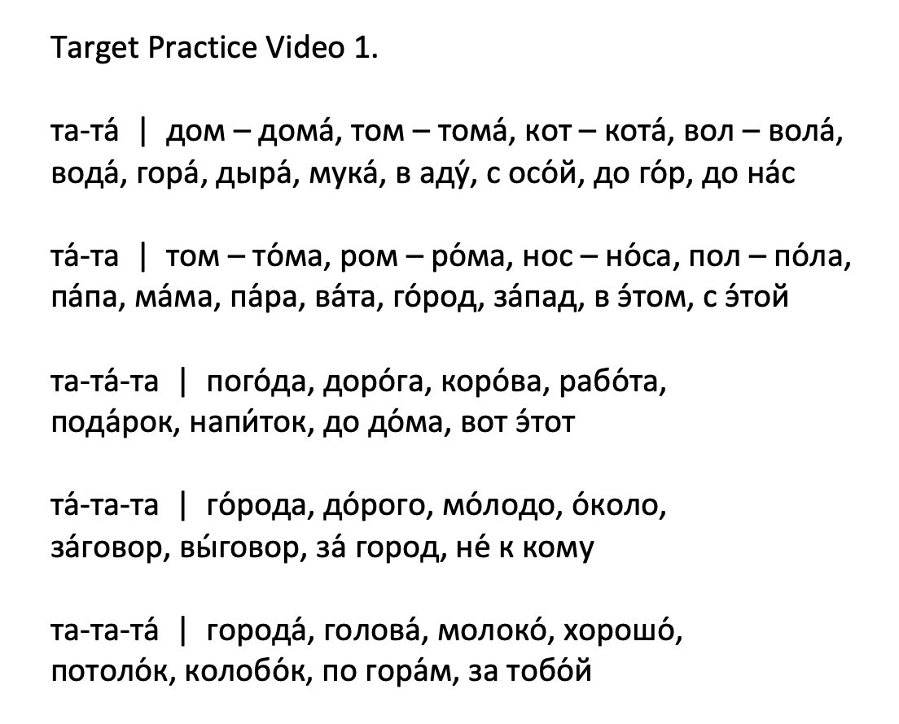
Unstressed Syllables

Slide 87
Unstressed Syllables

Slide 88
2 вопроса!

Slide 89
NEW!
Pop-Up Phonetics with Kira
Group class, $5
Dates & Times TBA

Slide 90
My Goals for You
Default Mouth Position
Unstressed Syllables
Individual Phonemes
Practice Routine
Secret Code
Phonetics Topics

Slide 91
My Goals for You
Default Mouth Position
Unstressed Syllables
Individual Phonemes
Practice Routine
Secret Code
Phonetics Topics

Slide 92
My Goals for You
Default Mouth Position
Unstressed Syllables
Individual Phonemes
Practice Routine
Secret Code
Phonetics Topics

Slide 93
The Secret Code

Slide 94
What is the Secret Code for?
It spells words phonetically, revealing all hidden phonetic phenomena.
Notes:
There may be times when you are confused.

Slide 95
Our main task:
Learn to use the шпаргалка.
Notes:
There may be times when you are confused.

Slide 96
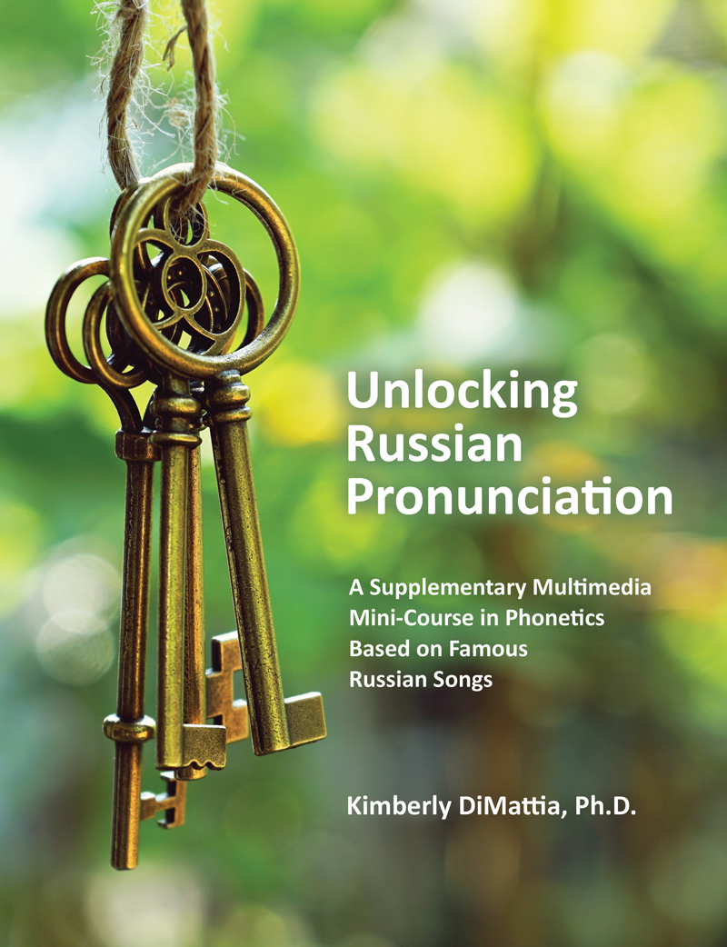
Шпарга́лка!
Notes:
You DO NOT have to remember or even understand everything we do today. I will give you a “cheat sheet” that will be easy to use, and you can always review the videos of me teaching the same lesson on the website that accompanies the book.

Slide 97
Life Hack
Print out your шпаргалка.
Notes:
There may be times when you are confused.

Slide 98
Print out your шпарга́лка!
Notes:
You DO NOT have to remember or even understand everything we do today. I will give you a “cheat sheet” that will be easy to use, and you can always review the videos of me teaching the same lesson on the website that accompanies the book.

Slide 99
N. B. (Nota bene!)
The transcriptions of words in this lesson
are based only on the topics we’ve covered!

Slide 100
My Goals for You
Default Mouth Position
Unstressed Syllables
Individual Phonemes
Practice Routine
Secret Code
Phonetics Topics

Slide 101
Шпарга́лка!
Secret Code
Notes:
You DO NOT have to remember or even understand everything we do today. I will give you a “cheat sheet” that will be easy to use, and you can always review the videos of me teaching the same lesson on the website that accompanies the book.

Slide 102
Шпарга́лка!
Vowels & Consonants
Notes:
You DO NOT have to remember or even understand everything we do today. I will give you a “cheat sheet” that will be easy to use, and you can always review the videos of me teaching the same lesson on the website that accompanies the book.

Slide 103
Vowels & Consonants

Slide 104
English vowels?
a, e, i, o, u...and sometimes y
bat
bet
bit
bot
but
yet
byte

Slide 105
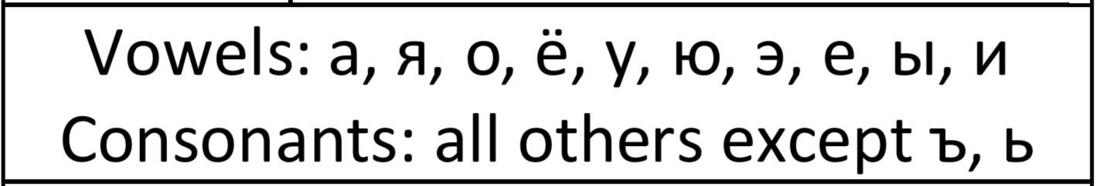
Russian Vowels

Slide 106
Quiz!
How many Russian vowels are there?
Name them!
All the other letters are consonants except...?

Slide 107
Vowels & Consonants
Vowels
Consonants all others
except ъ, ь
а | о | у | э | ы
я | ё | ю | е | и

Slide 108
Vowels & Consonants
Vowels
Soft Vowels
Consonants all others
except ъ, ь
а | о | у | э | ы
я | ё | ю | е | и

Slide 109
Which vowels are soft?

Slide 110
A Special Thing

Slide 111
A Special Thing
’-
“apostrophe hyphen”

Slide 112


Slide 113
2 вопроса!

Slide 114
Quizlet 1
Choose “Flashcards”
Options: Answer with Definition

Slide 115
2 вопроса!

Slide 116
Lots of letters are simple!

Slide 117
а б в г д е ё ж з и й к л м н о п р с т у ф х ц ч ш щ ъ ы ь э ю я
Russian Alphabet

Slide 118
а б в г д е ё ж з и й к л м н о п р с т у ф х ц ч ш щ ъ ы ь э ю я
These are all simple!

Slide 119
а б в г д е ё ж з и й к л м н о п р с т у ф х ц ч ш щ ъ ы ь э ю я
These are also simple...

Slide 120
а б в г д е ё ж з и й к л м н о п р с т у ф х ц ч ш щ ъ ы ь э ю я
Soft Vowels

Slide 121
е ё ю я и
Soft Vowels

Slide 122
е ё ю я и
Soft Vowels
ye?

Slide 123
е ё ю я и
Soft Vowels
je
jo
ju
ja
i
(Most of the time!)

Slide 124
е ё ю я и
Soft Vowels
je
jo
ju
ja
i
After consonants:
’e
’o
’u
’a
’i

Slide 125
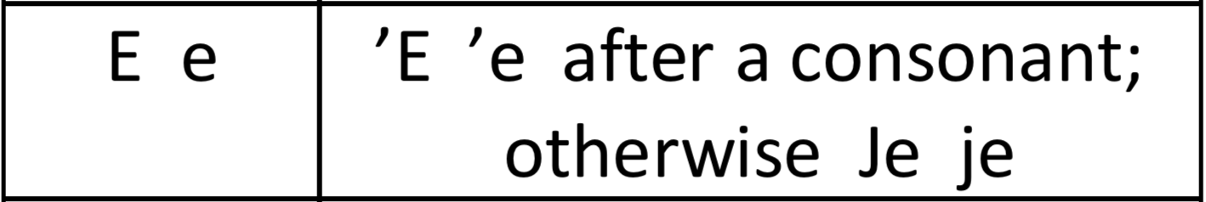
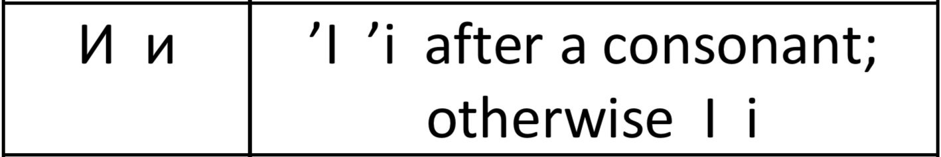
Шпаргалка!

Slide 126
A Leetle Practice

Slide 127
A Leetle Practice

Slide 128
A Leetle Practice

Slide 129
A Leetle Practice
не →

Slide 130
A Leetle Practice
не →
n’e

Slide 131
A Leetle Practice
не →
n’e
ено́т →

Slide 132
A Leetle Practice
не →
n’e
ено́т →
jenót

Slide 133

A Leetle Practice
не →
n’e
ено́т →
jenót

Slide 134
A Leetle Practice
не →
n’e
ено́т →
jenót
Ура́!

Slide 135
Quizlet 2
Choose “Flashcards”
Options: Answer with Definition

Slide 136
2 вопроса!

Slide 137
а б в г д е ё ж з и й к л м н о п р с т у ф х ц ч ш щ ъ ы ь э ю я
So far...

Slide 138
а б в г д е ё ж з и й к л м н о п р с т у ф х ц ч ш щ ъ ы ь э ю я
What’s left?

Slide 139
а б в г д е ё ж з и й к л м н о п р с т у ф х ц ч ш щ ъ ы ь э ю я
Special Letters — ы and й

Slide 140
а б в г д е ё ж з и й к л м н о п р с т у ф х ц ч ш щ ъ ы ь э ю я
Special Letters — ж, ш, ц, ч, щ

Slide 141
а б в г д е ё ж з и й к л м н о п р с т у ф х ц ч ш щ ъ ы ь э ю я
Special Letters — ъ and ь

Slide 142
а б в г д е ё ж з и й к л м н о п р с т у ф х ц ч ш щ ъ ы ь э ю я
Special Letters — ы and й

Slide 143
Russian Letter
Ы ы
Transcription

Slide 144
Russian Letter
Ы ы
Transcription
Y y

Slide 145
ты →

Slide 146
ты →
ty

Slide 147
ты →
ty
ено́т →

Slide 148
ты →
ty
ено́т →
jenót

Slide 149
ты →
ty
ено́т →
jenót
Да!

Slide 150
Russian Letter
Й й
Transcription

Slide 151
Russian Letter
Й й
Transcription
J j

Slide 152
Practice with: Й й
J j

Slide 153
Practice with: Й й
J j
дай →

Slide 154
Practice with: Й й
J j
дай →
daj

Slide 155
Practice with: Й й
J j
дай →
daj
йод →

Slide 156
Practice with: Й й
J j
дай →
daj
йод →
jоd

Slide 157
э́то →

Slide 158
э́то →
éto

Slide 159
э́то →
éto
не →

Slide 160
э́то →
éto
не →
n’e

Slide 161
э́то →
éto
не →
n’e
ено́т →

Slide 162
э́то →
éto
не →
n’e
ено́т →
jenót

Slide 163
э́то →
éto
не →
n’e
ено́т →
jenót
Почему́??
Я ено́т!

Slide 164
2 вопроса!

Slide 165
а б в г д е ё ж з и й к л м н о п р с т у ф х ц ч ш щ ъ ы ь э ю я
Special Letters — ж, ш, ц, ч, щ

Slide 166
Russian Letter
Ж ж
Transcription

Slide 167
Russian Letter
Ж ж
Transcription
zh?

Slide 168
Russian Letter
Ж ж
Transcription
Ž ž

Slide 169
háček
Russian Letter
Ж ж
Transcription
Ž ž

Slide 170

háček
Russian Letter
Ж ж
Transcription
Ž ž

Slide 171
Practice with: Ё ё and Ж ж
’O ’o (after a consonant)
Jo jo (elsewhere)

Slide 172
Practice with: Ё ё and Ж ж
’O ’o (after a consonant)
Jo jo (elsewhere)
ёж →

Slide 173
Practice with: Ё ё and Ж ж
’O ’o (after a consonant)
Jo jo (elsewhere)
ёж →
jož

Slide 174
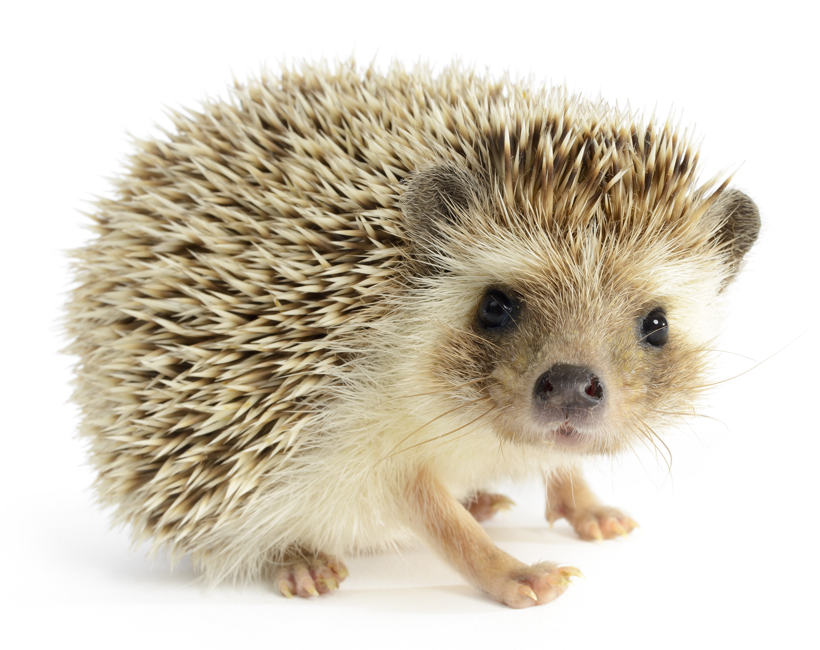
Practice with: Ё ё and Ж ж
’O ’o (after a consonant)
Jo jo (elsewhere)
ёж →
jož
Молоде́ц!

Slide 175
Russian Letter
Ш ш
Transcription

Slide 176
Russian Letter
Ш ш
Transcription
sh?

Slide 177
Russian Letter
Ш ш
Transcription
Š š

Slide 178
Russian Letter
Ц ц
Transcription

Slide 179
Russian Letter
Ц ц
Transcription
C c

Slide 180
Russian Letter
Ц ц
Transcription
C c

Slide 181
Practice with: Ц ц
C c

Slide 182
Practice with: Ц ц
C c
цáрство →

Slide 183
Practice with: Ц ц
C c
цáрство →
cárstvo

Slide 184
Practice with: Ц ц
C c
цáрство →
cárstvo
коне́ц →

Slide 185
Practice with: Ц ц
C c
цáрство →
cárstvo
коне́ц →
kon’éc

Slide 186
Russian Letter
Ч ч
Transcription

Slide 187
Russian Letter
Ч ч
Transcription
ch?

Slide 188
Russian Letter
Ч ч
Transcription
Č’ č’

Slide 189
Russian Letter
Ч ч
Transcription
Č’ č’

Slide 190
Russian Letter
Ч ч
Transcription
Č’ č’

Slide 191
Practice with: Ч ч
Č’ č’

Slide 192
Practice with: Ч ч
Č’ č’
чай →

Slide 193
Practice with: Ч ч
Č’ č’
чай →
č’aj

Slide 194
Practice with: Ч ч
Č’ č’
чай →
č’aj
but

Slide 195
Practice with: Ч ч
Č’ č’
чай →
č’aj
but
чей →

Slide 196
Practice with: Ч ч
Č’ č’
чай →
č’aj
but
чей →
č’ej

Slide 197
Practice with: Ч ч
Č’ č’
чай →
č’aj
but
чей →
č’ej

Slide 198
Practice with: Ч ч
Č’ č’
чай →
č’aj
but
чей →
č’ej

Slide 199
Russian Letter
Щ щ
Transcription

Slide 200
Russian Letter
Щ щ
Transcription
Š’ š’

Slide 201
Russian Letter
Щ щ
Transcription
Š’ š’

Slide 202
Russian Letter
Щ щ
Transcription
Š’ š’

Slide 203
Practice with: Щ щ
Š’ š’

Slide 204
Practice with: Щ щ
Š’ š’
борща́ →

Slide 205
Practice with: Щ щ
Š’ š’
борща́ →
borš’á

Slide 206
Practice with: Щ щ
Š’ š’
борща́ →
borš’á
but

Slide 207
Practice with: Щ щ
Š’ š’
борща́ →
borš’á
but
ещё →

Slide 208
Practice with: Щ щ
Š’ š’
борща́ →
borš’á
but
ещё →
ješ’ó

Slide 209
Practice with: Щ щ
Š’ š’
борща́ →
borš’á
but
ещё →
ješ’ó

Slide 210
Practice with: Щ щ
Š’ š’
борща́ →
borš’á
but
ещё →
ješ’ó

Slide 211
2 вопроса!

Slide 212
а б в г д е ё ж з и й к л м н о п р с т у ф х ц ч ш щ ъ ы ь э ю я
Special Letters — ъ and ь

Slide 213
Russian Letter
Ъ ъ
Transcription

Slide 214
Russian Letter
Ъ ъ
Transcription
–

Slide 215
Practice with: Ъ ъ
–

Slide 216
Practice with: Ъ ъ
–
объе́кт
↓

Slide 217
Practice with: Ъ ъ
–
объе́кт
↓

Slide 218
Practice with: Ъ ъ
–
объе́кт
↓
ob-jékt

Slide 219
Russian Letter
Ь ь
Transcription

Slide 220
Russian Letter
Ь ь
Transcription
’– (before a soft vowel)

Slide 221
Russian Letter
Ь ь
Transcription
’– (before a soft vowel)
’ (elsewhere)

Slide 222
Russian Letter
Ь ь
Transcription
’– (before a soft vowel)
’ (elsewhere)

Slide 223
Russian Letter
Ь ь
Transcription
’– (before a soft vowel)
’ (elsewhere)

Slide 224
е ё ю я и
BOLO
Soft Vowels

Slide 225
Practice with: Ь ь
’- (before a soft vowel)
’ (elsewhere)

Slide 226
Practice with: Ь ь
’- (before a soft vowel)
’ (elsewhere)
бельё →

Slide 227
Practice with: Ь ь
’- (before a soft vowel)
’ (elsewhere)
бельё →

Slide 228
Practice with: Ь ь
’- (before a soft vowel)
’ (elsewhere)
бельё →
b’el

Slide 229
Practice with: Ь ь
’- (before a soft vowel)
’ (elsewhere)
бельё →
b’el

Slide 230
Practice with: Ь ь
’- (before a soft vowel)
’ (elsewhere)
бельё →
b’el’-

Slide 231
Practice with: Ь ь
’- (before a soft vowel)
’ (elsewhere)
бельё →
b’el’-jó

Slide 232
Practice with: Ь ь
’- (before a soft vowel)
’ (elsewhere)
бельё →
b’el’-jó
чита́ть →

Slide 233
Practice with: Ь ь
’- (before a soft vowel)
’ (elsewhere)
бельё →
b’el’-jó
чита́ть →
č’itát’

Slide 234
Practice with: Ь ь
’- (before a soft vowel)
’ (elsewhere)
бельё →
b’el’-jó
чита́ть →
č’itát’

Slide 235
Practice with: Ь ь
’- (before a soft vowel)
’ (elsewhere)
бельё →
b’el’-jó
чита́ть →
č’itát’

Slide 236
2 вопроса!

Slide 237
What should I do before the next class & when?

Slide 238
What should I do before the next class & when?

Slide 239
What should I do before the next class & when?

Slide 240
Daily Homework

Slide 241
Optional Check-Ins
Mondays 4 p.m. ET
Register now, come to any and all
https://us02web.zoom.us/meeting/register/tZAodeypqTkjH9eiVeKmTpXIy9xDUUTecxP_

Slide 242

Next time...!

Slide 243
Конец!
(Kon’éc!)

Slide 244
2 вопроса!

Slide 245
Credits:
© mindy77/Shutterstock.com
© Robert Eastman/Shutterstock.com
j, ž, č, š
Courtesy of the Czech alphabet

Slide 246
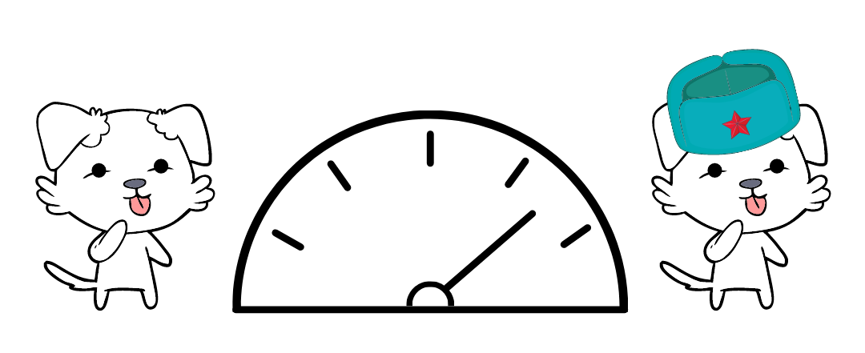
Canva.com

Slide 247
How can I support Kira?
?
Notes:
Sometimes people ask me...

Slide 248



1) Check out Kira’s other stuff
How can I support Kira?
2) Become an ambassador
If you love Kira’s stuff, you could tell:
fellow Russian students
teachers
Reddit!
learnrussianwithkira.com
patreon.com/learnrussianwithkira
learnrussianwithkira.com
3) Become a Patron
4) Buy Kira a coffee : )
At the $5 a month level:
exclusive podcast focused on sounds
library of podcast episodes
optional texts & emails
patreon.com/learnrussianwithkira
buymeacoffee.com/kiradi
Notes:
Sometimes people ask me...

Slide 249
Chat & Sing!
(Kira – stop sharing your screen and remember to use the букс!)

Slide 250
Are you a teacher?
Would you like to use this PPT?
Please do! Take it, tweak it, share it – just please include “based on Unlocking Russian Pronunciation by Kimberly (Kira) DiMattia” in it.
In return, I would love it if you would share these two links with your students:
www.learnrussianwithkira.com
www.patreon.com/learnrussianwithkira
Спасибо!
Kimberly DiMattia, kiradimattia@gmail.com
Notes:
Use real-life hands! Participants can’t see the digital ones.

