Slide 1
Are you a teacher?
Would you like to use this PPT?
Please do! Take it, tweak it, share it – just please include “based on Unlocking Russian Pronunciation by Kimberly (Kira) DiMattia” in it.
In return, I would love it if you would share these two links with your students:
www.learnrussianwithkira.com
www.patreon.com/learnrussianwithkira
Спасибо!
Kimberly DiMattia, kiradimattia@gmail.com
Notes:
Use real-life hands! Participants can’t see the digital ones.

Slide 2
Welcome!
Gather items now
  Unlocking Russian Pronunciation (Kira’s book if you have it already)
  smart phone for recording yourself
  paper, pen/pencil
  water
Rename yourself on Zoom
  Click on Participants, hover over your name, choose Rename, and use your Russian name in Cyrillic (e.g. Кира)

Slide 3
Let’s say hello : )
Notes:
Use real-life hands! Participants can’t see the digital ones.

Slide 4
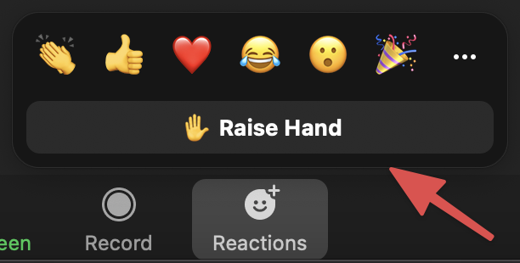
If you have a question, raise your electronic hand!
Notes:
Use real-life hands! Participants can’t see the digital ones.

Slide 5
Master Class with Kira
Kimberly (Kira) DiMattia
Week 2 – Hard & Soft Sounds

Slide 6

What am I looking for?
Right answers?
Epiphanies!
Perfection?
Vulnerability!
Amplify your visuals. : )

Slide 7
What is our goal?

Slide 8


Slide 9


Slide 10
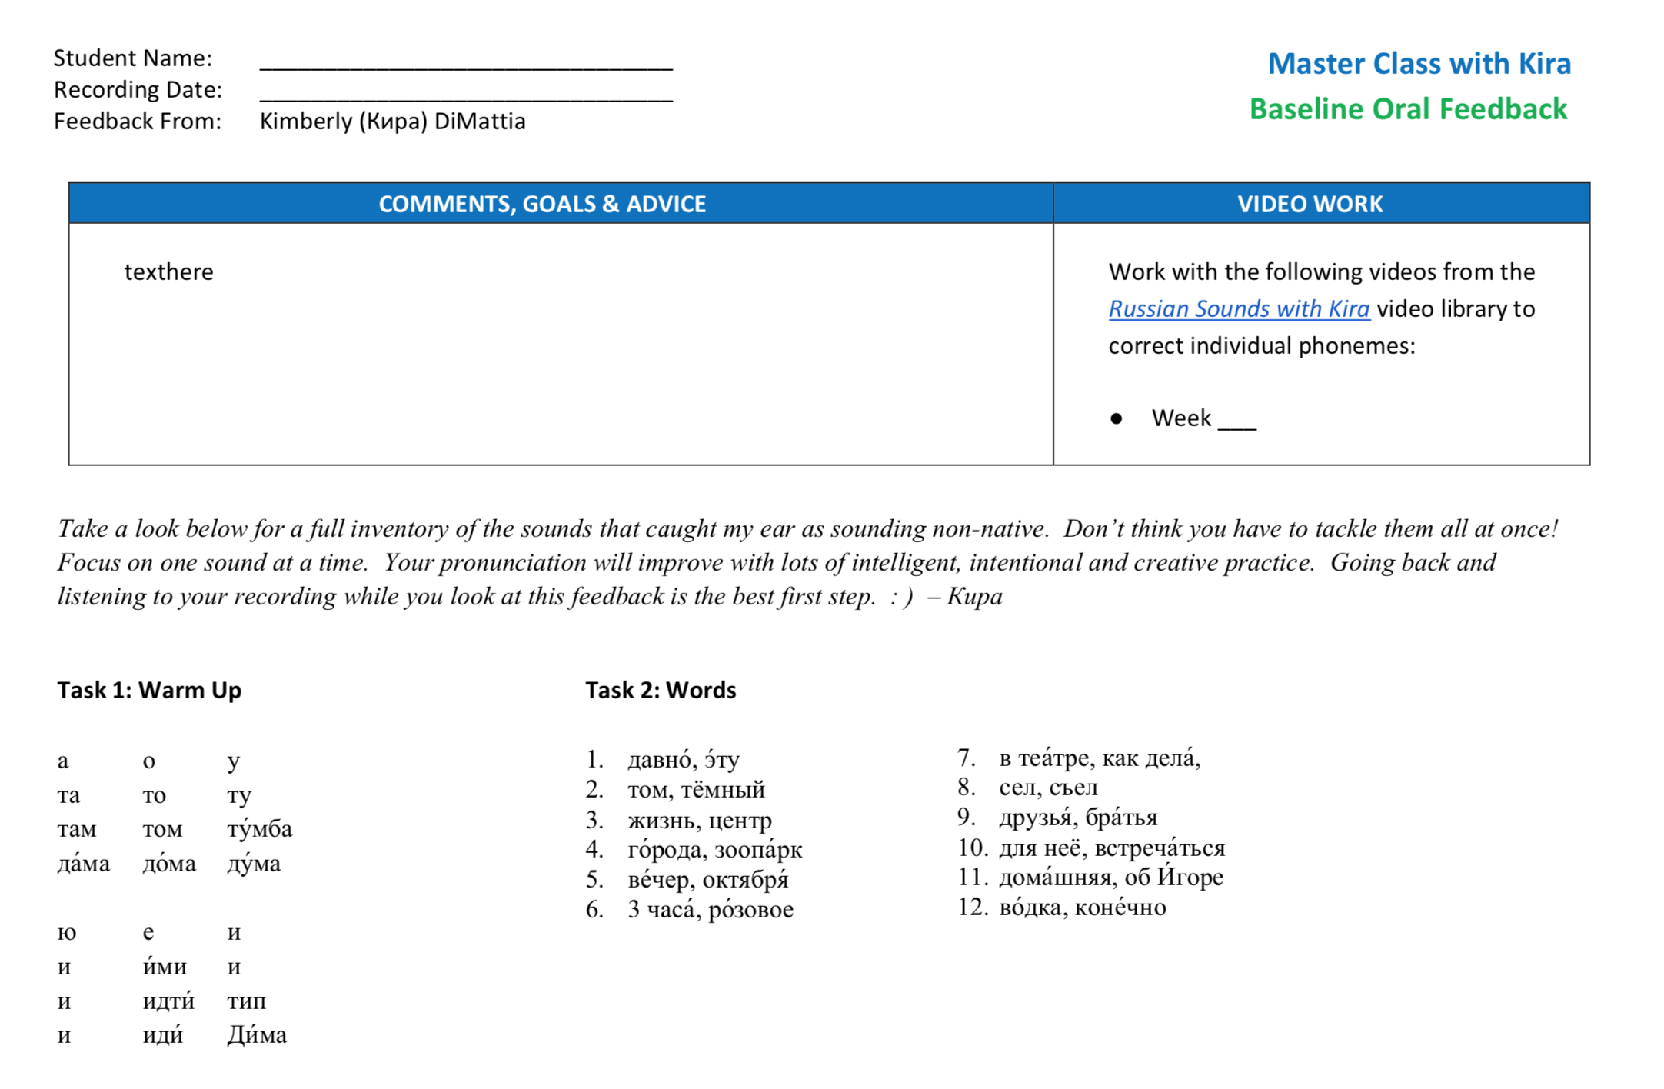
Baseline Oral Feedback
Notes:
You receive feedback

Slide 11
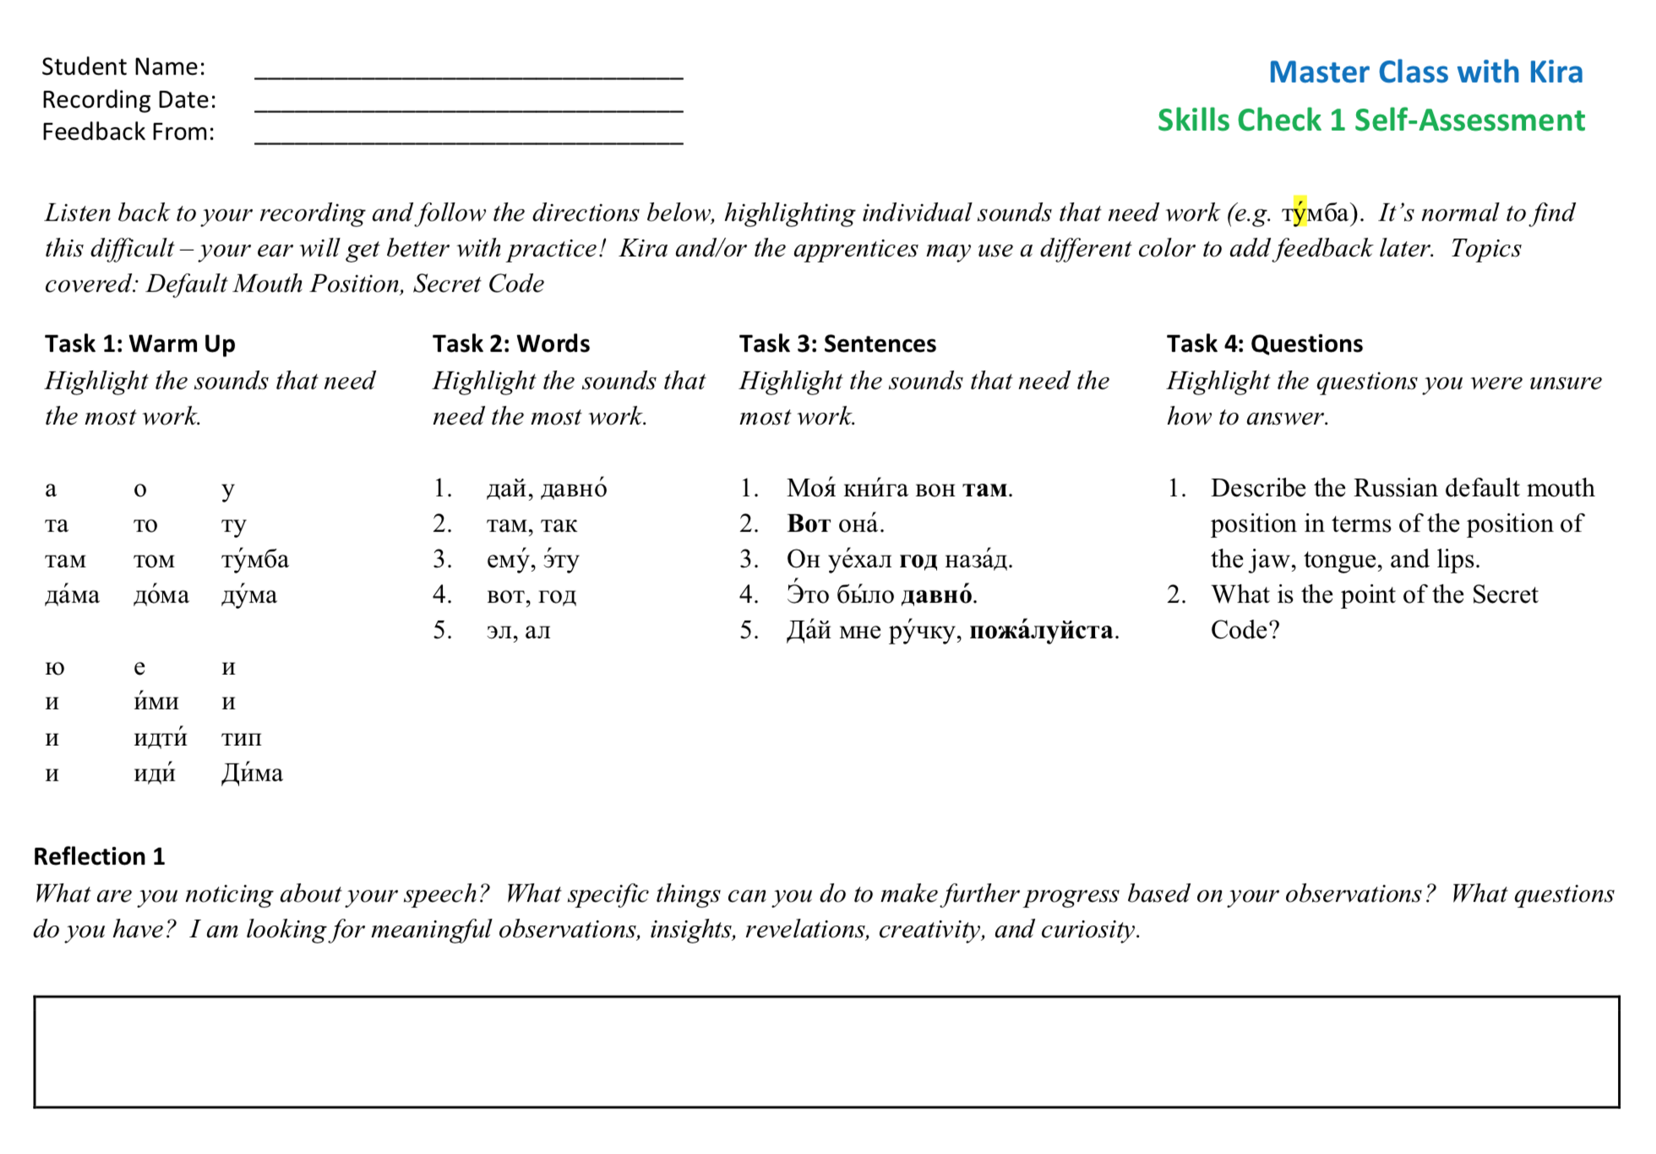
Skills Check Self-Assessment
Notes:
You receive feedback

Slide 12
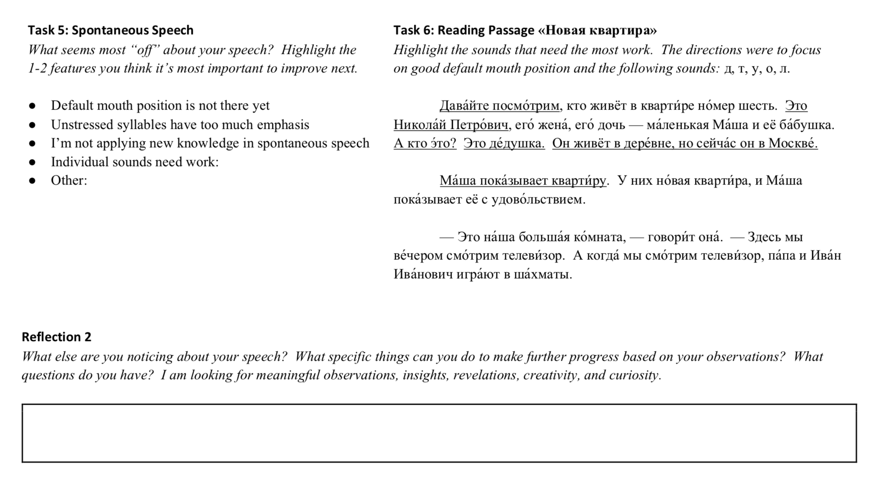
Skills Check Self-Assessment
Notes:
You receive feedback

Slide 13
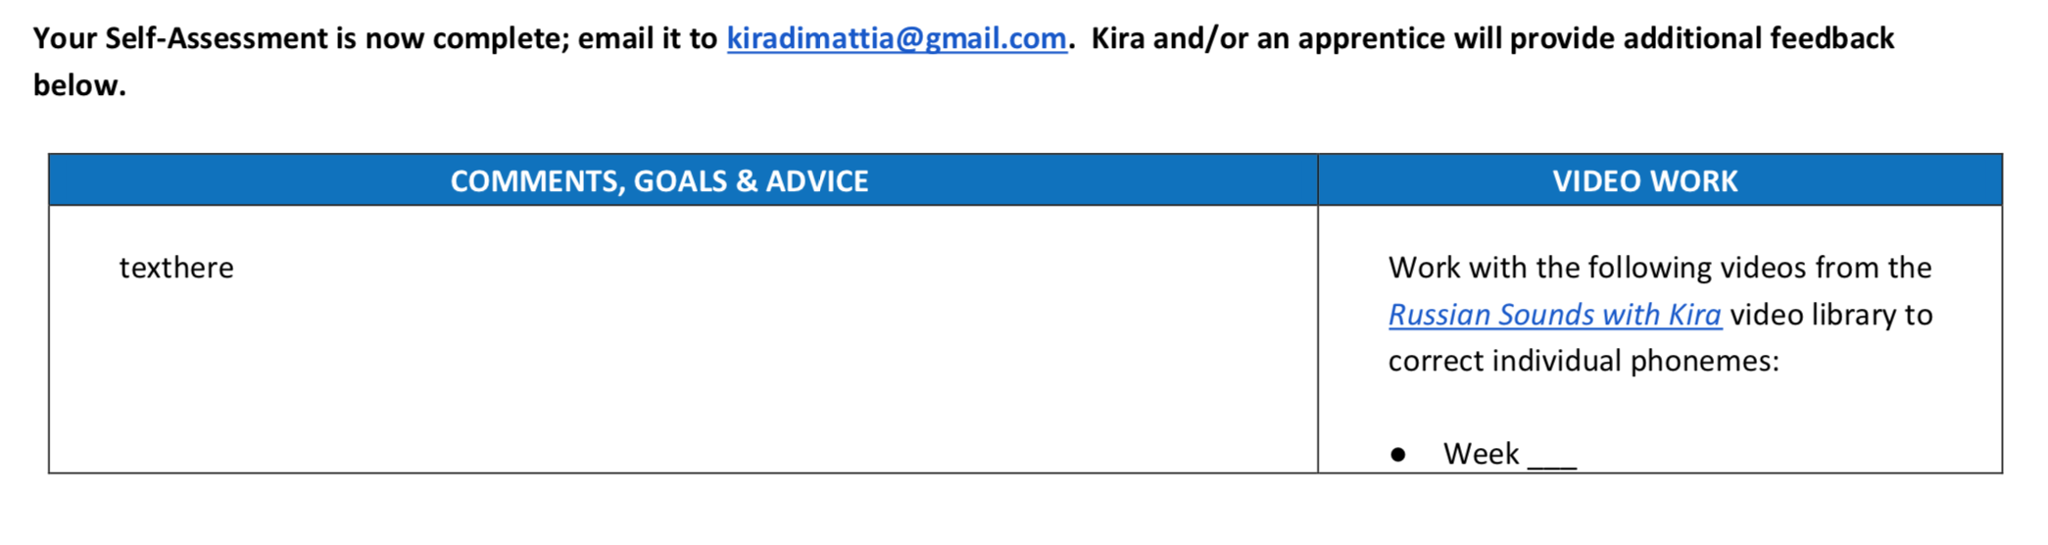
Skills Check Feedback
Notes:
You receive feedback

Slide 14
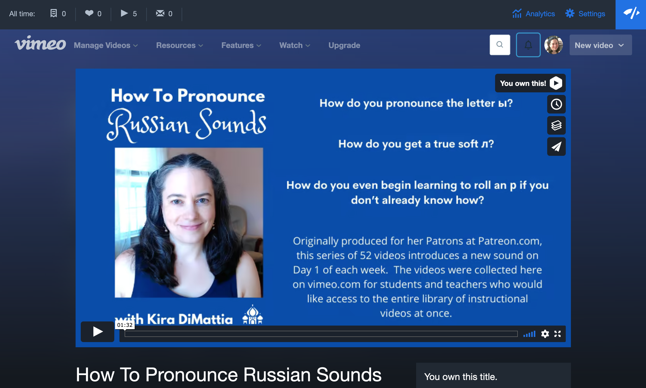
Russian Sounds with Kira
Notes:
You receive feedback

Slide 15
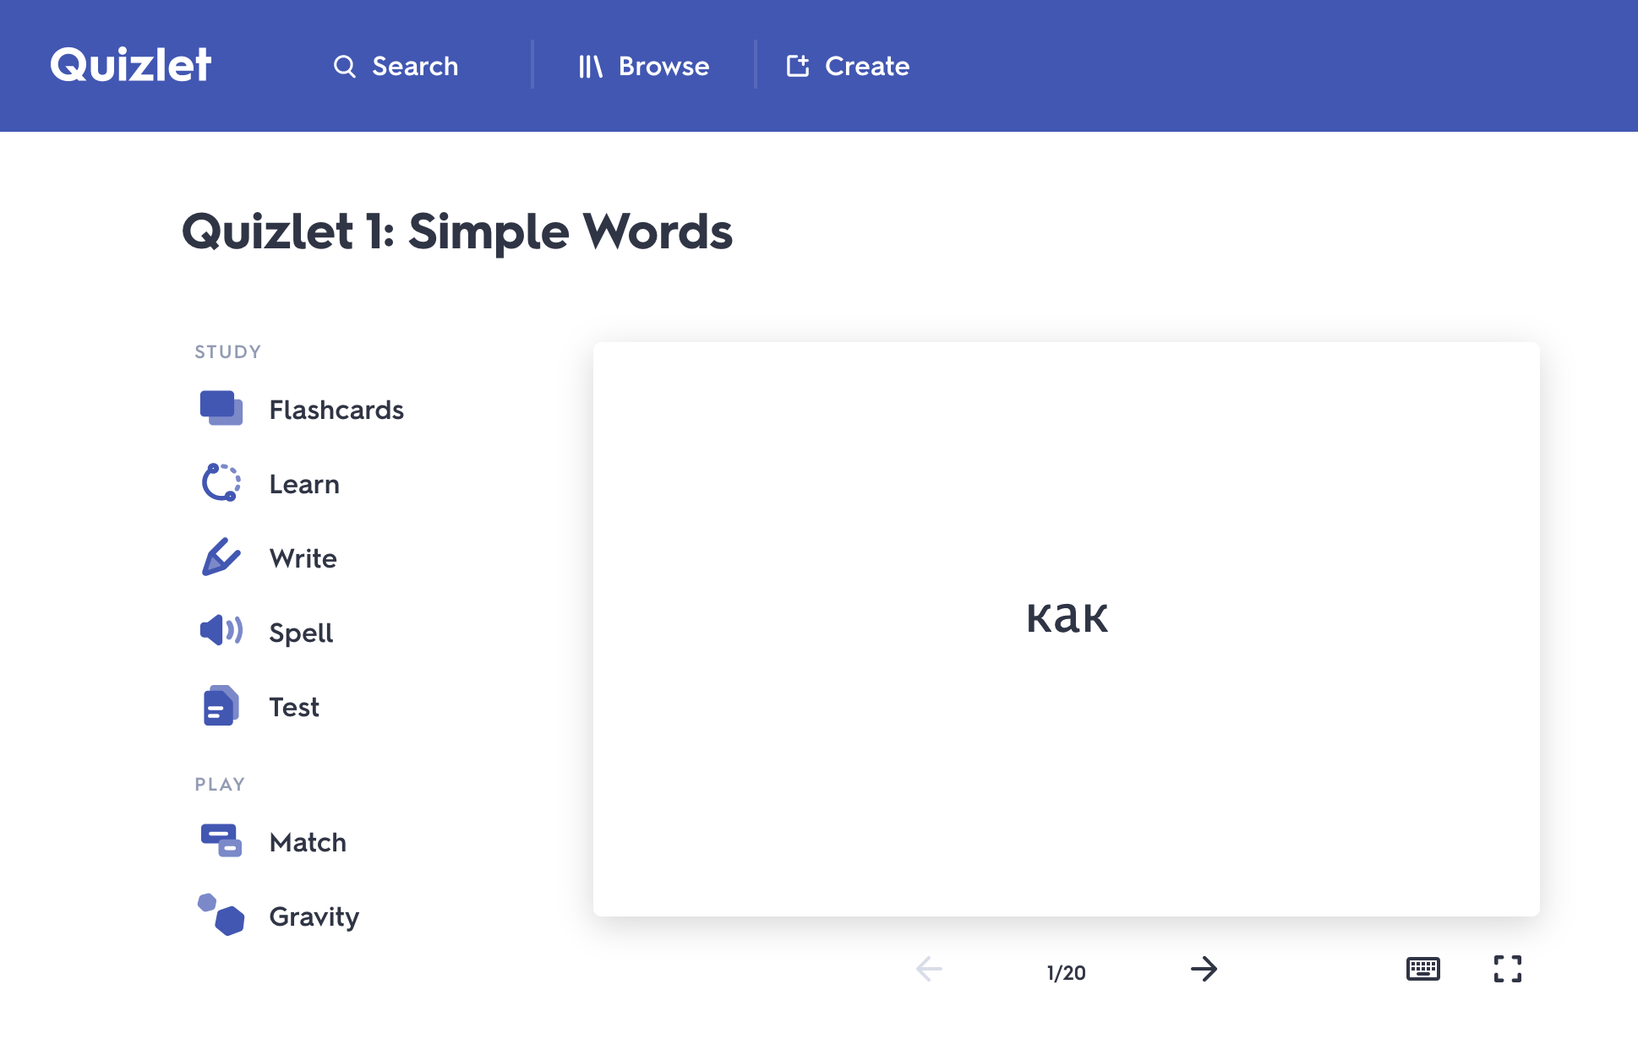
Quizlet Life Hacks

Slide 16
Quizlet Life Hacks
Use pencil and paper, actually write!
Compare your answer to the one on the card
Work for mastery

Slide 17
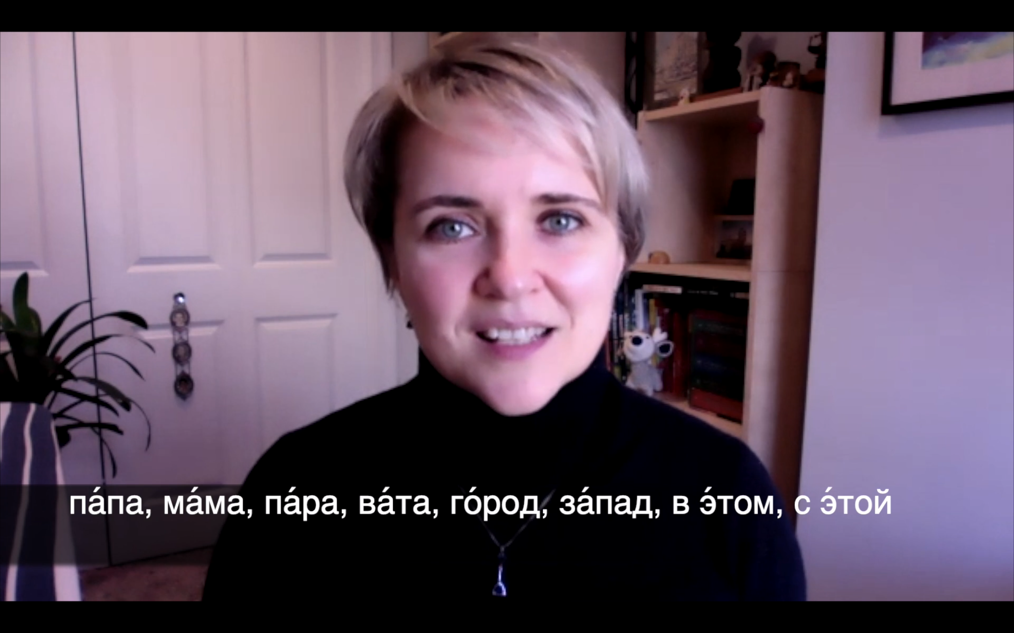
Daily Practice Life Hacks

Slide 18
Daily Practice Life Hacks

Slide 19
Daily Practice Life Hacks
Consistency is key

Slide 20
Daily Practice Life Hacks
Consistency is key
Listen intently to the native speaker

Slide 21
Daily Practice Life Hacks
Consistency is key
Listen intently to the native speaker
Try to imitate exactly what you hear

Slide 22
Daily Practice Life Hacks
Consistency is key
Listen intently to the native speaker
Try to imitate exactly what you hear
Pause and predict

Slide 23
Daily Practice Life Hacks
Consistency is key
Listen intently to the native speaker
Try to imitate exactly what you hear
Pause and predict
Listen back

Slide 24
Daily Practice Life Hacks
Consistency is key
Listen intently to the native speaker
Try to imitate exactly what you hear
Pause and predict
Listen back
Keep a tab open & work 5 min on a tiny section

Slide 25


How did you do?
Notes:
AND SOMETIMES AN EXTRA ASSIGNMENT that is not more than 15 min

Slide 26
Obstacles?

Slide 27
Let’s visually rehearse your choice points!

Slide 28
My Goals for You
Default Mouth Position
Unstressed Syllables
Individual Phonemes
Practice Routine
Secret Code
Phonetics Topics

Slide 29
My Goals for You
Default Mouth Position
Unstressed Syllables
Individual Phonemes
Practice Routine
Secret Code
Phonetics Topics

Slide 30
My Goals for You
Default Mouth Position
Unstressed Syllables
Individual Phonemes
Practice Routine
Secret Code
Phonetics Topics

Slide 31
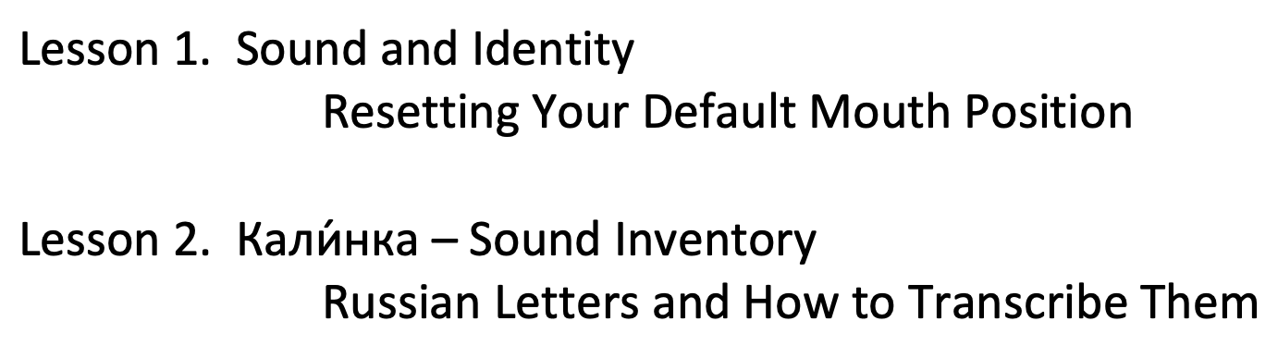
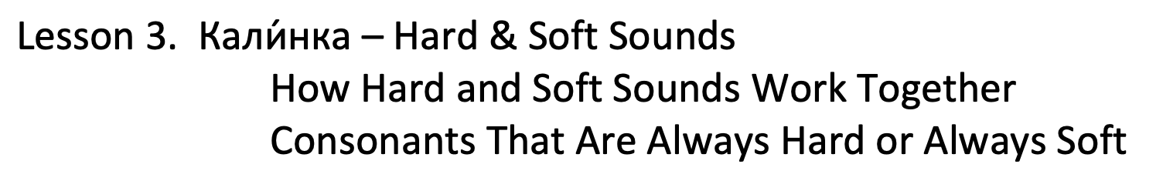
Where are we?

Slide 32
Where are we?
☑︎

Slide 33
Where are we?
☑︎
☐

Slide 34
Today...
Leetle Convo
Leetle Game
Leetle Warm Up
Hard & Soft Sounds
8:30 p.m. EST

Slide 35
Leetle Convo

Slide 36
Mistakes.

Slide 37


Slide 38
Shame

Slide 40
News Flash!

Slide 41
Mistakes

Slide 42
Mistakes are

Slide 43
Mistakes are normal

Slide 44
Mistakes are normal.

Slide 45
Mistakes are necessary.

Slide 46
Second Language Acquisition

Slide 47


Slide 48


Slide 49
(!)

Slide 50
Interlanguage

Slide 51

Interlanguage

Slide 52

Interlanguage

Slide 53
Interlanguage

Slide 54

Interlanguage

Slide 55

Interlanguage

Slide 56
Interlanguage

Slide 57
We learn by doing.

Slide 58
mistakes

Slide 59
mistakes → feedback

Slide 60
mistakes → feedback = data

Slide 61
Interlanguage

Slide 62

Interlanguage

Slide 63
Interlanguage

Slide 64

Interlanguage

Slide 65
Interlanguage

Slide 66
Interlanguage

Slide 67
Interlanguage

Slide 68
Interlanguage

Slide 69
Interlanguage

Slide 70
Me, teaching.

Slide 72
*

Slide 73
*

Slide 75


Slide 76


Slide 78


Slide 80
Leetle Game!

Slide 81
Get your шпаргалка!

Slide 82
What should we say if we make a mistake?
Ой! Я забы́л!
Ой! Я забы́ла!

Slide 83

Download the “Leetle Game – Practice” doc
Stop when I call time
Drop your answers in the chat when I ask for them!
Let’s practice together first!
ко́шка
ве́ра
Росси́я
kóška
v’éra
Ross’íja

Slide 84
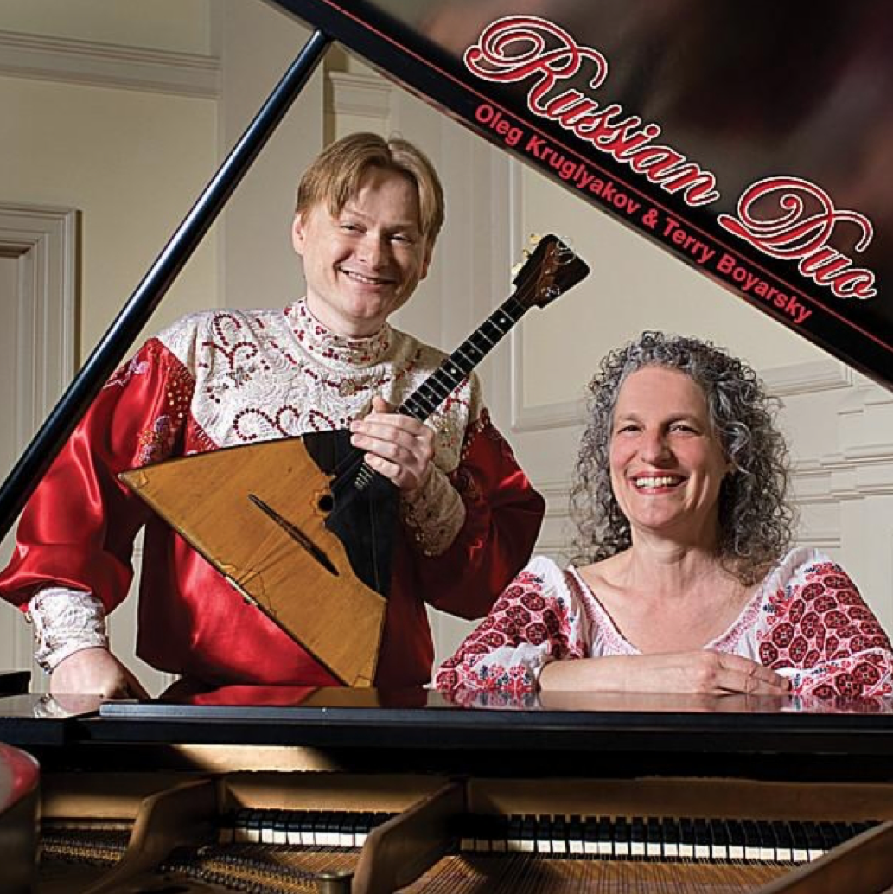

Download the “Leetle Game – Day 2” doc
Stop when I call time
Drop your answers in the chat when I ask for them!
Москва́
бале́т
ка́ша
е́ла
бе́лая
день
объём
бельё
Moskvá
bal’ét
káša
jéla
b’élaja
d’én’
ob-jóm
b’el’-jó

Slide 85
Ну, как?

Slide 86
*

Slide 87
*

Slide 88
Interlanguage

Slide 89
Next time...!

Slide 90
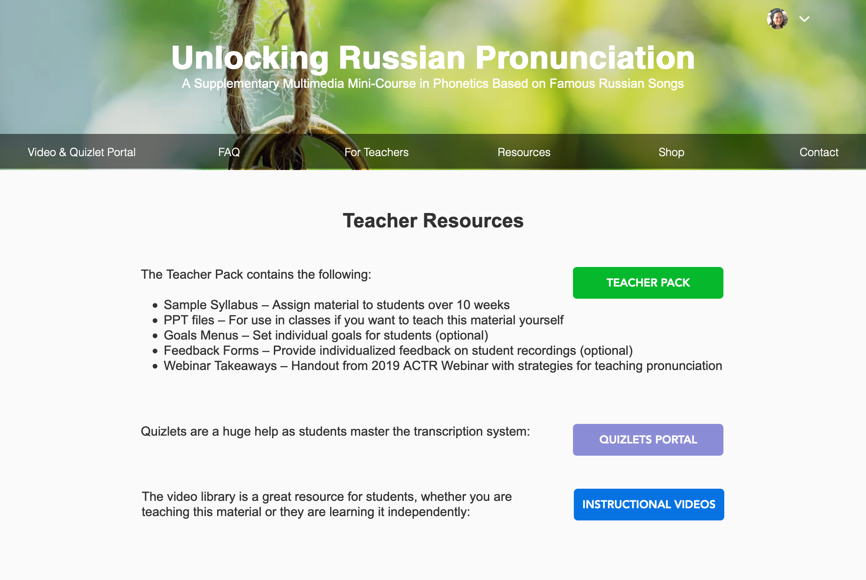
For Teachers/Observers

Slide 91
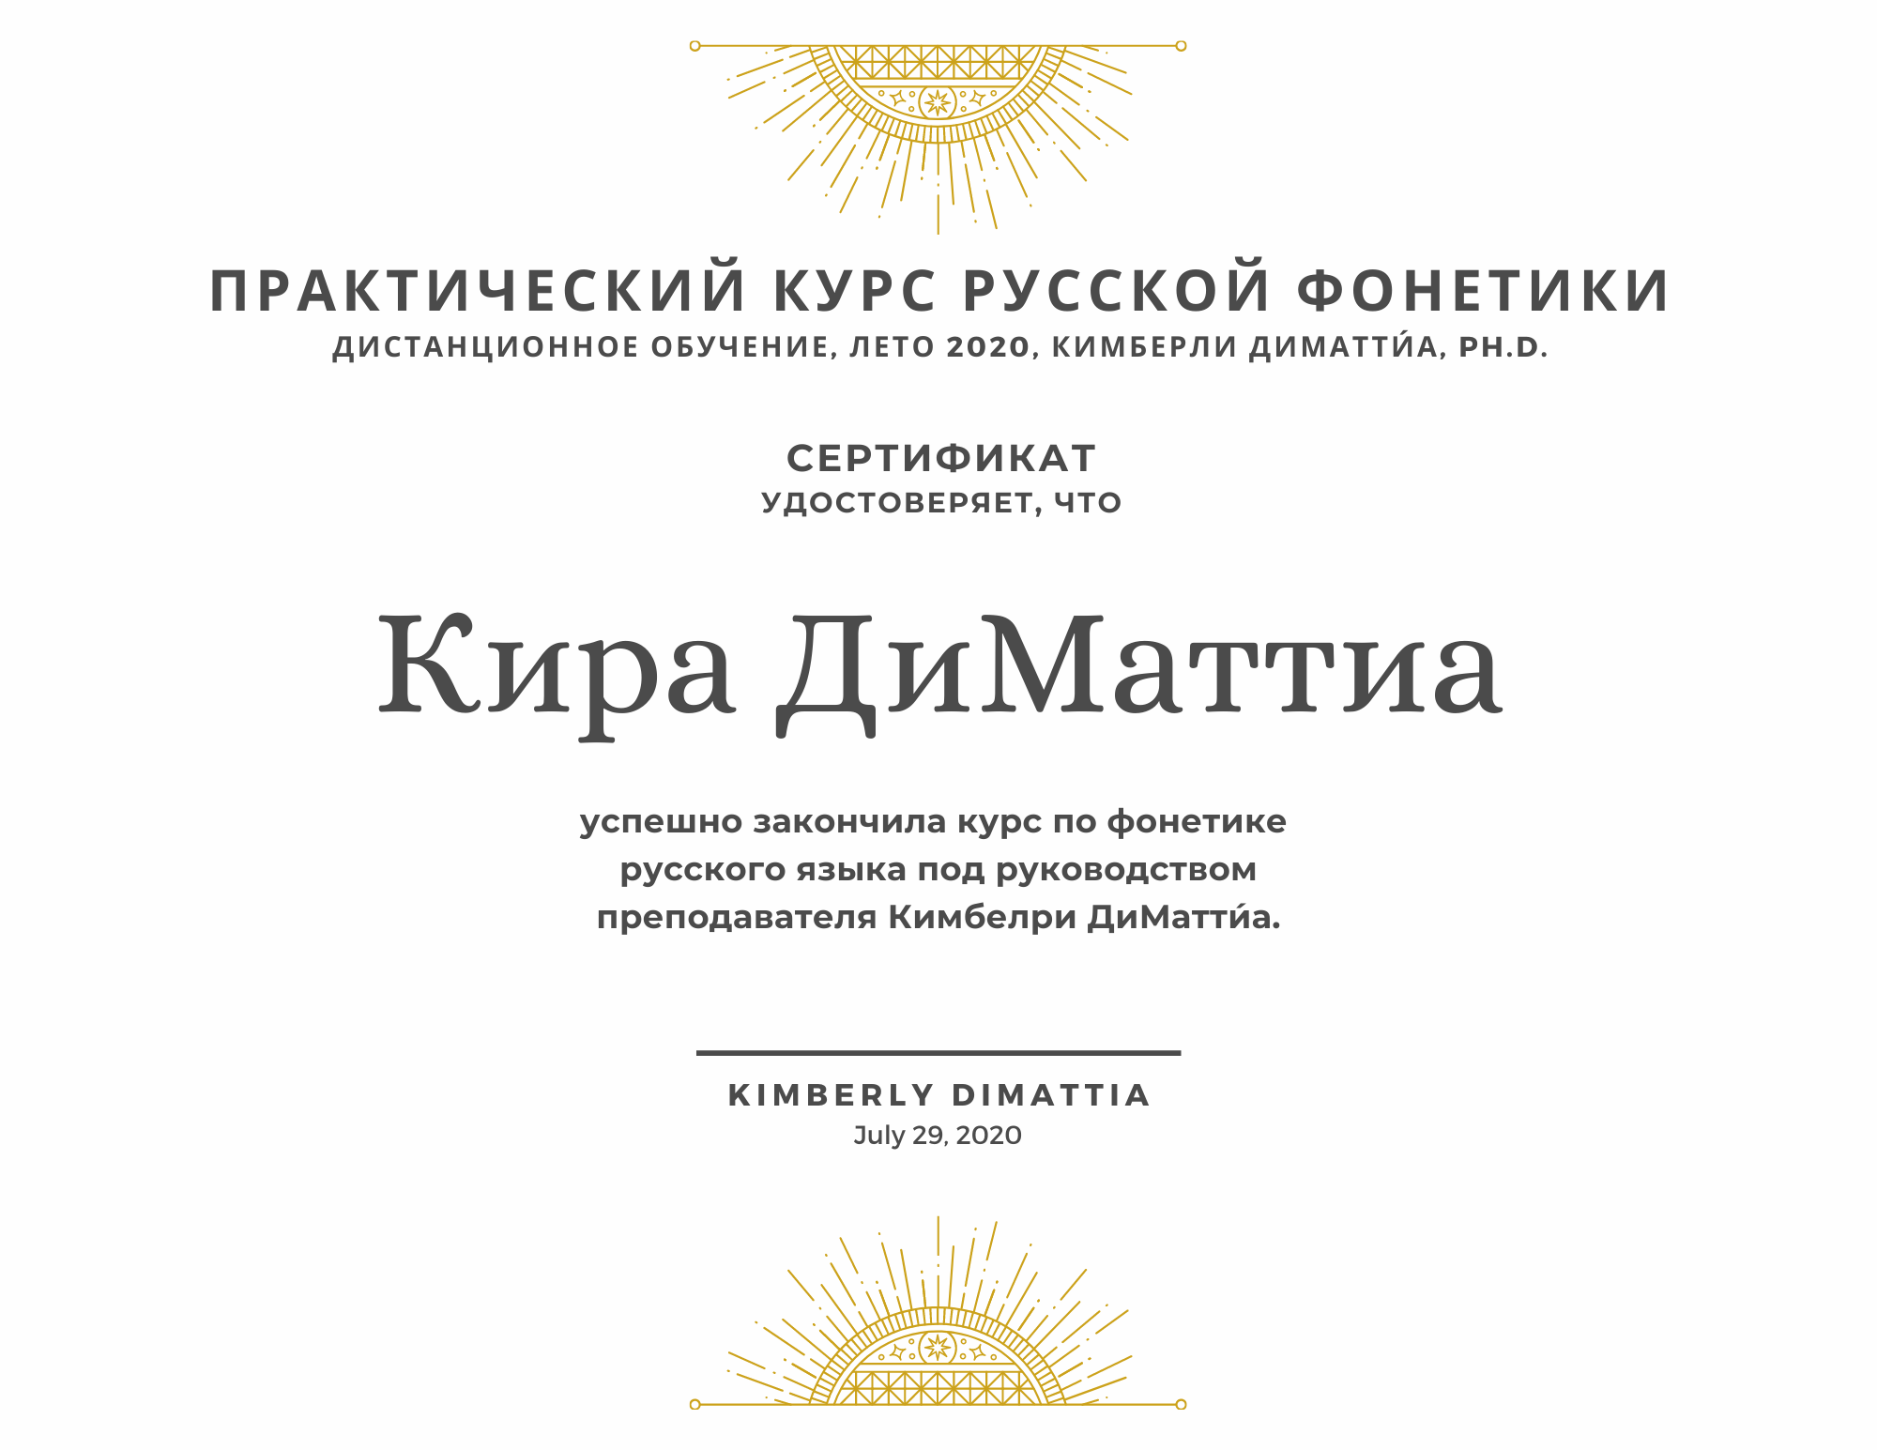
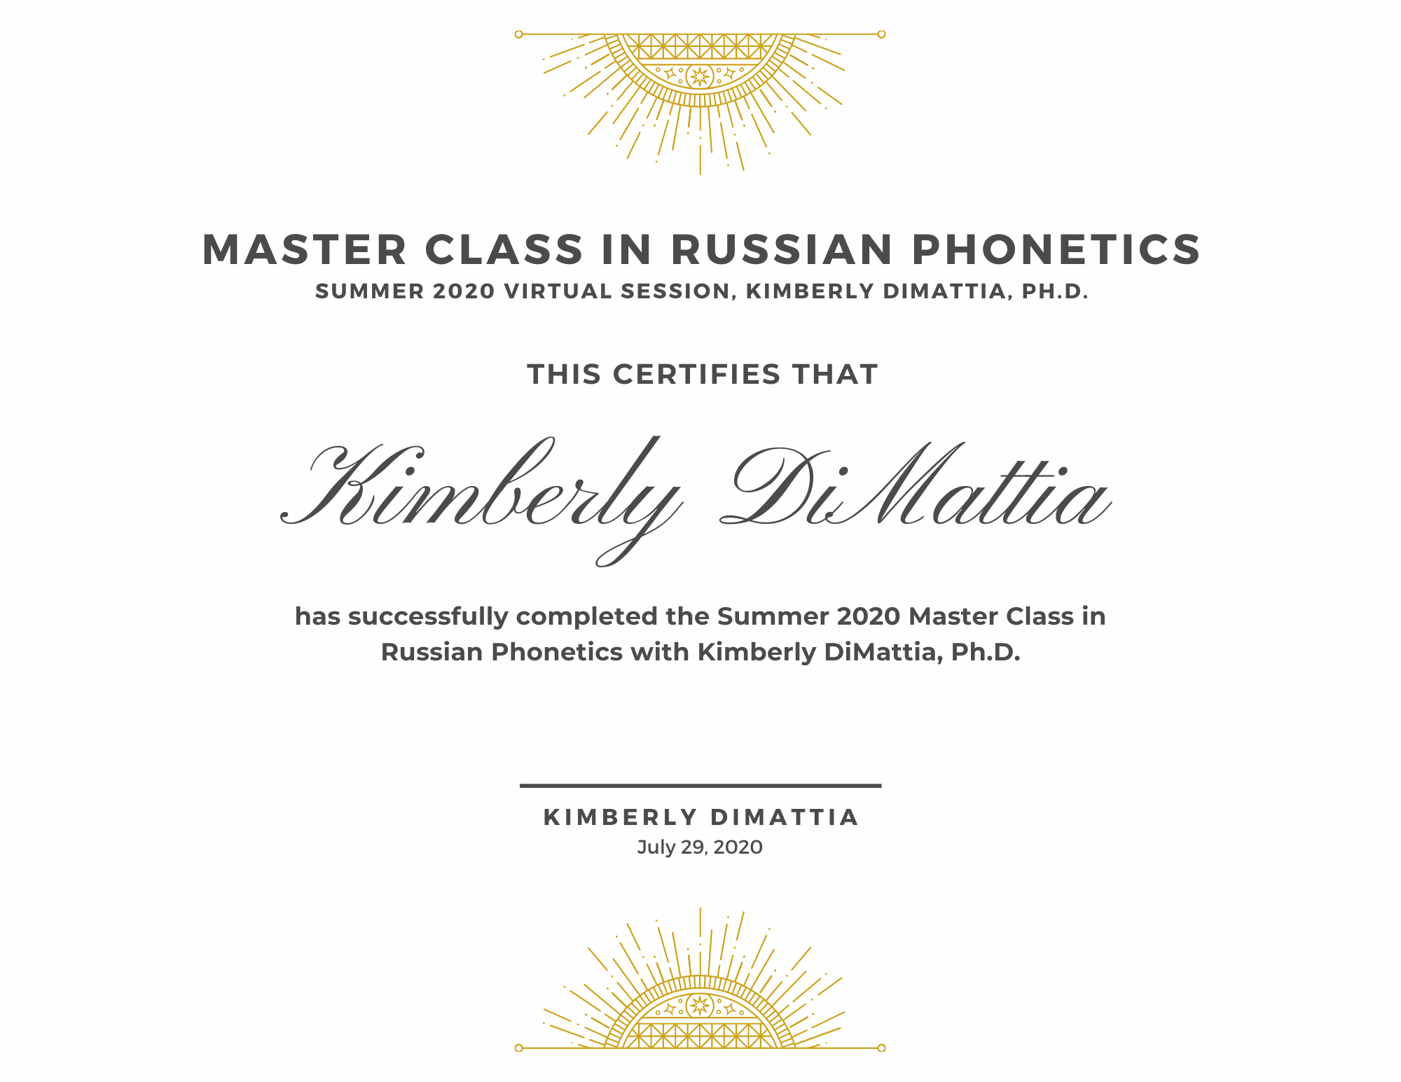
Certificates
Complete all oral assessments (Oral Baseline Exam, Week 1-4 Skills Checks, Oral Final Exam)
Fill out a survey at the end of the course

Slide 92


Slide 93
Leetle Warm Up

Slide 94


Slide 96


Slide 97


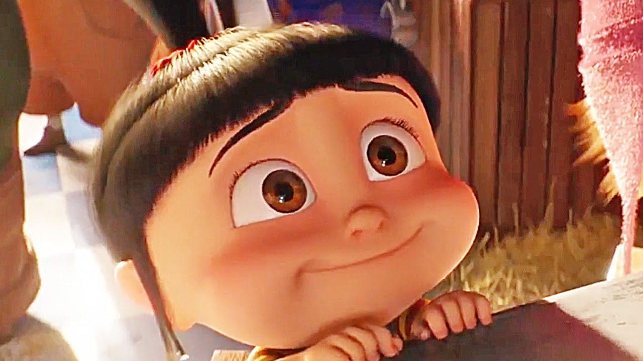

Slide 98
Extra Phrases for Practice
(jaw – tongue – LEEPS!)
Hello, world!
Lake Baikal
Don’t say no!
You must say yes!
Your face…is asking for a brick!

Slide 99
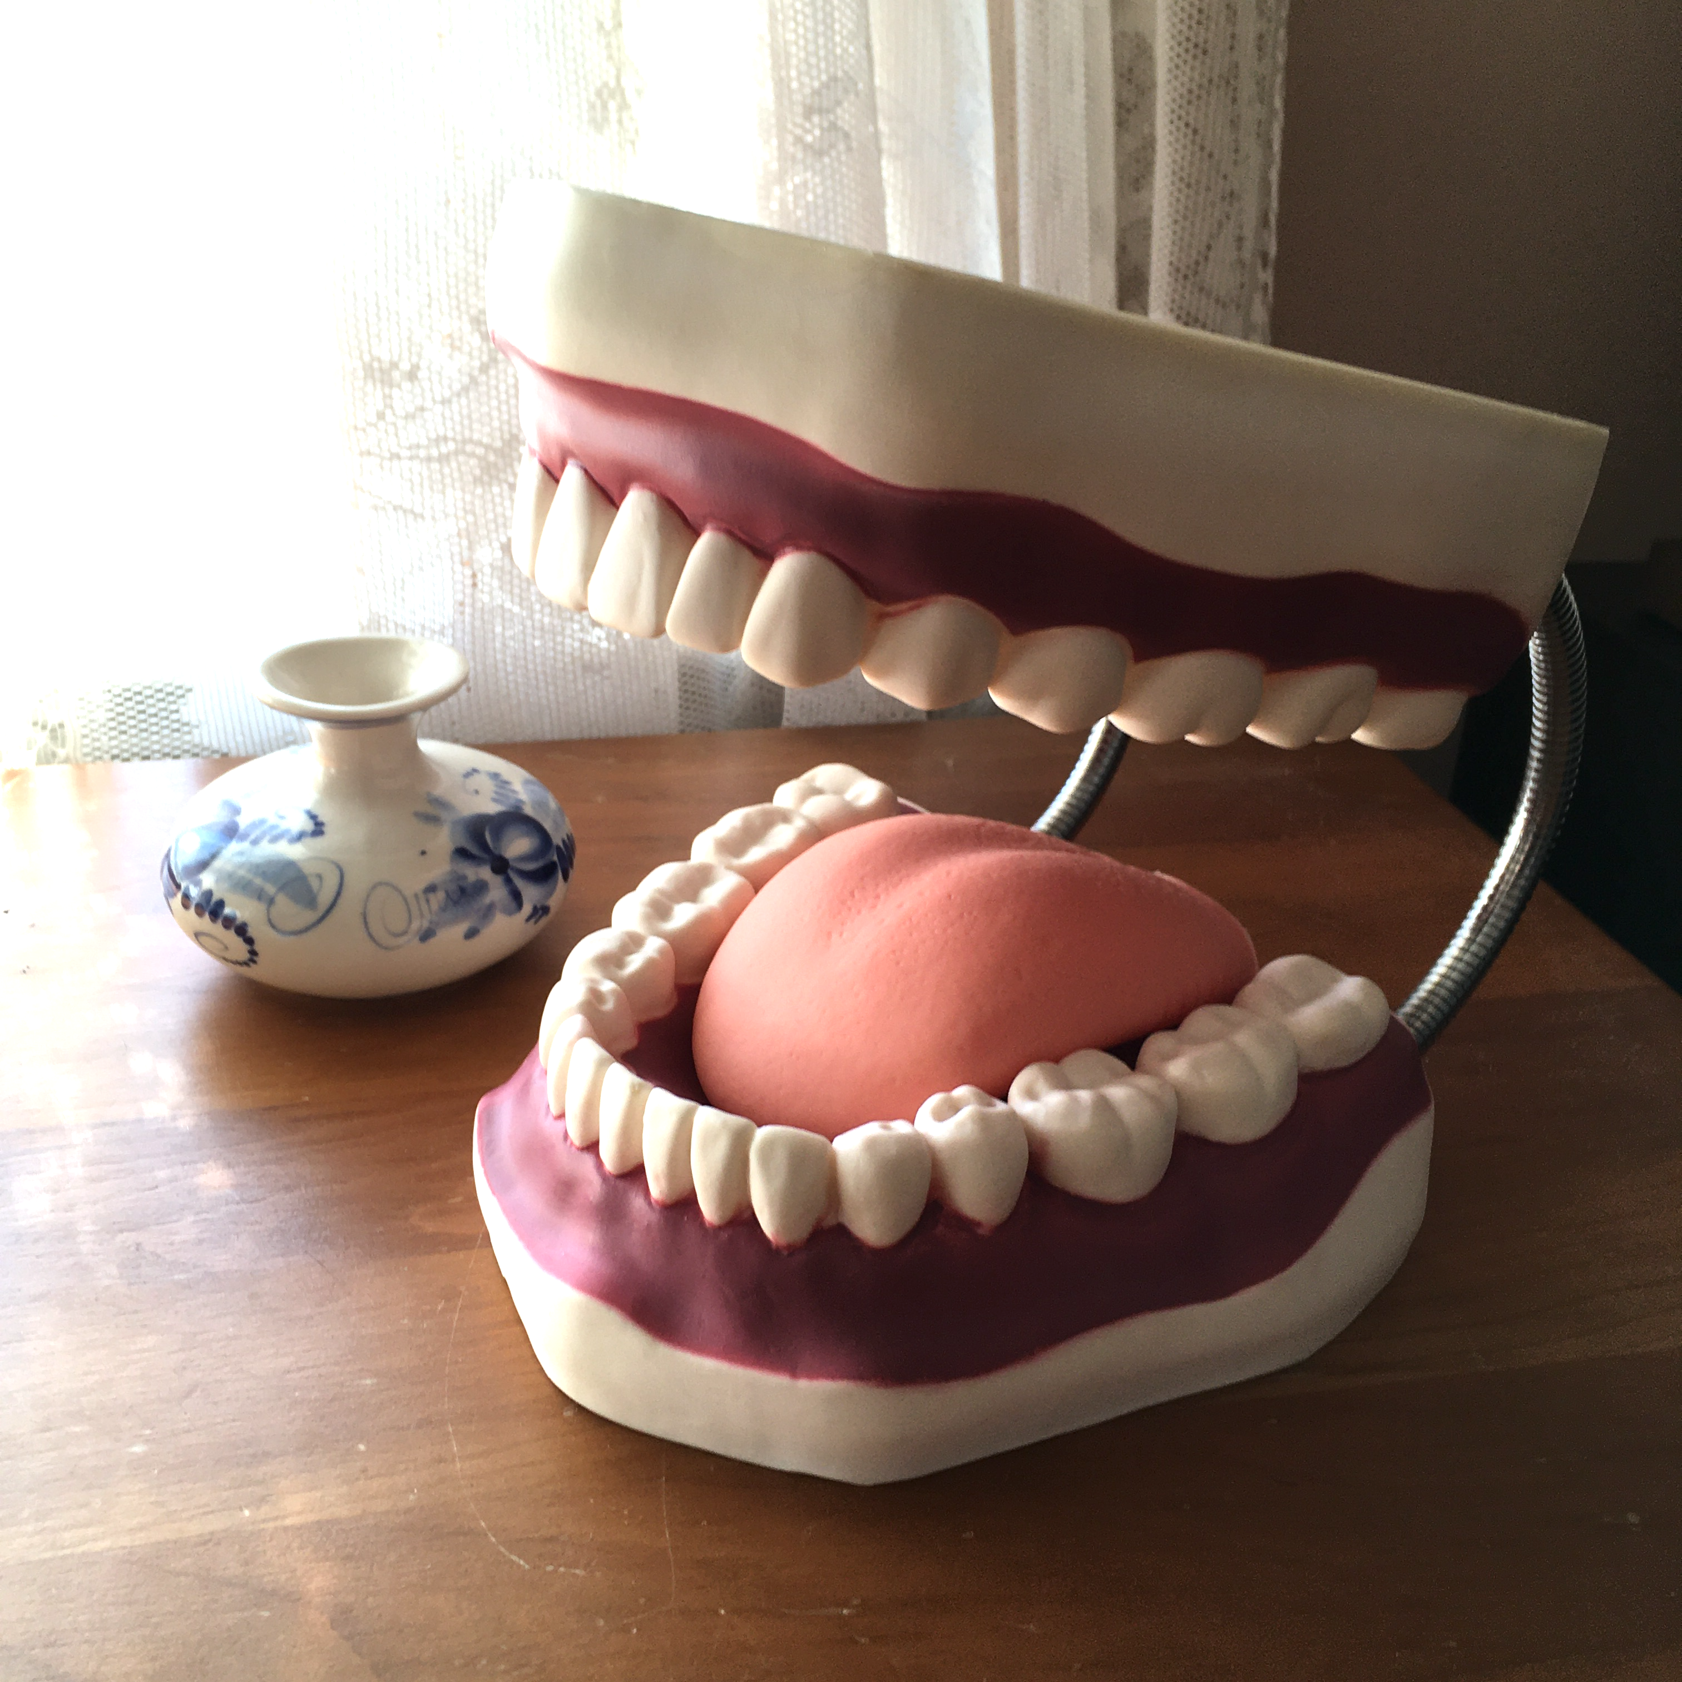
Russian Default Mouth Position
Jaw
Tongue
Lips

Slide 100
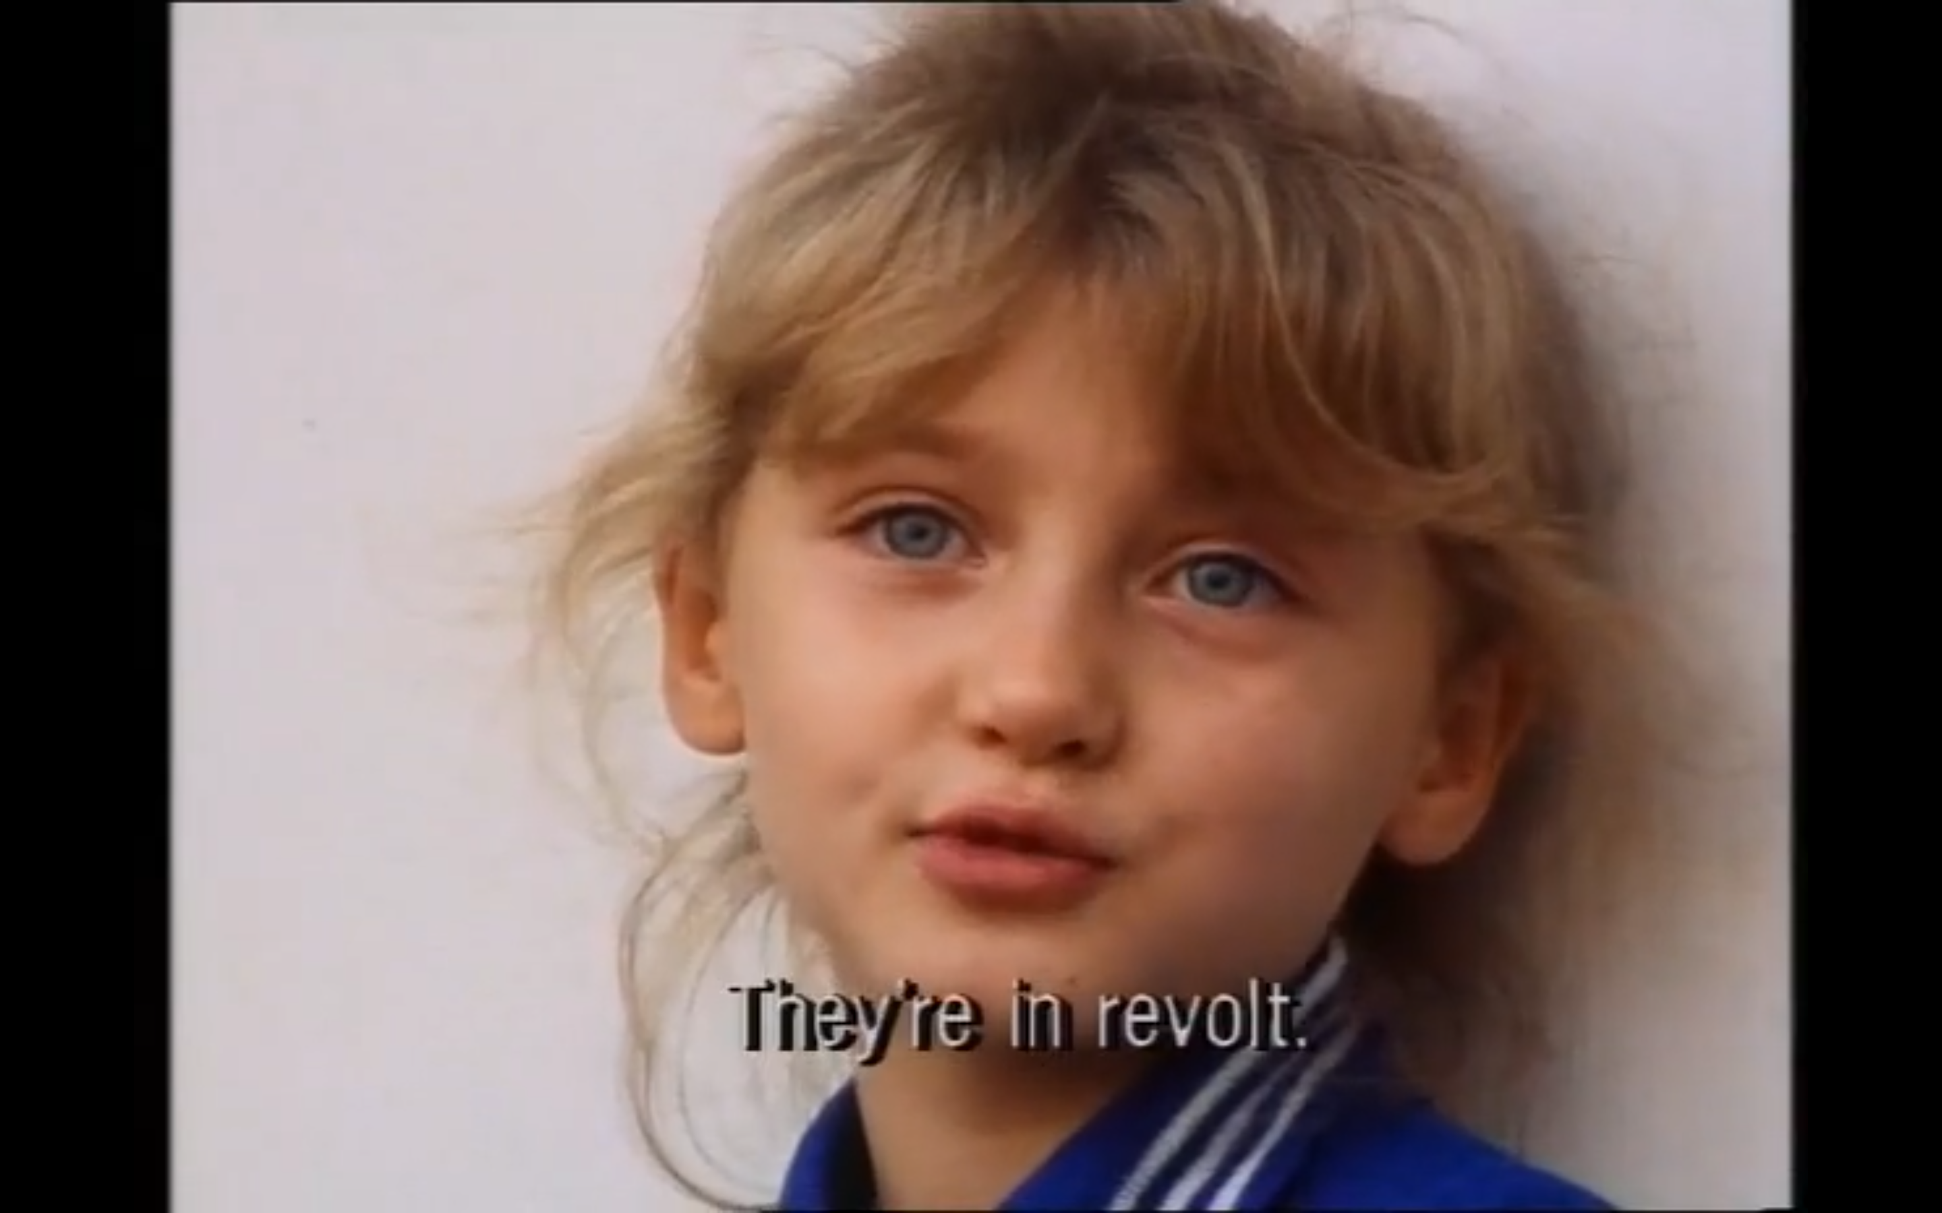
басту́ют

Slide 101
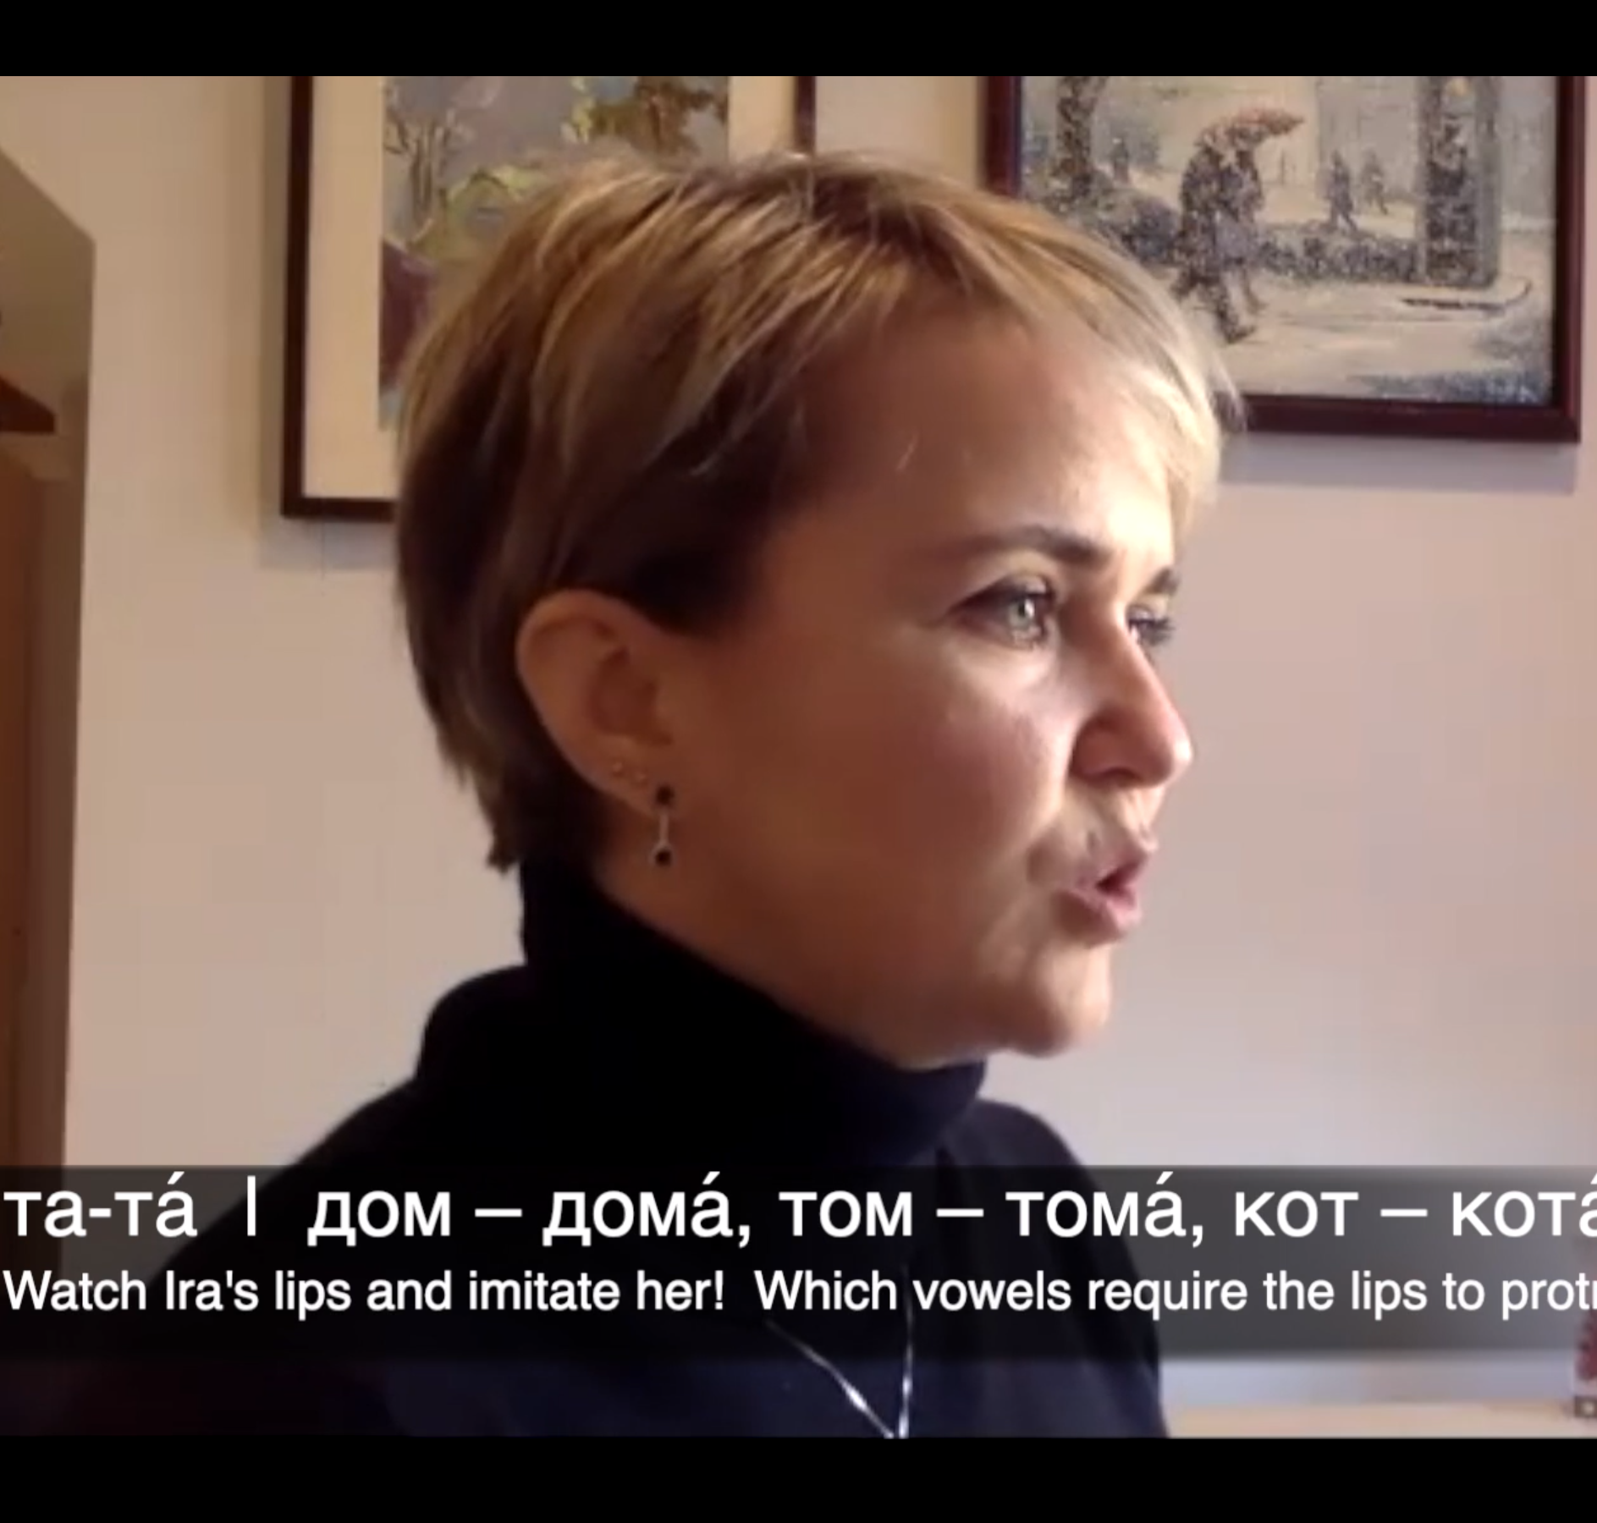

дом

Slide 102
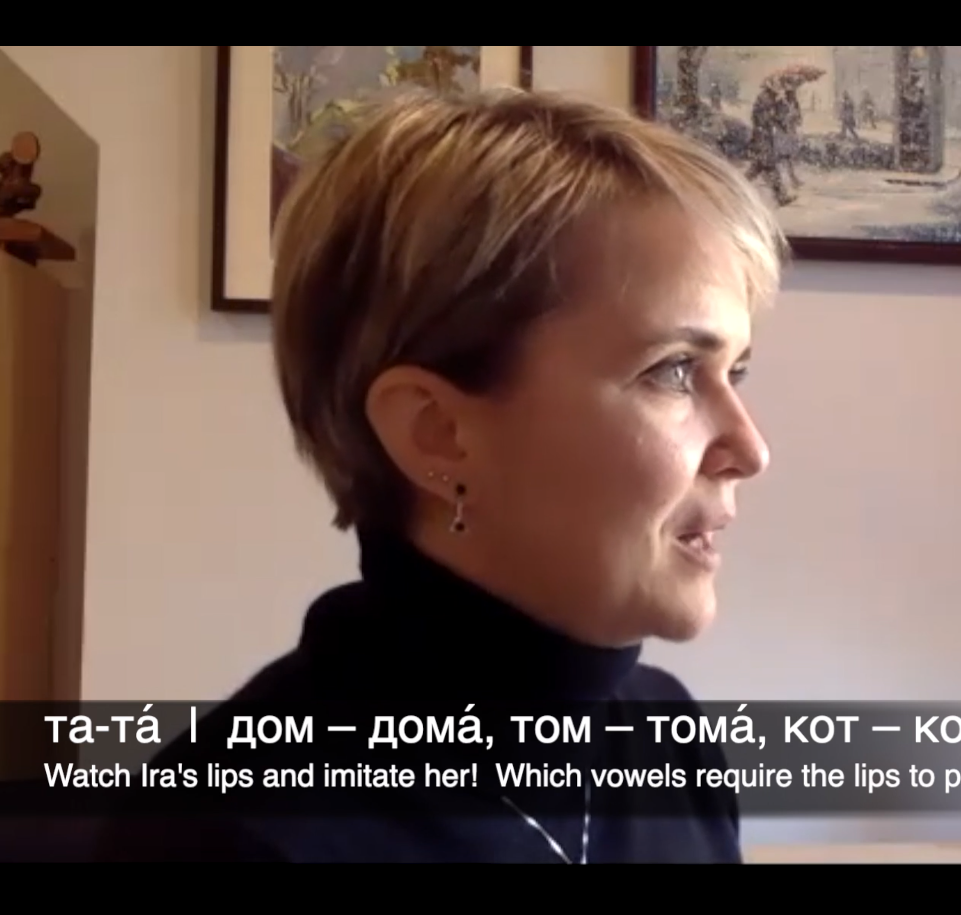
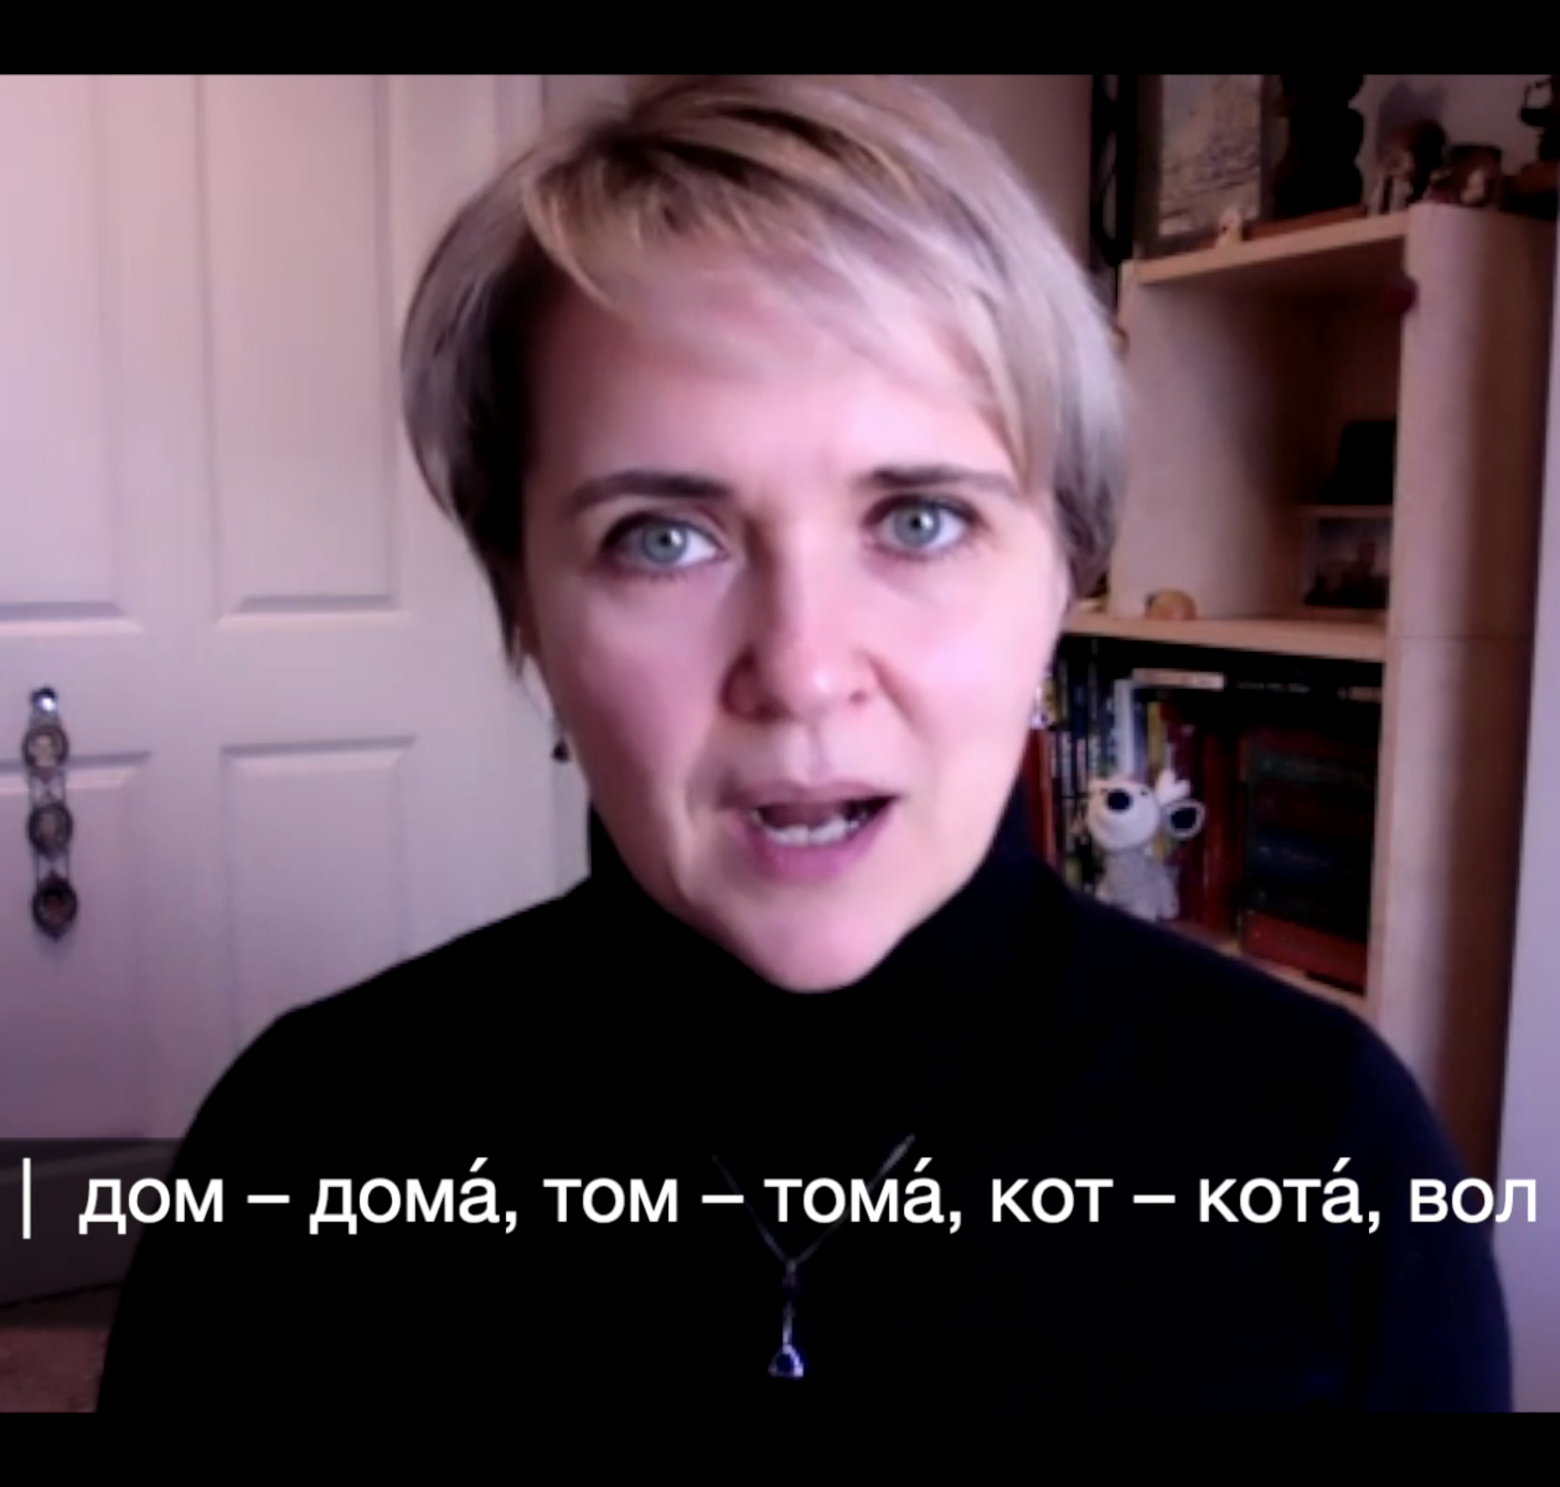
тома́

Slide 103


Get your phones!

Slide 104
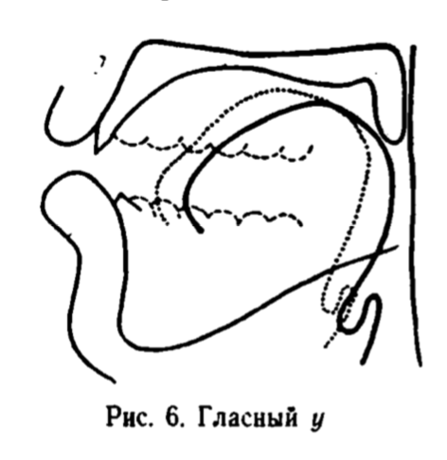
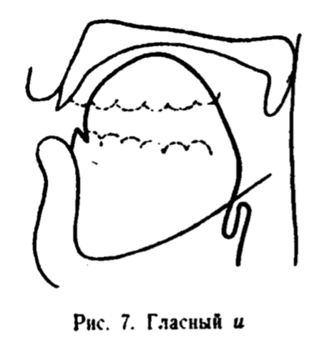
Let’s reset our DMP.
а о у
та то ту
там том ту́мба
да́ма до́ма ду́ма
ю е и
и и́ми и
и идти́ тип
и иди́ Ди́ма
Warm Up 1
No aspiration, tongue is back & low
Warm Up 2
Lots of aspiration, tongue is high & forward

Slide 105
Skills Check – Words
дай, давно́
там, так
ему́, э́ту
вот, год
эл, ал

Slide 106
Skills Check – Sentences
Моя́ кни́га вон там.
Вот она́.
Он уе́хал год наза́д.
Э́то бы́ло давно́.
Да́й мне ру́чку, пожа́луйста.

Slide 107
Skills Check – Questions
Describe the Russian default mouth position in terms of the position of the jaw, tongue, and lips.
What is the point of the Secret Code?

Slide 108
Default Mouth Position: д/т
дай
дал
дар
два
дуб
до́лго
до́рого
дорого́й
давно́
там
то
так
тако́й, така́я, тако́е
толь, то́лько
э́то, э́та
э́тот
тот
тут

Slide 109
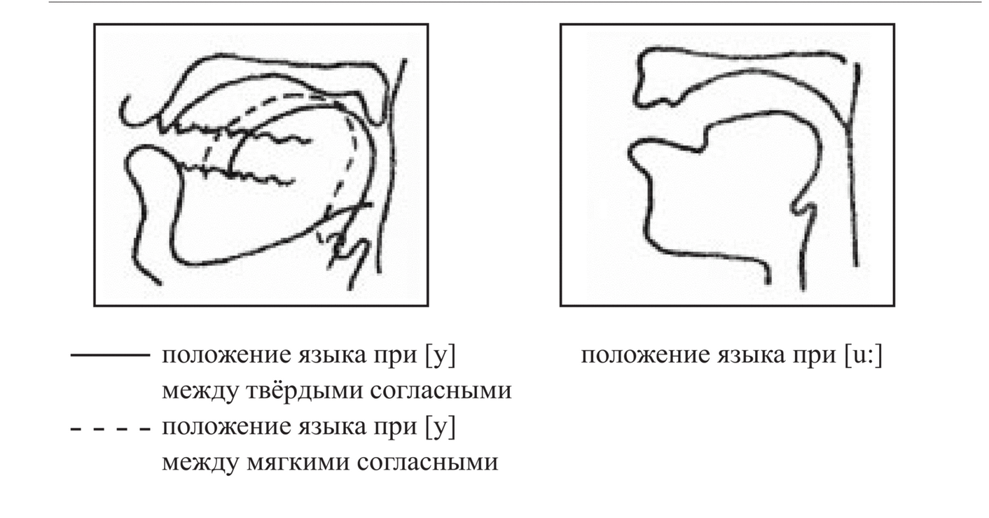
Default Mouth Position: у
фу!
шум
ну…
жук
каку́ю
ему́
э́ту
рука́
е́ду

Slide 110
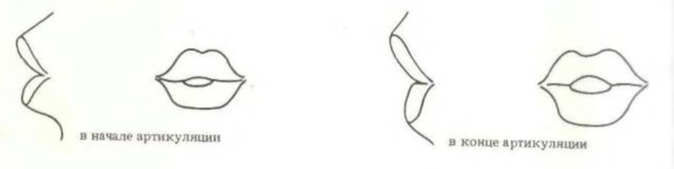
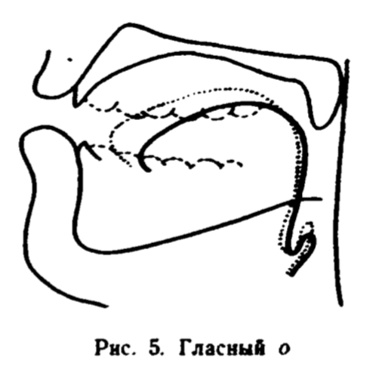
Default Mouth Position: о
вот
год
до́лго
зо́лото
молоко́
ло́дка
мо́ре
но
пол
beginning of articulation
end of articulation

Slide 111
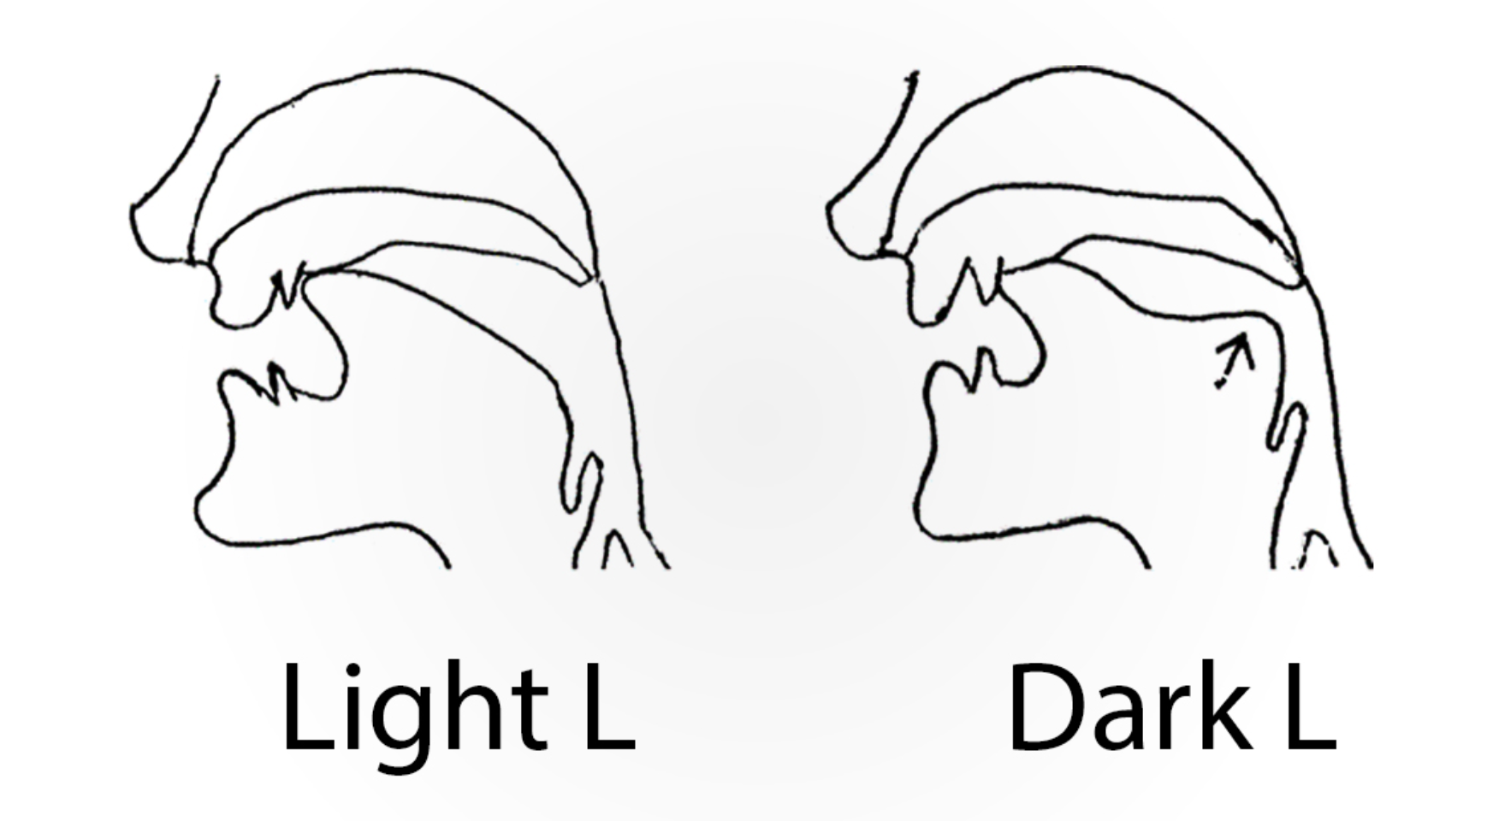
Default Mouth Position: л
эл
ал
ол
вол
мол
мул
пол
па́лка
вя́лый
English Letter L
late
like
lamp
look
call
school
tell
people

Slide 112
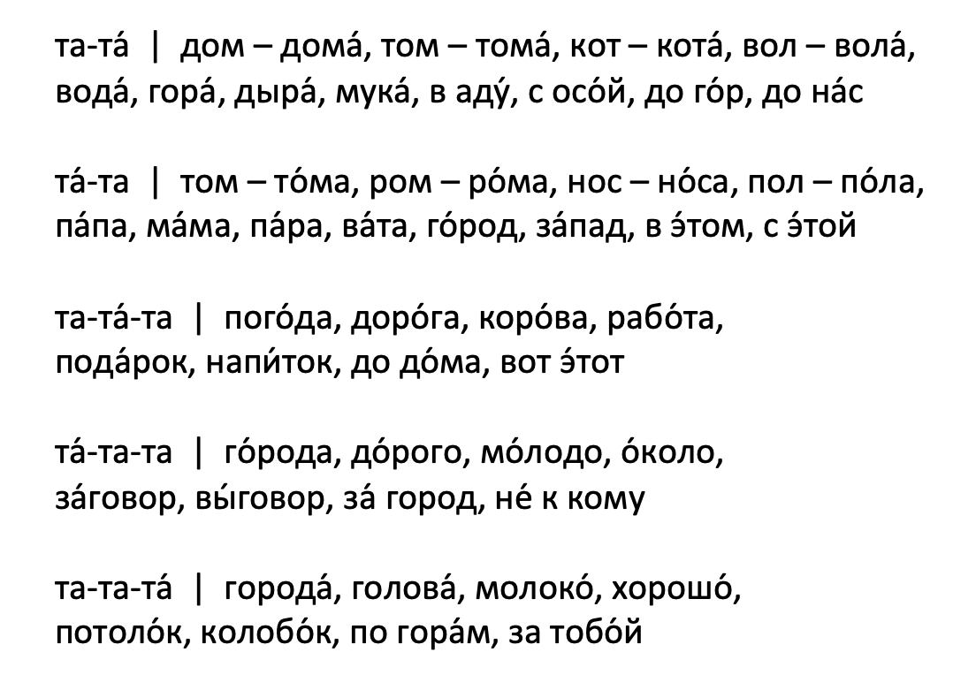
Unstressed Syllables
1
2
3
4
5
6
7
8
9
10

Slide 113

2 вопроса!

Slide 114
Website Orientation
Master Class webpage
What you get when you buy the book – including the password!
Notes:
Use real-life hands! Participants can’t see the digital ones.

Slide 115
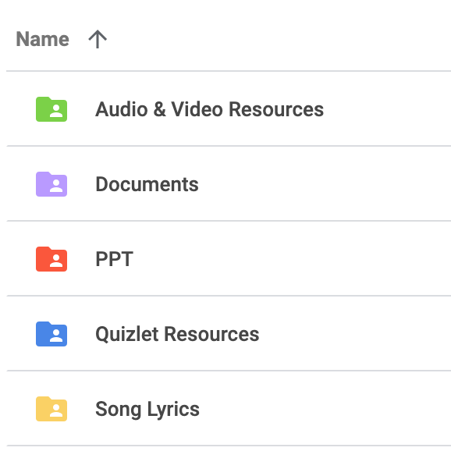
Class Folder

Slide 116
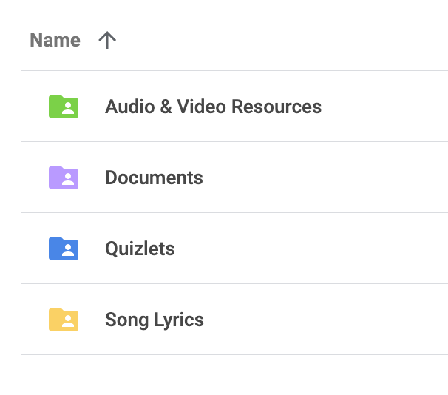
Class Folder

Slide 117
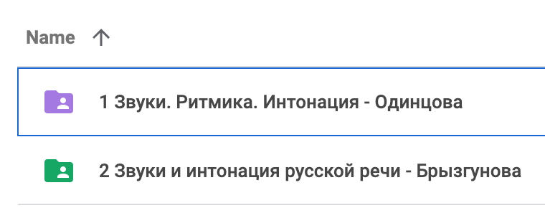
Class Folder

Slide 118
Class Folder

Slide 119
Class Folder

Slide 120
Lesson 3
Hard & Soft Sounds

Slide 121
Hard & Soft Sounds

Slide 122
Hard & Soft Sounds
What are hard and soft sounds?

Slide 123
Hard & Soft Sounds
Hard Sounds
Tongue is lower and further back in the mouth

Slide 124
Hard & Soft Sounds
Hard Sounds
Tongue is lower and further back in the mouth
Soft Sounds
Tongue is higher and further forward, much closer to the hard palate

Slide 125
Soft Vowels

Slide 126
Soft Vowels

Slide 127
Soft Vowels
“Tongue is higher and further forward, much closer to the hard palate”

Slide 128
Did you know...?
There’s more than one б sound!

Slide 129
Did you know...?
There’s more than one в sound!

Slide 130
Did you know...?
There’s more than one...

Slide 131
Слу́шайте и повторя́йте!
ба – бя ba – b’a бо – бё bo – b’o бу – бю bu – b’u бэ – бе be – b’e бы – би by – b’i | ва – вя va – v’a во – вё vo – v’o ву – вю vu – v’u вэ – ве ve – v’e вы – ви vy – v’i | га – гя ga – g’a го – гё go – g’o гу – гю gu – g’u гэ – ге ge – g’e гы – ги gy – g’i | да – дя da – d’a до – дё do – d’o ду – дю du – d’u дэ – де de – d’e ды – ди dy – d’i | за – зя za – z’a зо – зё zo – z’o зу – зю zu – z’u зэ – зе ze – z’e зы – зи zy – z’i

Slide 132
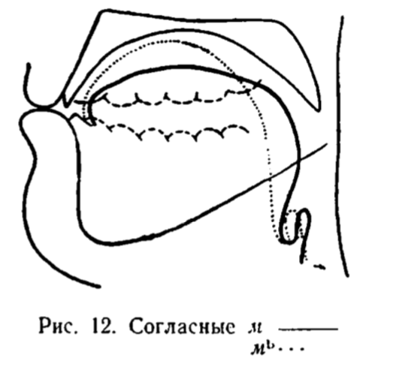
Hard & Soft «м»

Slide 133
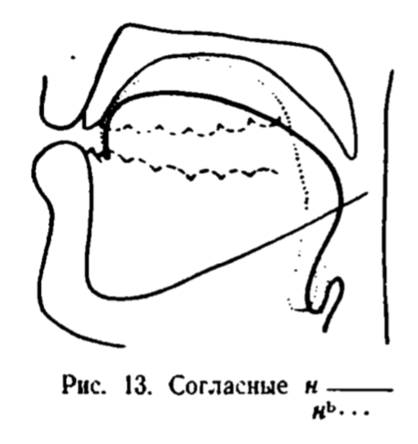
Hard & Soft «н»

Slide 134
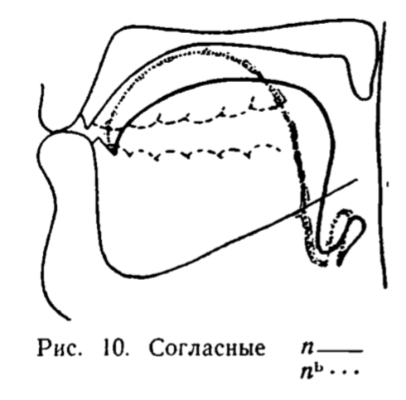
Hard & Soft «п» and «б»

Slide 135
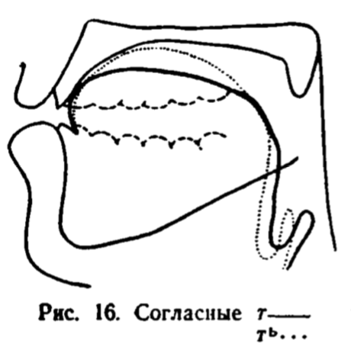
Hard & Soft «т» and «д»

Slide 136
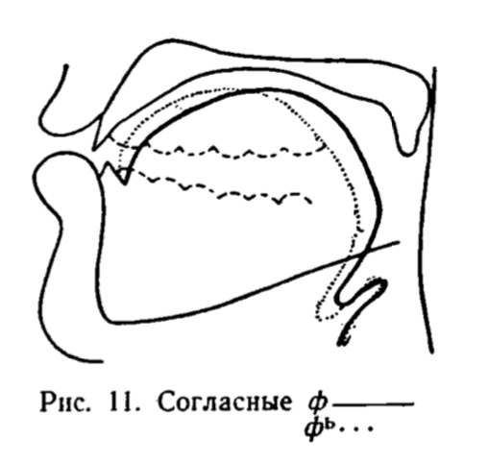
Hard & Soft «ф» and «в»

Slide 137
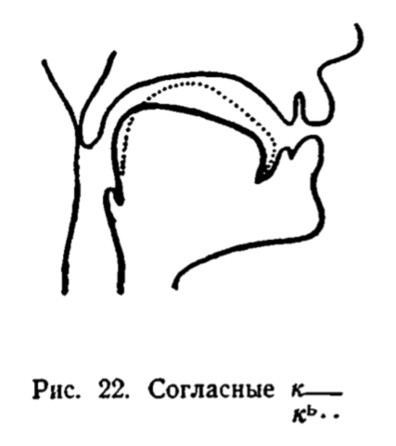
Hard & Soft «к», «г», «х»

Slide 138
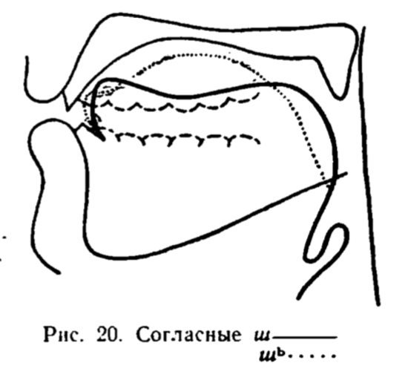
Hard «ш» & Soft «щ»

Slide 139
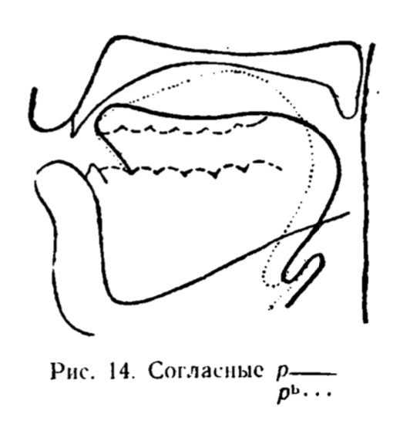
Hard & Soft «р»

Slide 140
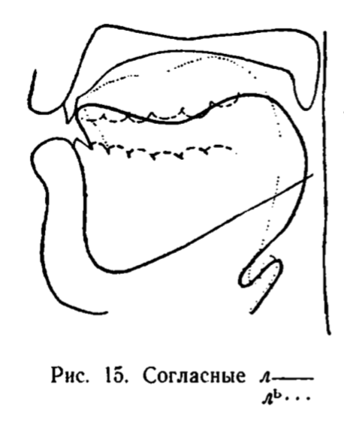
Hard & Soft «л»

Slide 141
More than one...
был
бил
ток
тёк

Slide 142
More than one...
был
бил
ток
тёк

Slide 143
More than one...
был
бил
ток
тёк

Slide 144
How will we ever know???
был
бил
ток
тёк

Slide 145





Allies!
Ы
Я
О
Э
И

Slide 146
Vowels!
Ы
Я
О
Э
И

Slide 147
What do they do?
Ы
Я
О
Э
И

Slide 148
vowel
They reveal!
Я

Slide 149

vowel
They reveal!
Я
consonant

Slide 150
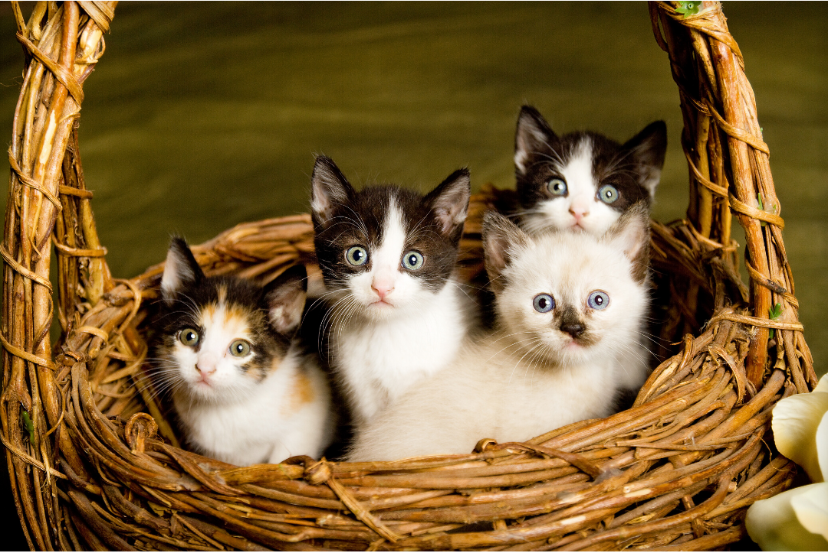
котя́та

Slide 151
котя́та →

Slide 152
котя́та →
?
?
?

Slide 153
котя́та →

Slide 154
котя́та →
kot’ata

Slide 155
котя́та →
kot’ata

Slide 156

котя́та →
kot’ata
apostrophes
equal
soft consonants!

Slide 157
vowel
котя́та →
kot’ata
Я

Slide 158
vowel
котя́та →
kot’ata
Я
consonant

Slide 159
Hard vs Soft «т»
там, тя́га
темп, те́ма
том, тёмный
тут, тюк
ты, тип
tam, t’ága
temp, t’éma
tom, t’ómnyj
tut, t’uk
ty, t’ip

Slide 160
Hard vs Soft (Word-Final) «т»
брат, брать
мат, мать
тот, коло́ть
нут, -нуть
э́тот, ду́мать
brat, brat’
mat, mat’
tot, kolót’
nut, -nut’
étot, dúmat’

Slide 161
Hard vs Soft «д»
дал, дя́дя
до́лго, дёшево
ду́мать, дю́жина
дым, дива́н
дэ, де́ва
dal, d’ád’a
dólgo, d’óševo
dúmat’, d’úžyna
dym, d’iván
de, d’évo

Slide 162
Hard vs Soft «л»
ла́ска, ля́гу
ло́зунг, лёг
лук, люк
ЛЭП, ле́то
лы́жа, лифт
láska, l’águ
lózung, l’og
luk, l’uk
lep, l’éto
lyža, l’ift

Slide 163
Russian Sounds with Kira
Notes:
You receive feedback

Slide 164
Target Practice: Word-Final «т»
т
чита́ет
понима́ет
говори́т
зову́т
лю́бит
смо́трит
ви́дит
пять
шесть
ть
чита́ть
понима́ть
говори́ть
звать
люби́ть
смотре́ть
ви́деть
пять
шесть

Slide 165
Target Practice: Word-Final «л»
л
вол
футбо́л
звал
упа́л
ль
толь
боль
бо́льше
до́льше
жаль
февра́ль
ма́льчик
л
ел
уме́л
дул
гул
ль
ель
апре́ль
учи́тель
учи́тельница
ию́ль
Кремль

Slide 166
Target Practice: Word-Final «р»
р
пар
стар
удар
шар
вар
бар
дар
жар
рь
фона́рь
царь
янва́рь
сентя́брь
октя́брь
ноя́брь
дека́брь
дверь

Slide 167
Target Practice:
Word-Final «м», «н»
м
крем
гром
мь
семь
во́семь
нь
ма́ленький
ма́ленькая
ма́ленькое
ма́ленькие
н
слон
звон
нь
дань
тень
ка́мень
день
зе́лень
ию́нь

Slide 168
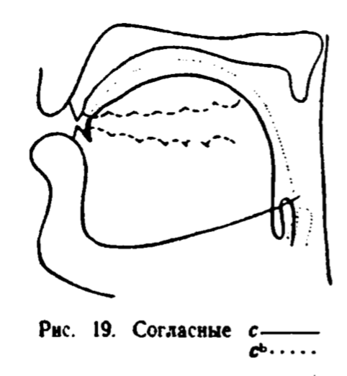
Target Practice:
Word-Final «п», «с»
п
скуп
пь
топь
с
вес
сь
весь
смесь

Slide 169
2 вопроса!

Slide 170
Consonants That Are Always Hard or Always Soft

Slide 171
Consonants That Are Always Hard or Always Soft
ж, ш, ц
are always HARD

Slide 172
Consonants That Are Always Hard or Always Soft
ж, ш, ц
are always HARD
ч, щ
are always SOFT

Slide 173
Consonants That Are Always Hard
ж, ш, ц

Slide 174
Consonants That Are Always Hard
ж, ш, ц
жизнь

Slide 175
Consonants That Are Always Hard
ж, ш, ц
жизнь
ž’izn’

Slide 176
Consonants That Are Always Hard
ж, ш, ц
жизнь
ž’izn’

Slide 177
Consonants That Are Always Hard
ж, ш, ц
жизнь
ž’izn’

Slide 178
Consonants That Are Always Hard
ж, ш, ц
жизнь
ž’izn’

Slide 179
Consonants That Are Always Hard
ж, ш, ц
жизнь
ž’izn’

Slide 180
Consonants That Are Always Hard
ж, ш, ц
жизнь
ž’izn’
Hard vowels: | а | э | о | у | ы
Soft vowels: | я | е | ё | ю | и

Slide 181
Consonants That Are Always Hard
ж, ш, ц
жизнь
žyzn’
Hard vowels: | а | э | о | у | ы
Soft vowels: | я | е | ё | ю | и

Slide 182
Consonants That Are Always Hard
ж, ш, ц
жизнь
žyzn’
Hard vowels: | а | э | о | у | ы
Soft vowels: | я | е | ё | ю | и

Slide 183
Consonants That Are Always Hard
ж, ш, ц
жизнь
“жызнь”
žyzn’
Hard vowels: | а | э | о | у | ы
Soft vowels: | я | е | ё | ю | и

Slide 184
Consonants That Are Always Hard
ж, ш, ц
жизнь
žyzn’
Hard vowels: | а | э | о | у | ы
Soft vowels: | я | е | ё | ю | и

Slide 185

Consonants That Are Always Hard
ж, ш, ц
жизнь
žyzn’
Hard vowels: | а | э | о | у | ы
Soft vowels: | я | е | ё | ю | и

Slide 186

Consonants That Are Always Hard
ж, ш, ц
жизнь
žyzn’
Hard vowels: | а | э | о | у | ы
Soft vowels: | я | е | ё | ю | и

Slide 187
Consonants That Are Always Hard
ж, ш, ц
жизнь
žyzn’
Hard vowels: | а | э | о | у | ы
Soft vowels: | я | е | ё | ю | и

Slide 188

Consonants That Are Always Hard
ж, ш, ц
жизнь
žyzn’
Hard vowels: | а | э | о | у | ы
Soft vowels: | я | е | ё | ю | и

Slide 189

Consonants That Are Always Hard
ж, ш, ц
жизнь
žyzn’
Hard vowels: | а | э | о | у | ы
Soft vowels: | я | е | ё | ю | и

Slide 190
Consonants That Are Always Hard
ж, ш, ц
жизнь
žyzn’
Hard vowels: | а | э | о | у | ы
Soft vowels: | я | е | ё | ю | и

Slide 191
Consonants That Are Always Hard
ж, ш, ц
жизнь
žyzn’
Hard vowels: | а | э | о | у | ы
Soft vowels: | я | е | ё | ю | и

Slide 192
Consonants That Are Always Hard
ж, ш, ц
жизнь
žyzn’
Hard vowels: | а | э | о | у | ы
Soft vowels: | я | е | ё | ю | и

Slide 193


Consonants That Are Always Hard
ж, ш, ц
жизнь
žyzn’
Hard vowels: | а | э | о | у | ы
Soft vowels: | я | е | ё | ю | и

Slide 194
Consonants That Are Always Hard
ж, ш, ц
маши́на
Hard vowels: | а | э | о | у | ы
Soft vowels: | я | е | ё | ю | и

Slide 195
Consonants That Are Always Hard
ж, ш, ц
маши́на
Hard vowels: | а | э | о | у | ы
Soft vowels: | я | е | ё | ю | и

Slide 196
Consonants That Are Always Hard
ж, ш, ц
маши́на
Hard vowels: | а | э | о | у | ы
Soft vowels: | я | е | ё | ю | и

Slide 197
Consonants That Are Always Hard
ж, ш, ц
маши́на
mašýna
Hard vowels: | а | э | о | у | ы
Soft vowels: | я | е | ё | ю | и

Slide 198
Consonants That Are Always Hard
ж, ш, ц
центр
Hard vowels: | а | э | о | у | ы
Soft vowels: | я | е | ё | ю | и

Slide 199
Consonants That Are Always Hard
ж, ш, ц
центр
Hard vowels: | а | э | о | у | ы
Soft vowels: | я | е | ё | ю | и

Slide 200
Consonants That Are Always Hard
ж, ш, ц
центр
Hard vowels: | а | э | о | у | ы
Soft vowels: | я | е | ё | ю | и

Slide 201
Consonants That Are Always Hard
ж, ш, ц
центр
centr
Hard vowels: | а | э | о | у | ы
Soft vowels: | я | е | ё | ю | и

Slide 202
Consonants That Are Always Soft
ч, щ

Slide 203
Consonants That Are Always Soft
ч, щ
чай
Hard vowels: | а | э | о | у | ы
Soft vowels: | я | е | ё | ю | и

Slide 204
Consonants That Are Always Soft
ч, щ
чай
Hard vowels: | а | э | о | у | ы
Soft vowels: | я | е | ё | ю | и

Slide 205
Consonants That Are Always Soft
ч, щ
чай
Hard vowels: | а | э | о | у | ы
Soft vowels: | я | е | ё | ю | и

Slide 206
Consonants That Are Always Soft
ч, щ
чай
č’aj
Hard vowels: | а | э | о | у | ы
Soft vowels: | я | е | ё | ю | и

Slide 207
Consonants That Are Always Soft
ч, щ
чай
č’aj
борща́

Slide 208
Consonants That Are Always Soft
ч, щ
чай
č’aj
борща́
borš’á

Slide 209
Consonants That Are Always Hard or Always Soft
ча́с
маши́на
живу́
це́нтр
ищу́
жёны
цель
ешь
č’ás
mašýna
žyvú
centr
iš’ú
žóny
cel'
ješ

Slide 210
2 вопроса!

Slide 211
Get your phones!

Slide 212
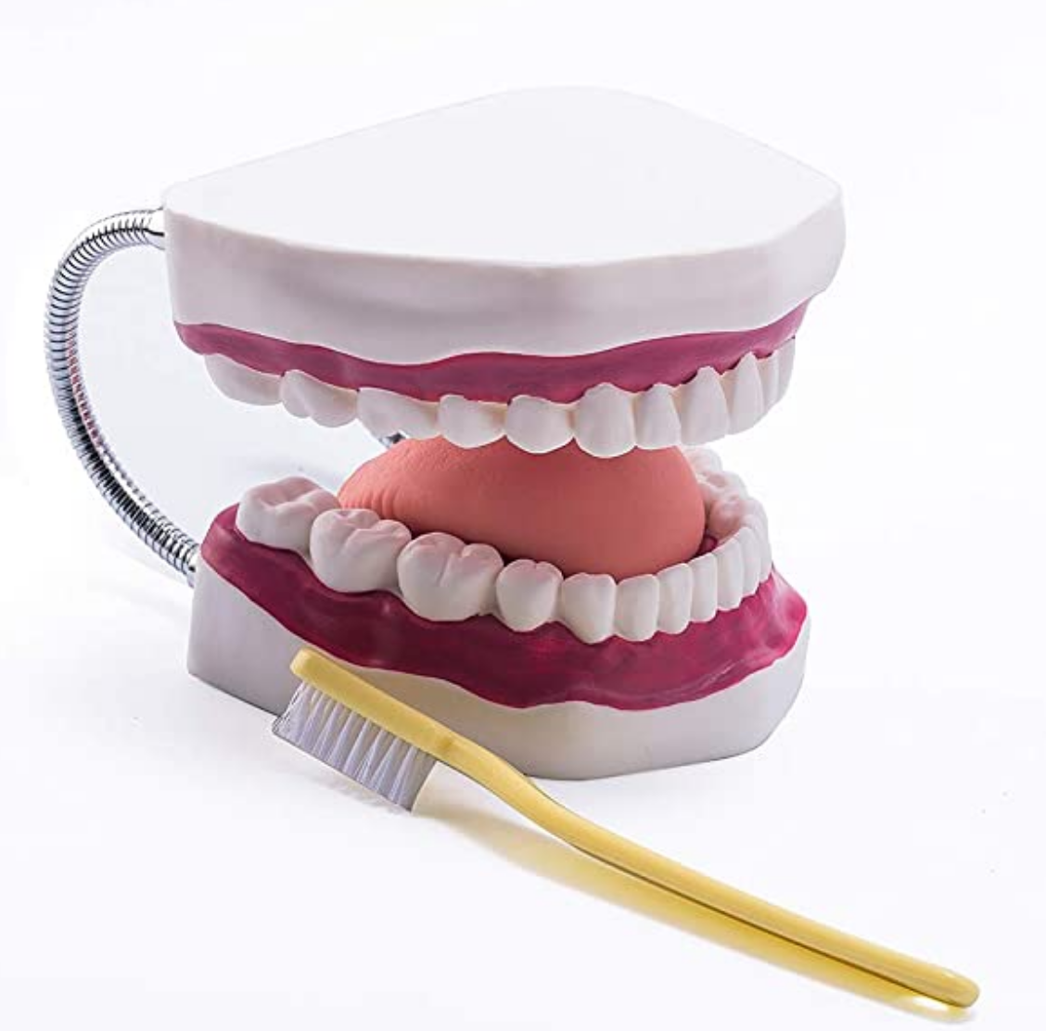
Russian Default Mouth Position
Jaw
Tongue
Lips

Slide 213
Слу́шайте и повторя́йте!
ба – бя ba – b’a бо – бё bo – b’o бу – бю bu – b’u бэ – бе be – b’e бы – би by – b’i | ва – вя va – v’a во – вё vo – v’o ву – вю vu – v’u вэ – ве ve – v’e вы – ви vy – v’i | га – гя ga – g’a го – гё go – g’o гу – гю gu – g’u гэ – ге ge – g’e гы – ги gy – g’i | да – дя da – d’a до – дё do – d’o ду – дю du – d’u дэ – де de – d’e ды – ди dy – d’i | за – зя za – z’a зо – зё zo – z’o зу – зю zu – z’u зэ – зе ze – z’e зы – зи zy – z’i

Slide 214
Слу́шайте и повторя́йте!
ка – кя ко – кё ку – кю кэ – ке кы – ки | ла – ля ло – лё лу – лю лэ – ле лы – ли | ма – мя мо – мё му – мю мэ – ме мы – ми | на – ня но – нё ну – ню нэ – не ны – ни | па – пя по – пё пу – пю пэ – пе пы – пи
ра – ря ро – рё ру – рю рэ – ре ры – ри | са – ся со – сё су – сю сэ – се сы – си | та – тя то – тё ту – тю тэ – те ты – ти | фа – фя фо – фё фу – фю фэ – фе фы – фи | ха – хя хо – хё ху – хю хэ – хе хы – хи

Slide 215
2 вопроса!

Slide 216
What should I do before the next class & when?

Slide 217
What should I do before the next class & when?

Slide 218
What should I do before the next class & when?

Slide 219
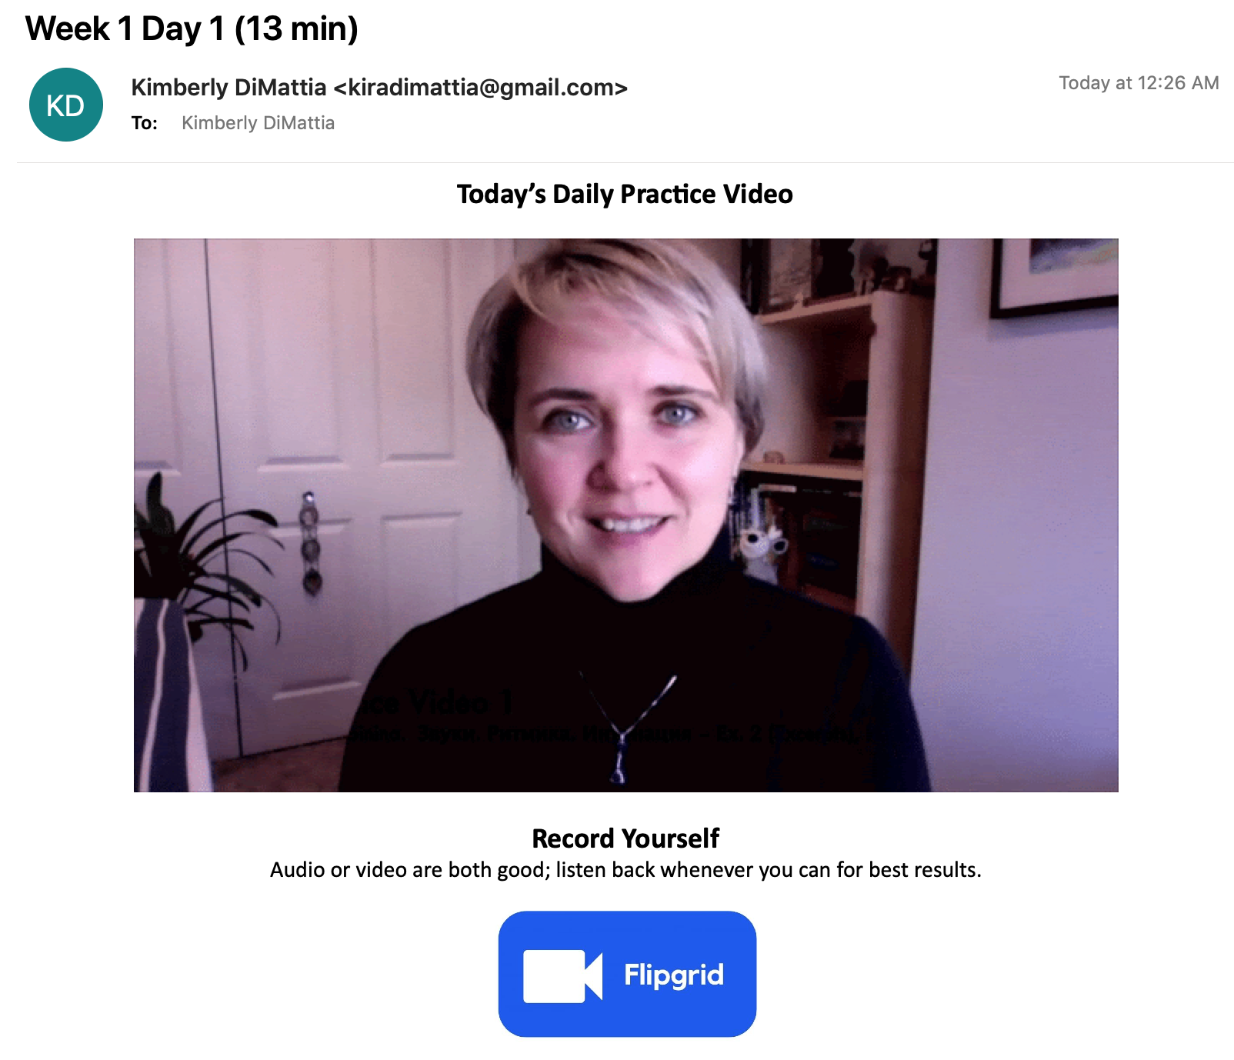
Daily Homework

Slide 220
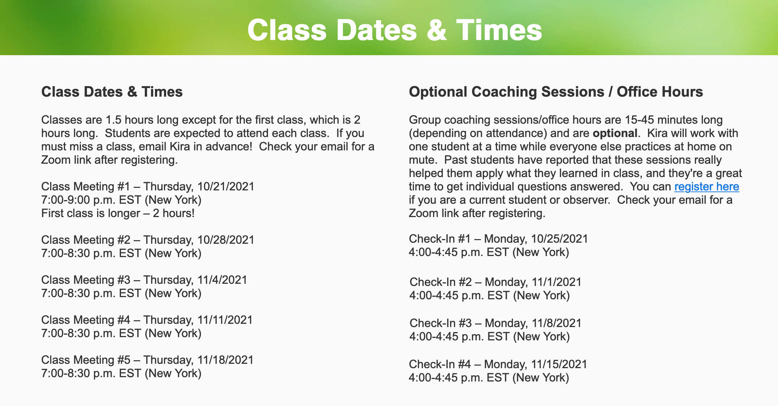
Optional Check-Ins

Slide 221
Next time...!

Slide 222
Конец!
(Kon’éc!)

Slide 223
How can I support Kira?
?
Notes:
Sometimes people ask me...

Slide 224

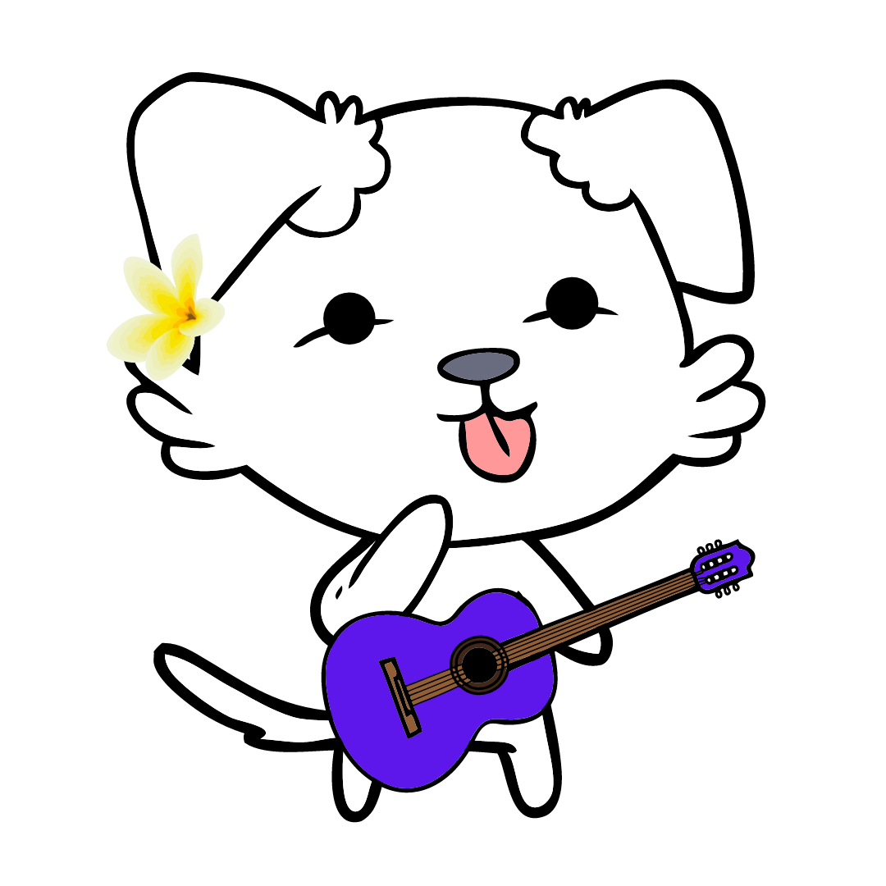

1) Check out Kira’s other stuff
How can I support Kira?
2) Become an ambassador
If you love Kira’s stuff, you could tell:
fellow Russian students
teachers
Reddit!
learnrussianwithkira.com
patreon.com/learnrussianwithkira
learnrussianwithkira.com
3) Become a Patron
4) Buy Kira a coffee : )
At the $5 a month level:
exclusive podcast focused on sounds
library of podcast episodes
optional texts & emails
patreon.com/learnrussianwithkira
buymeacoffee.com/kiradi
Notes:
Sometimes people ask me...

Slide 225

Chat & Sing!
(Kira – stop sharing your screen and remember to use the букс!)

Slide 226
Are you a teacher?
Would you like to use this PPT?
Please do! Take it, tweak it, share it – just please include “based on Unlocking Russian Pronunciation by Kimberly (Kira) DiMattia” in it.
In return, I would love it if you would share these two links with your students:
www.learnrussianwithkira.com
www.patreon.com/learnrussianwithkira
Спасибо!
Kimberly DiMattia, kiradimattia@gmail.com
Notes:
Use real-life hands! Participants can’t see the digital ones.

