Slide 1
Are you a teacher?
Would you like to use this PPT?
Please do! Take it, tweak it, share it – just please include “based on Unlocking Russian Pronunciation by Kimberly (Kira) DiMattia” in it.
In return, I would love it if you would share these two links with your students:
www.learnrussianwithkira.com
www.patreon.com/learnrussianwithkira
Спасибо!
Kimberly DiMattia, kiradimattia@gmail.com
Notes:
Use real-life hands! Participants can’t see the digital ones.

Slide 2
Welcome!
Gather items now
  Unlocking Russian Pronunciation (Kira’s book if you have it already)
  smart phone for recording yourself
  paper, pen/pencil
  water
Rename yourself on Zoom
  Click on Participants, hover over your name, choose Rename, and use your Russian name in Cyrillic (e.g. Кира)

Slide 3
Let’s say hello : )

Slide 4
Master Class with Kira
Kimberly (Kira) DiMattia
Week 3

Slide 5

What am I looking for?
Right answers?
Epiphanies!
Perfection?
Vulnerability!
Amplify your visuals. : )

Slide 6


Slide 7


Slide 8
Молодцы! Good work!
(HW and Skills Checks!!!)

Slide 9
Mid-Course Survey!
Notes:
Link

Slide 10
Other Links
Notes:
Link

Slide 11
Observation from Anna Lordan!
Notes:
Link

Slide 12
Observation from Anna Lordan!
The overall observation is how critical shifting the default mouth position is. The way I heard myself describing it to someone this week is: The default mouth position is training to put your mouth into the shape of the instrument for Russian, so when the air comes through, it makes the sound of Russian.
So for example, the English default mouth position is one type of musical instrument, one type of wind instrument. It has its own shape, and when the air comes through that instrument, it makes certain sounds. You can’t try and “play” the sounds of Russian on the English instrument, because the shape of the instrument is completely different. You have to change instruments.

Slide 13
Practice Routine

Slide 14
Practice Routine
(Stop screen share)
Who has one?
What is/isn’t working for you?
Strategies

Slide 15
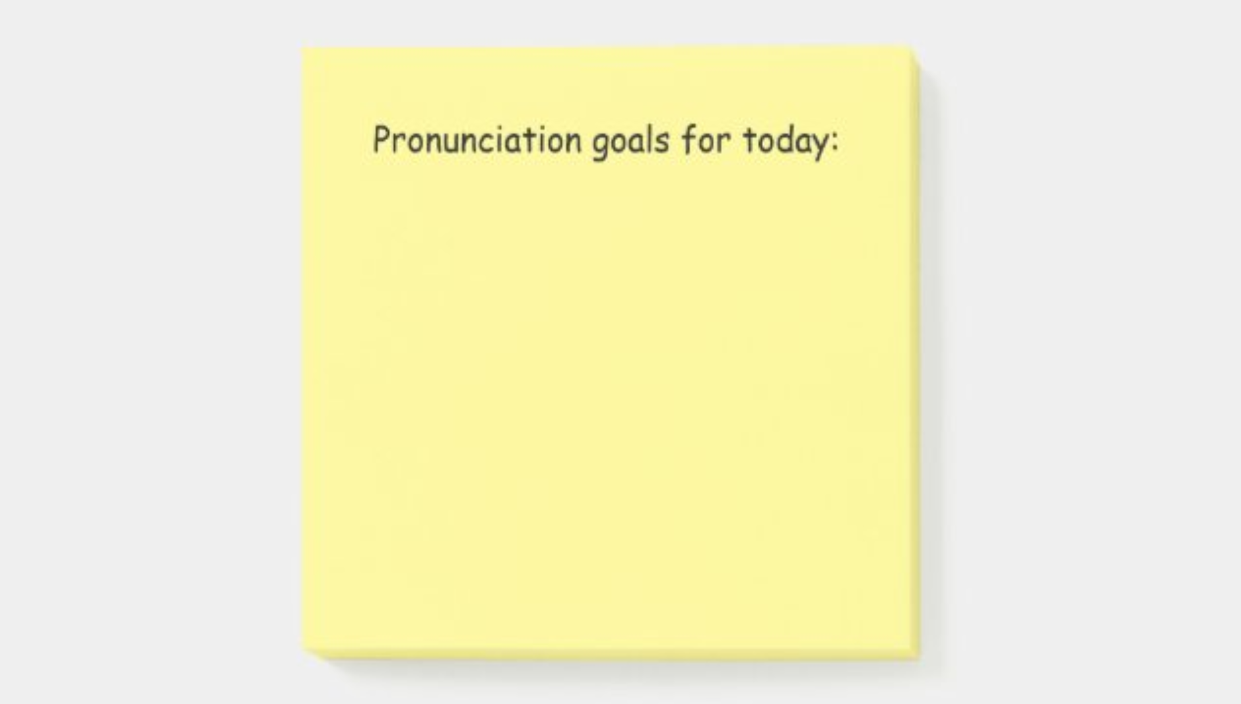
Actual sticky notes
https://www.zazzle.com/store/learnrussianwithkira

Slide 16

Daily alarm
Every day, 7 p.m.

Slide 17
Do you want to continue or tweak your practice routine this week?
Type your goal/plan/idea in the chat.

Slide 18
My Goals for You
Default Mouth Position
Unstressed Syllables
Individual Phonemes
Practice Routine
Secret Code
Phonetics Topics

Slide 19
My Goals for You
Default Mouth Position
Unstressed Syllables
Individual Phonemes
Practice Routine
Secret Code
Phonetics Topics

Slide 20
My Goals for You
Default Mouth Position
Unstressed Syllables
Individual Phonemes
Practice Routine
Secret Code
Phonetics Topics

Slide 21
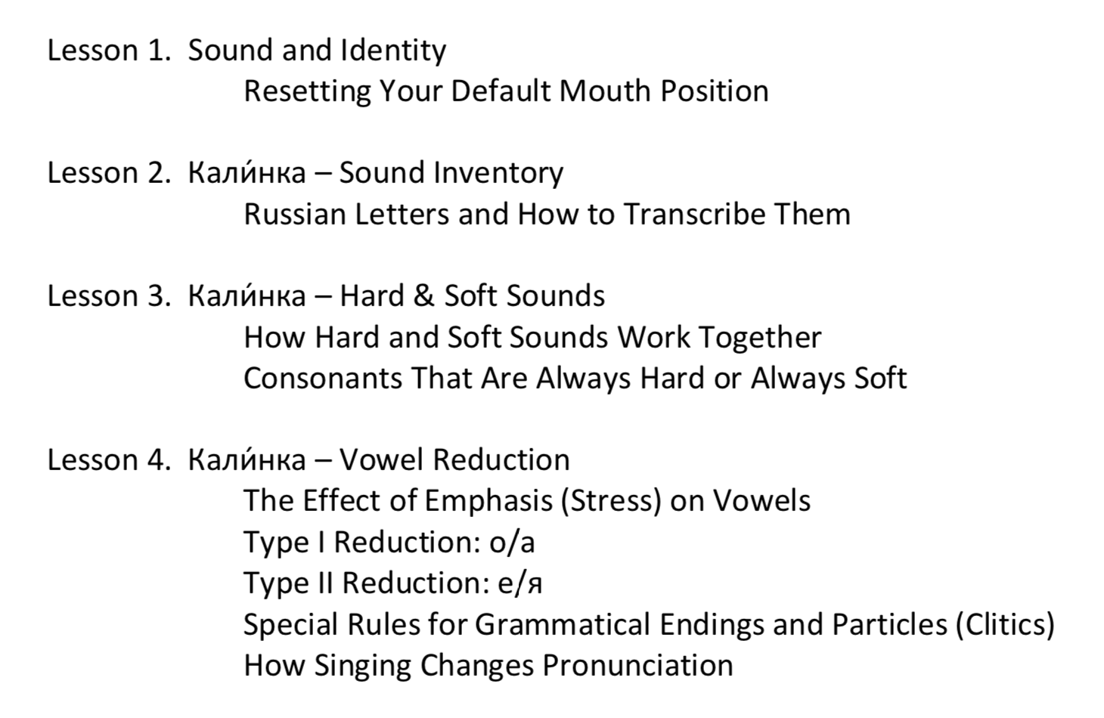
Where are we?

Slide 22
Where are we?
☑︎

Slide 23
Where are we?
☑︎
☐

Slide 24
Today...
Leetle Game
Leetle Warm Up
Vowel Reduction
8:30 p.m. EST

Slide 25
Leetle Game!

Slide 26
What should I say if I make a mistake?
Ой! Я забы́л/а!

Slide 27


Slide 28


Slide 29


Slide 30


Slide 31


Slide 33
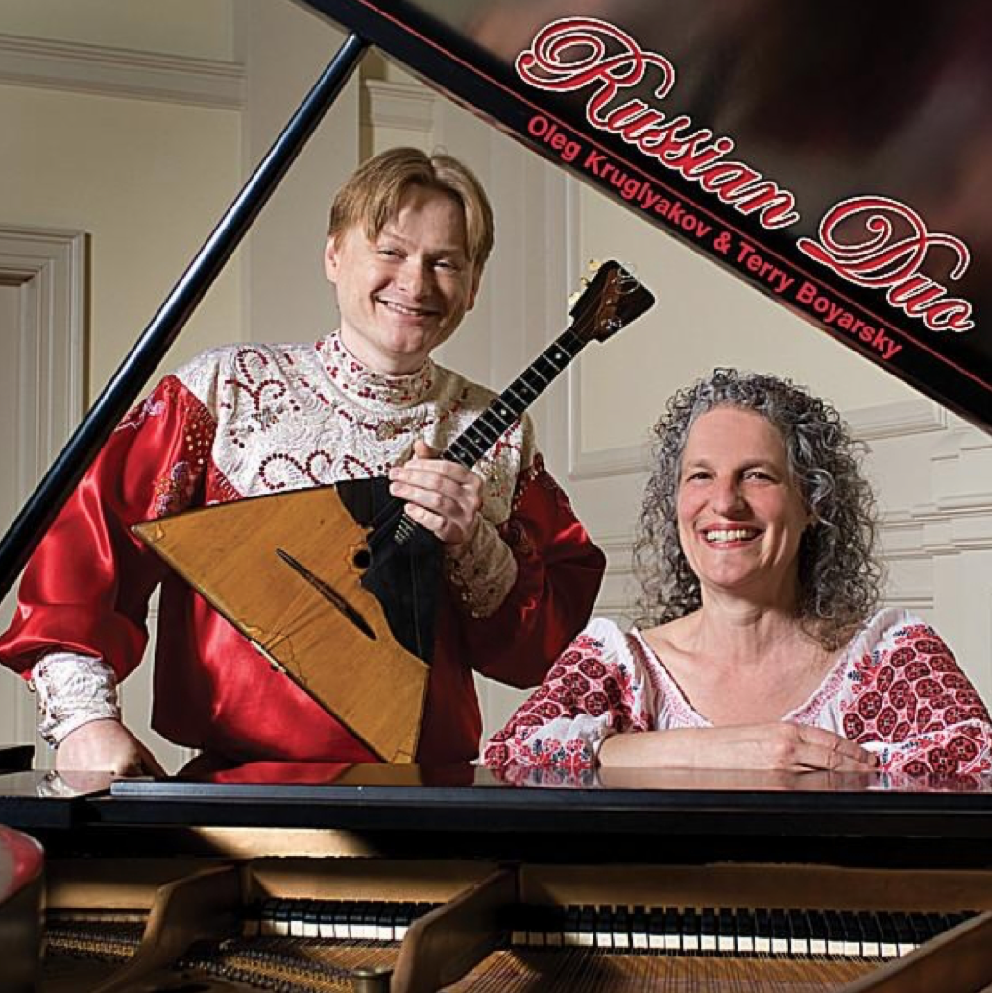


Download the “Leetle Game – Day 3” doc
Stop when I call time
Drop your answers in the chat when I ask for them!
Росси́я
де́рево
бра́тья
чита́ть
цирк
маши́ны
жёлуди
плащ
Ross’íja
d’ér’evo
brát’-ja
č’itát’
cyrk
mašýny
žólud’i
plaš’

Slide 34
Ну, как?

Slide 35
*

Slide 36

*

Slide 37




Interlanguage

Slide 38
Next time...!

Slide 39
Leetle Warm Up

Slide 40


Get your phones!

Slide 41



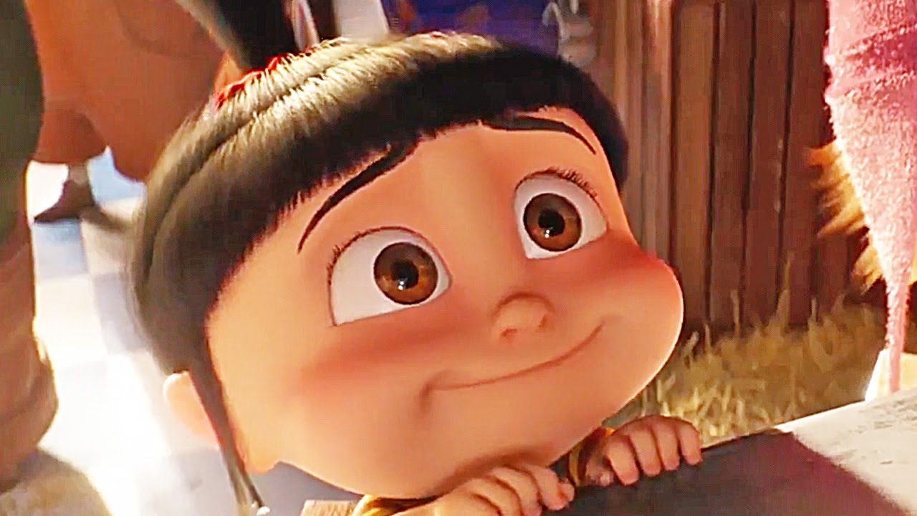

Slide 42
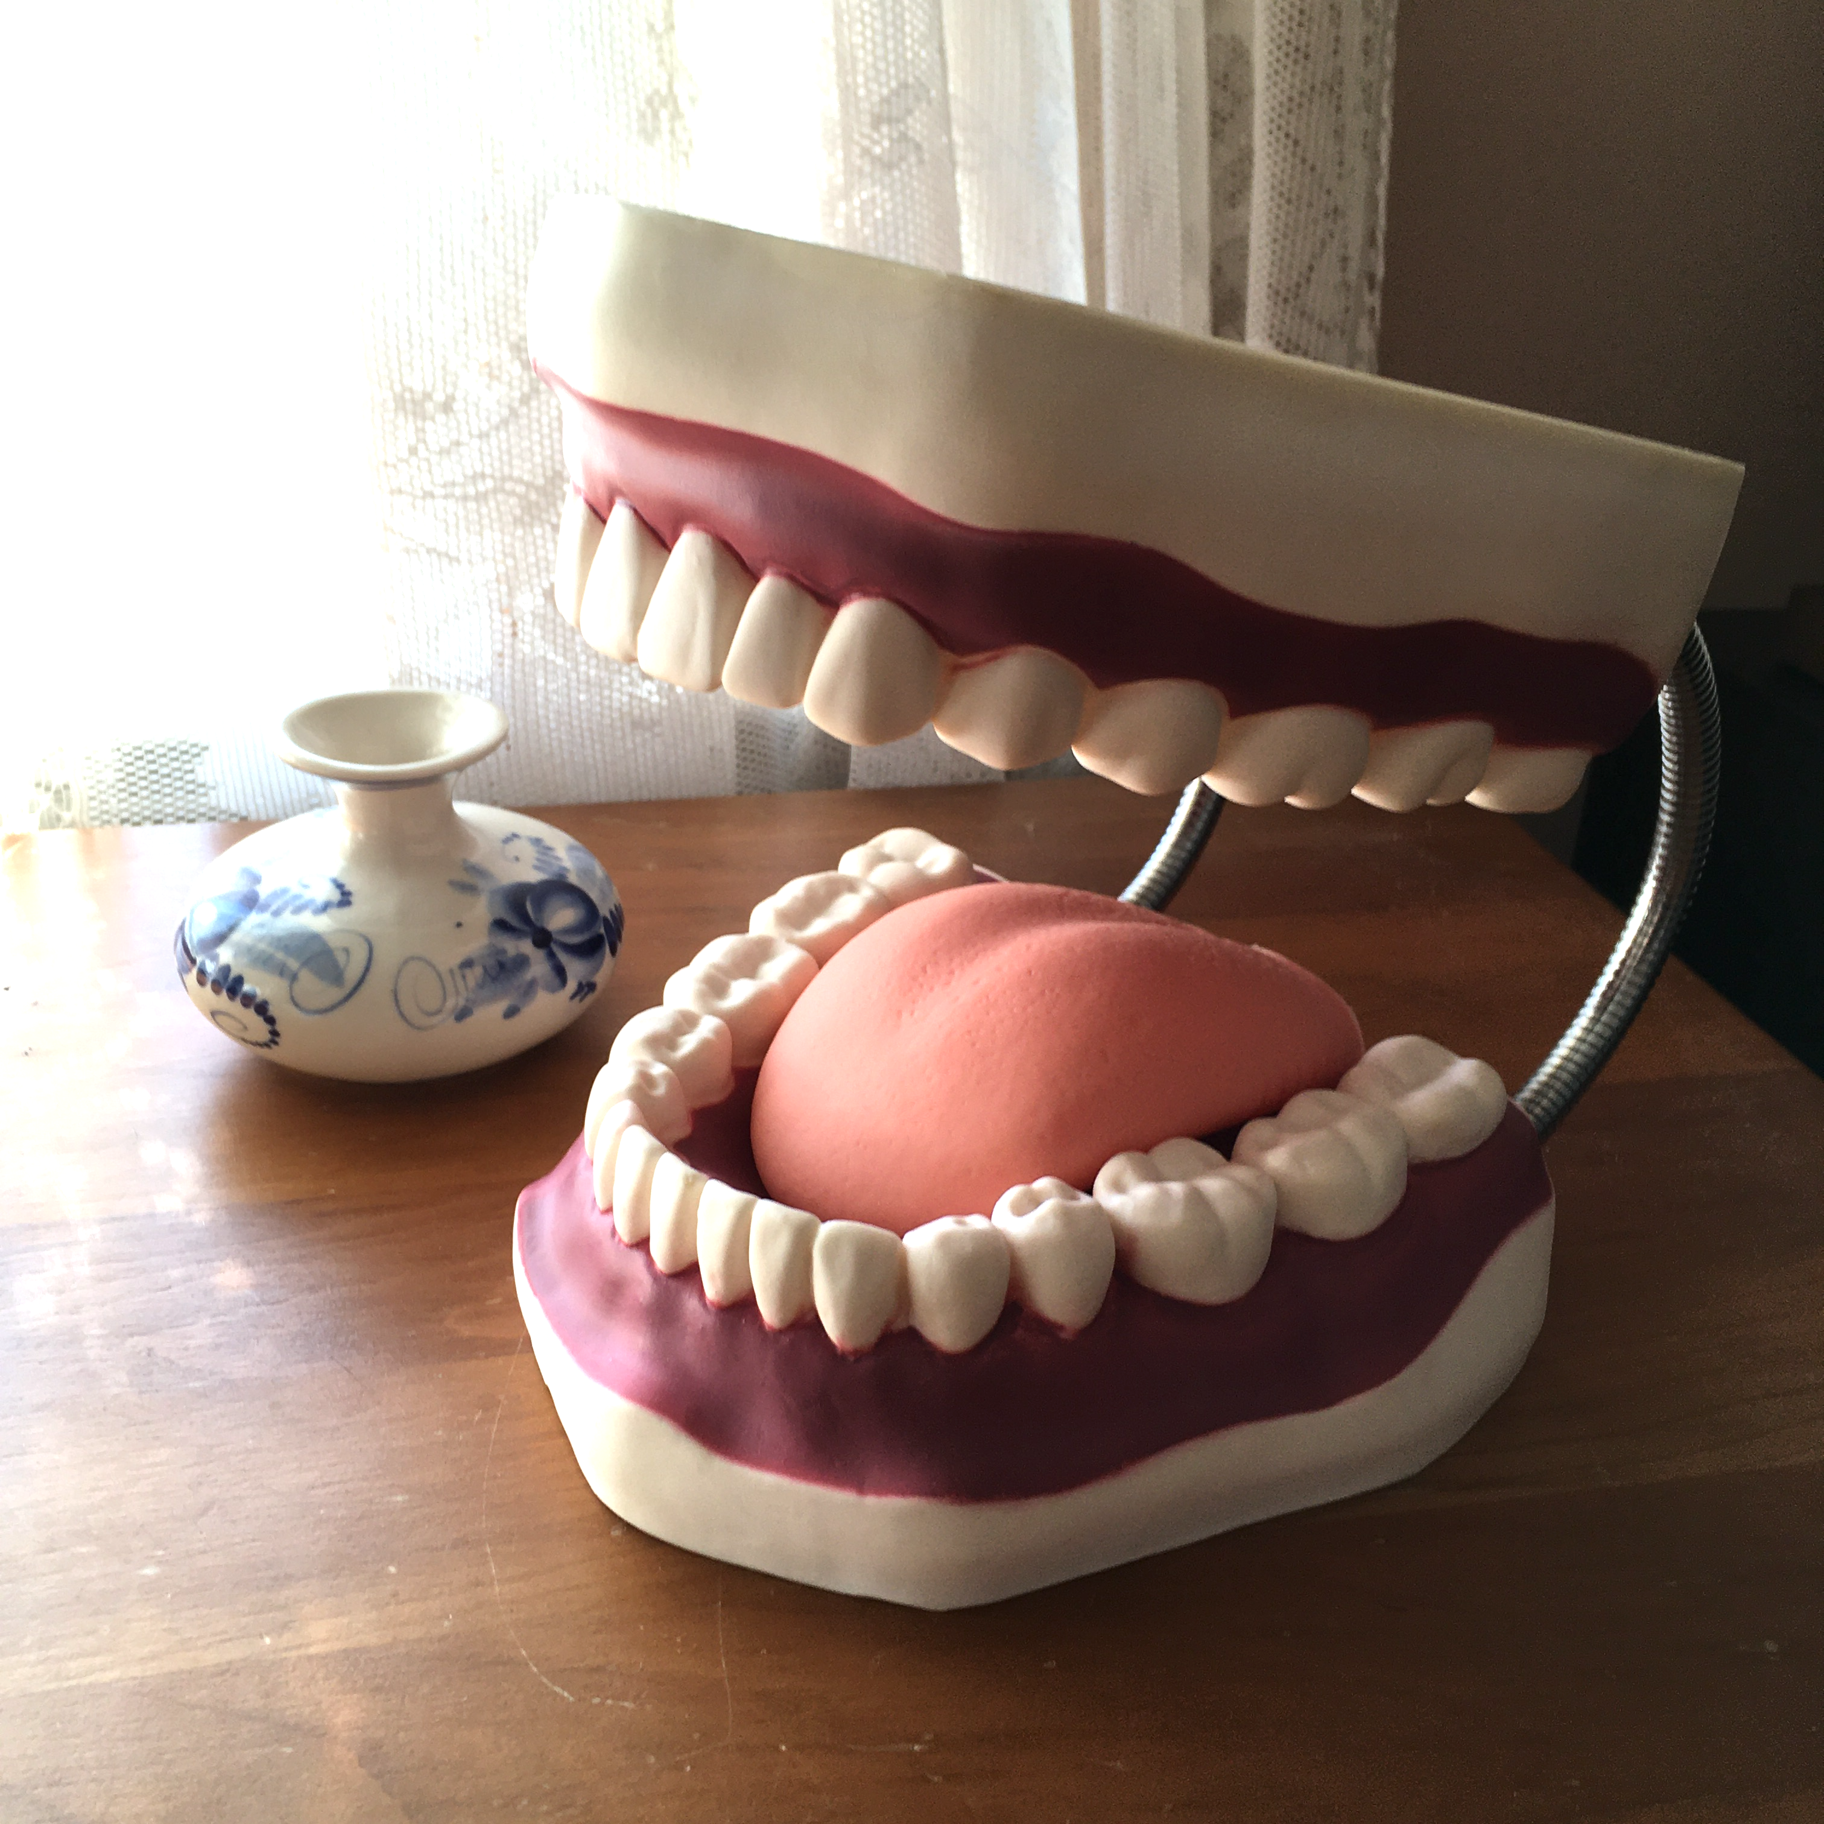
Russian Default Mouth Position
Jaw
Tongue
Lips

Slide 43
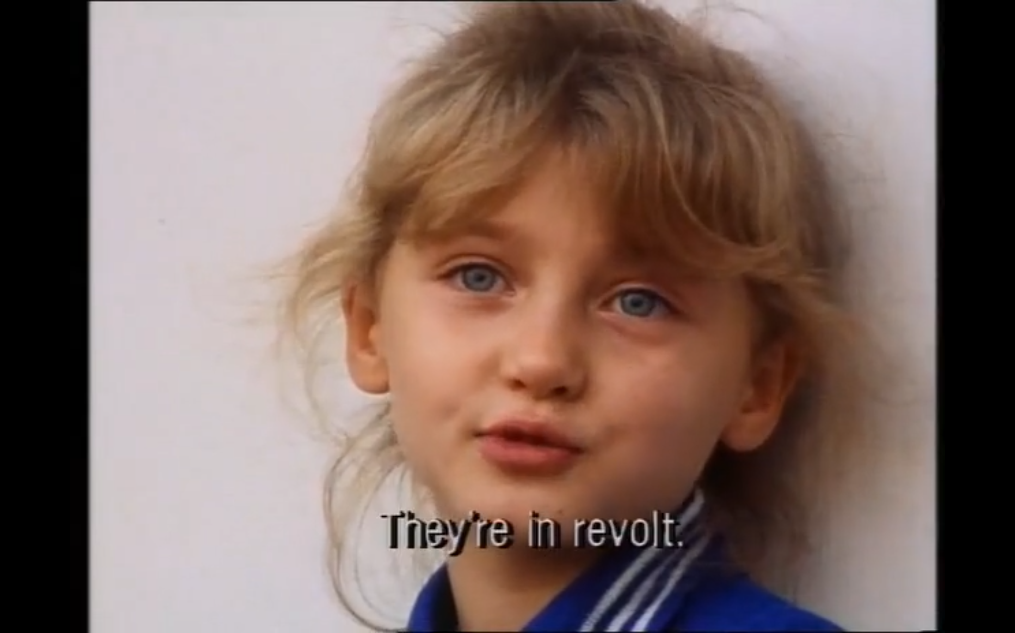
басту́ют

Slide 44
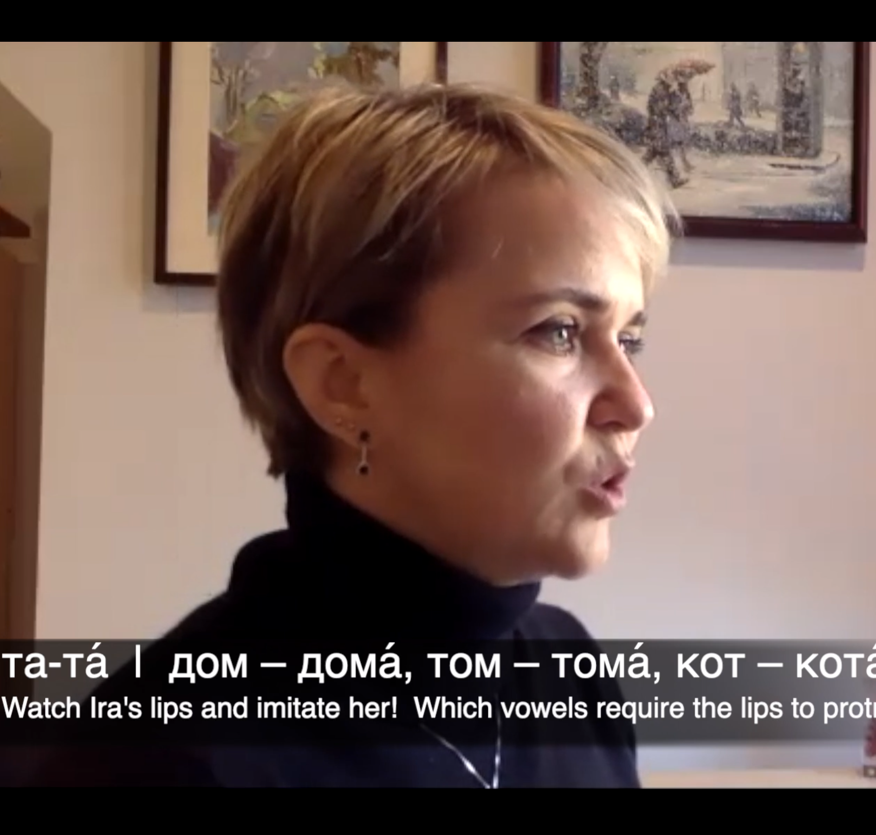
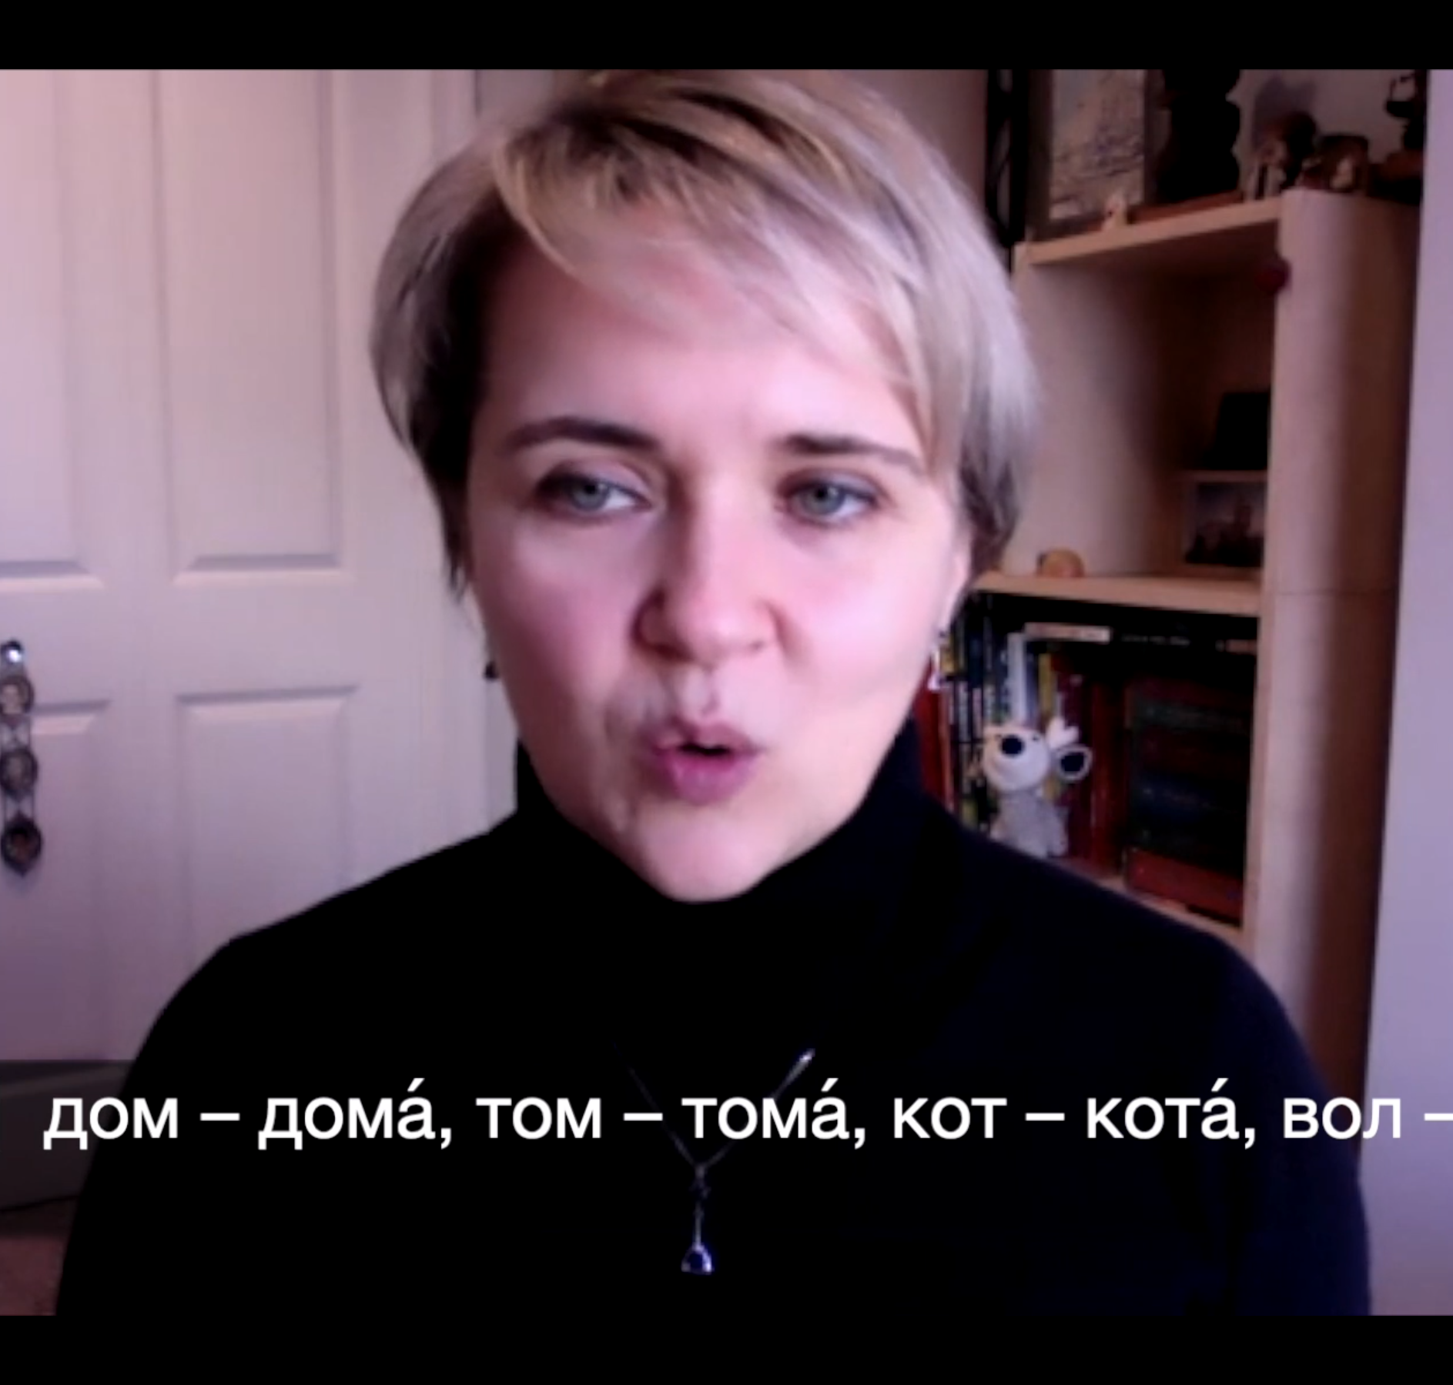
дом

Slide 45
Extra Phrases for Practice
(jaw – tongue – LEEPS!)
Hello, world!
Lake Baikal
Don’t say no!
You must say yes!
Your face…is asking for a brick!

Slide 46
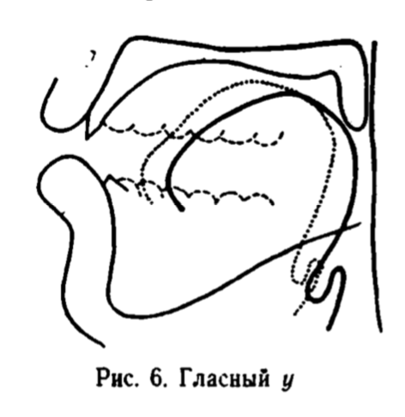
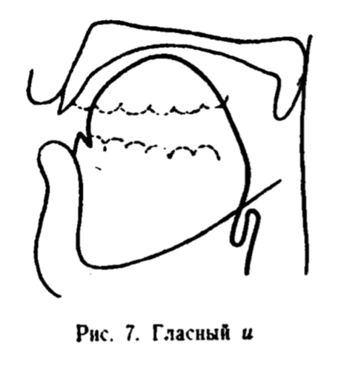
Let’s reset our DMP.
а о у
та то ту
там том ту́мба
да́ма до́ма ду́ма
ю е и
и и́ми и
и идти́ тип
и иди́ Ди́ма
Warm Up 1
No aspiration, tongue is back & low
Warm Up 2
Lots of aspiration, tongue is high & forward

Slide 47
Default Mouth Position
дай, давно́
там, так
ему́, э́ту
вот, год
эл, ал

Slide 48
Skills Check – Words
там, тя́га
том, тёмный
чита́ет, чита́ть
понима́ет, понима́ть
дал, дя́дя
жёны, жизнь
маши́на, ешь
цикл, цель
чей, ча́ры,
щи, ищу́

Slide 49
Skills Check – Words
там, тя́га
том, тёмный
чита́ет, чита́ть
понима́ет, понима́ть
дал, дя́дя
жёны, жизнь
маши́на, ешь
цикл, цель
чей, ча́ры,
щи, ищу́
tam, t’ága
tom, t’ómnyj
č’itájet, č’itát’
pon’imájet, pon’imát’
dal, d’ád’a
žóny, žyzn’
mašýna, ješ
cykl, cel’
č’ej, č’ary
š’i, iš’ú

Slide 50
Skills Check – Sentences
Так! Пойдём.
Э́то моя́ соба́ка.
Нет, не сто́ит.
Ти́хо!
«Но́вая кварти́ра»
Я хочу́ спать.

Slide 51
Skills Check – Applications
Моя́ кни́га вон там.
Моя́ кни́га в ко́мнате.
Вон там.
В ко́мнате.
Мой каранда́ш.
Вон там.
Мои́ очки́.
В ко́мнате.
Over there.
In the room.
My pencil.
Over there.
My glasses.

Slide 52
Skills Check – Consonants That Are Always Hard or Always Soft
ча́с
маши́на
живу́
це́нтр
ищу́
жёны
цель
ешь
č’ás
mašýna
žyvú
centr
iš’ú
žóny
cel'
ješ

Slide 53
Intonation Constructions
ИК-1: Ка́тя до́ма.
ИК-2: Где Ка́тя?
ИК-3: Ка́тя до́ма?
ИК-4: А Са́ша где?
ИК-5: Како́й хоро́ший фильм сего́дня!
ИК-6: Пого́да сего́дня!
ИК-7: А что он уме́ет!
Notes:
(Кира made these up, btw)

Slide 54
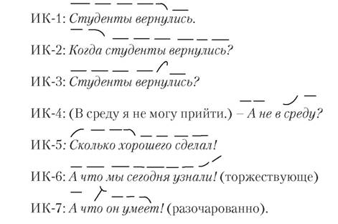
Intonation Constructions
ИК-1: Ка́тя до́ма.
ИК-2: Где Ка́тя?
ИК-3: Ка́тя до́ма?
ИК-4: А Са́ша где?
ИК-5: Како́й хоро́ший фильм сего́дня!
ИК-6: Пого́да сего́дня!
ИК-7: А что он уме́ет!
Notes:
START TO BE SENSITIVE to sentence-level phonetics in your daily practice videos!

Slide 55

2 вопроса!

Slide 56
Lesson 4
Vowel Reduction

Slide 57
The Effect of Stress on Vowels
In English: photo
photography

Slide 58
The Effect of Stress on Vowels
In English: phóto
photography

Slide 59
The Effect of Stress on Vowels
In English: phóto
photógraphy

Slide 60
The Effect of Stress on Vowels
In English: phóto
photógraphy

Slide 61
The Effect of Stress on Vowels
In English: phóto
photógraphy

Slide 62
The Effect of Stress on Vowels
In English words,
multiple syllables can be stressed.
ˈsym-pho-ˌny
ˈpho-to-ˌgraph

Slide 63
The Effect of Stress on Vowels
Most Russian words contain only 1 stressed (tonic) syllable.
ˈsym-pho-ˌny
симфо́ния
ˈpho-to-ˌgraph
фотогра́фия

Slide 64
The Effect of Stress on Vowels
In Russian, the tonic syllable retains its full quality while other syllables are reduced.
ˈsym-pho-ˌny
симфо́ния
ˈpho-to-ˌgraph
фотогра́фия

Slide 65
The Effect of Stress on Vowels
In Russian, there are three important categories of vowels in relation to stress.

Slide 66
The Effect of Stress on Vowels
In Russian, there are three important categories of vowels in relation to stress:
tonic
first pre-tonic and word-initial
all other positions

Slide 67
The Effect of Stress on Vowels
In Russian, there are three important categories of vowels in relation to stress:
tonic
first pre-tonic and word-initial
all other positions
лаборато́рия

Slide 68
The Effect of Stress on Vowels
In Russian, there are three important categories of vowels in relation to stress:
tonic
first pre-tonic and word-initial
all other positions
ла бо ра то́ ри я

Slide 69
The Effect of Stress on Vowels
In Russian, there are three important categories of vowels in relation to stress:
TONIC
first pre-tonic and word-initial
all other positions
ла бо ра то́ ри я

Slide 70
The Effect of Stress on Vowels
In Russian, there are three important categories of vowels in relation to stress:
TONIC
first pre-tonic and word-initial
all other positions
ла бо ра тО́ ри я

Slide 71
The Effect of Stress on Vowels
In Russian, there are three important categories of vowels in relation to stress:
TONIC
first pre-tonic and word-initial
all other positions
ла бо ра тО́ ри я

Slide 72
The Effect of Stress on Vowels
In Russian, there are three important categories of vowels in relation to stress:
TONIC
first pre-tonic and word-initial
all other positions
ла бо ра тО́ ри я

Slide 73
The Effect of Stress on Vowels
In Russian, there are three important categories of vowels in relation to stress:
TONIC
first pre-tonic and word-initial
all other positions
ла бо ра тО́ ри я

Slide 74
The Effect of Stress on Vowels
In Russian, there are three important categories of vowels in relation to stress:
TONIC
first pre-tonic and word-initial
all other positions
ла бо ра тО́ ри я

Slide 75
The Effect of Stress on Vowels
In Russian, there are three important categories of vowels in relation to stress:
TONIC
first pre-tonic and word-initial
all other positions
библиоте́ка

Slide 76
The Effect of Stress on Vowels
In Russian, there are three important categories of vowels in relation to stress:
TONIC
first pre-tonic and word-initial
all other positions
библиотЕ́ка

Slide 77
The Effect of Stress on Vowels
In Russian, there are three important categories of vowels in relation to stress:
TONIC
first pre-tonic and word-initial
all other positions
би бли о тЕ́ ка

Slide 78
The Effect of Stress on Vowels
In Russian, there are three important categories of vowels in relation to stress:
TONIC
first pre-tonic and word-initial
all other positions
библиотЕ́ка

Slide 79
The Effect of Stress on Vowels
In Russian, there are three important categories of vowels in relation to stress:
TONIC
first pre-tonic and word-initial
all other positions
библиотЕ́ка

Slide 80
The Effect of Stress on Vowels
In Russian, there are three important categories of vowels in relation to stress:
TONIC
first pre-tonic and word-initial
all other positions
библиотЕ́ка

Slide 81
The Effect of Stress on Vowels
In Russian, there are three important categories of vowels in relation to stress:
TONIC
first pre-tonic and word-initial
all other positions
комсомо́льская

Slide 82
The Effect of Stress on Vowels
In Russian, there are three important categories of vowels in relation to stress:
TONIC
first pre-tonic and word-initial
all other positions
комсомО́льская

Slide 83
The Effect of Stress on Vowels
In Russian, there are three important categories of vowels in relation to stress:
TONIC
first pre-tonic and word-initial
all other positions
комсомО́льская

Slide 84
The Effect of Stress on Vowels
In Russian, there are three important categories of vowels in relation to stress:
TONIC
first pre-tonic and word-initial
all other positions
комсомО́льская

Slide 85
The Effect of Stress on Vowels
In Russian, there are three important categories of vowels in relation to stress:
TONIC
first pre-tonic and word-initial
all other positions
обознача́ет

Slide 86
The Effect of Stress on Vowels
In Russian, there are three important categories of vowels in relation to stress:
TONIC
first pre-tonic and word-initial
all other positions
обозначА́ет

Slide 87
The Effect of Stress on Vowels
In Russian, there are three important categories of vowels in relation to stress:
TONIC
first pre-tonic and word-initial
all other positions
обозначА́ет

Slide 88
The Effect of Stress on Vowels
In Russian, there are three important categories of vowels in relation to stress:
TONIC
first pre-tonic and word-initial
all other positions
обозначА́ет

Slide 89
2 вопроса!

Slide 90
Patreon.com Podcast
Library of videos and audio recordings
Receive texts and/or emails from me
  Pronunciation tips
  Support for building habits
  Audio exercises
patreon.com/learnrussianwithkira

Slide 91
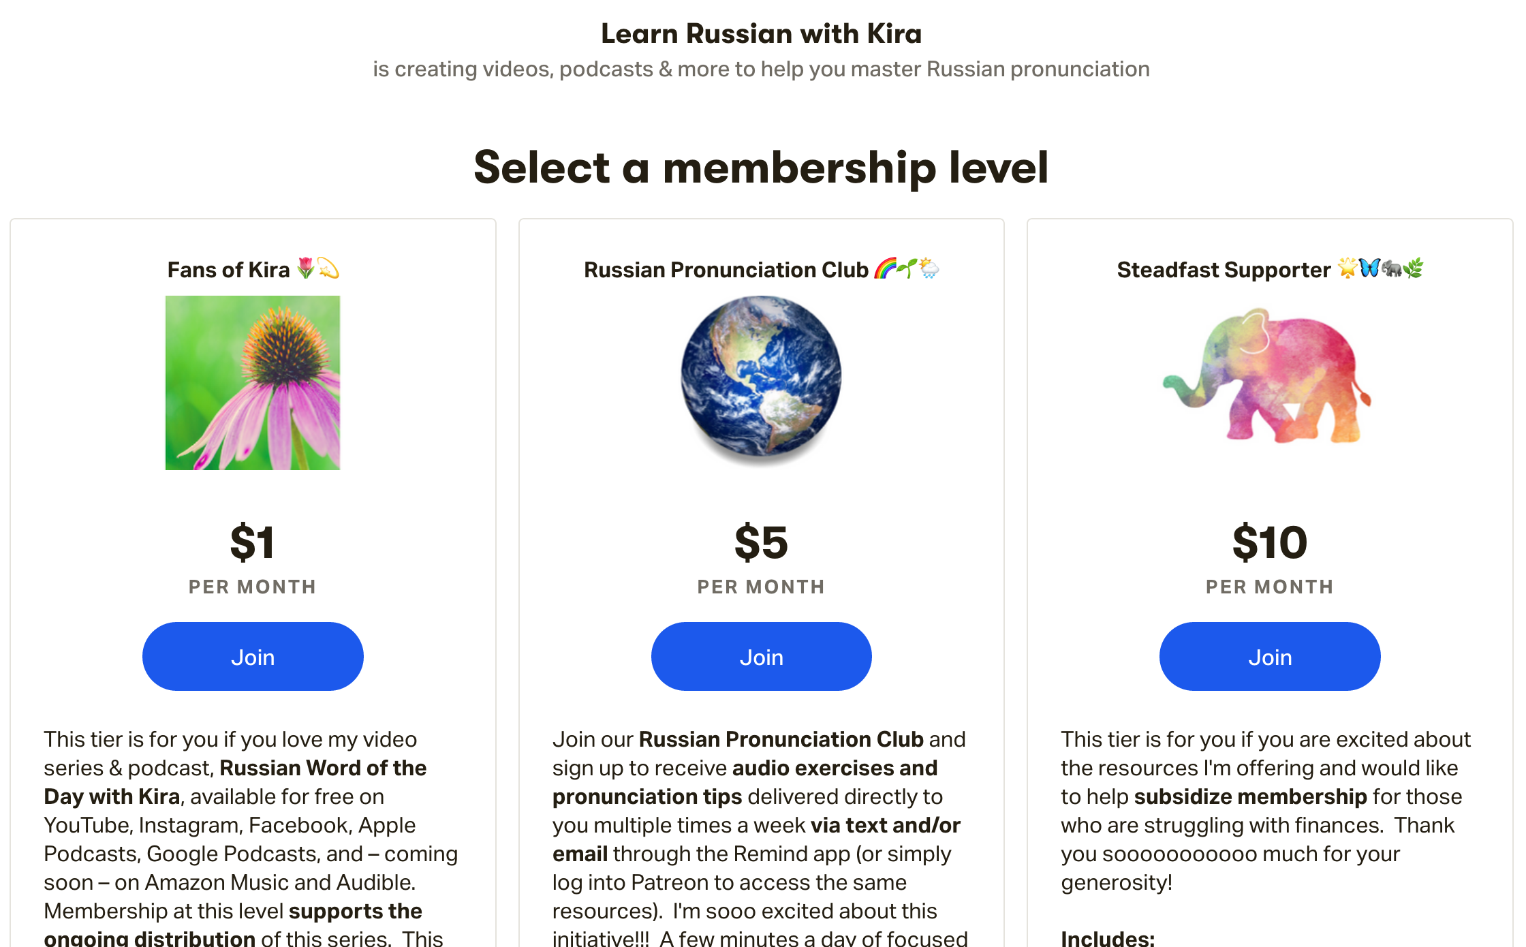
Patreon.com/learnrussianwithkira

Slide 92
Type I Reduction o/a
In Russian, there are three important categories of vowels in relation to stress:
tonic
first pre-tonic and word-initial
all other positions
обознача́ют

Slide 93
Type I Reduction o/a
In Russian, there are three important categories of vowels in relation to stress:
TONIC
first pre-tonic and word-initial
all other positions
обознача́ют

Slide 94
Type I Reduction o/a
In Russian, there are three important categories of vowels in relation to stress:
TONIC
first pre-tonic and word-initial
all other positions
обозначА́ют

Slide 95
Type I Reduction o/a
In Russian, there are three important categories of vowels in relation to stress:
TONIC
first pre-tonic and word-initial
all other positions
обозначА́ют

Slide 96
Type I Reduction o/a
In Russian, there are three important categories of vowels in relation to stress:
TONIC
first pre-tonic and word-initial
all other positions
обозначА́ют

Slide 97
Type I Reduction o/a
In Russian, there are three important categories of vowels in relation to stress:
TONIC
first pre-tonic and word-initial
all other positions
обозначА́ют

Slide 98
Type I Reduction o/a
In Russian, there are three important categories of vowels in relation to stress:
TONIC
first pre-tonic and word-initial
all other positions
обозначА́ют

Slide 99
Type I Reduction o/a
If there were NO reduction, how would we transcribe it?
обознача́ют

Slide 100
Type I Reduction o/a
If there were NO reduction, how would we transcribe it?
обознача́ют
oboznač’ájut

Slide 101
Type I Reduction o/a
Type I Reduction will make the transcription a little different.
обознача́ют
oboznač’ájut

Slide 102
Type I Reduction o/a
The vowels о and а undergo different types of reduction in each of these positions.
TONIC: full value
обозначáют
oboznač’ájut

Slide 103
Type I Reduction o/a
The vowels о and а undergo different types of reduction in each of these positions.
TONIC: full value
обозначА́ют
oboznač’ájut

Slide 104
Type I Reduction o/a
The vowels о and а undergo different types of reduction in each of these positions.
TONIC: full value
first pre-tonic and word-initial: ∧
обозначА́ют
oboznač’ájut

Slide 105
Type I Reduction o/a
The vowels о and а undergo different types of reduction in each of these positions.
TONIC: full value
first pre-tonic and word-initial: ∧
обозначА́ют
∧bozn∧č’ájut

Slide 106
Type I Reduction o/a
The vowels о and а undergo different types of reduction in each of these positions.
TONIC: full value
first pre-tonic and word-initial: ∧
all other positions: ъ
обозначА́ют
∧bozn∧č’ájut

Slide 107
Type I Reduction o/a
The vowels о and а undergo different types of reduction in each of these positions.
TONIC: full value
first pre-tonic and word-initial: ∧
all other positions: ъ
обозначА́ют
∧bъzn∧č’ájut

Slide 108
Type I Reduction o/a
Shazam!!!
The vowels о and а undergo different types of reduction in each of these positions.
TONIC: full value
first pre-tonic and word-initial: ∧
all other positions: ъ
обозначА́ют
∧bъzn∧č’ájut

Slide 109
Target Practice:
Type I Reduction o/a
TONIC: full value
first pre-tonic and word-initial: ∧
all other positions: ъ
молоко́ →
коро́ва →
анана́с →
открыва́ют →
mъl∧kó
k∧róvъ
∧n∧nás
∧tkryvájut

Slide 110
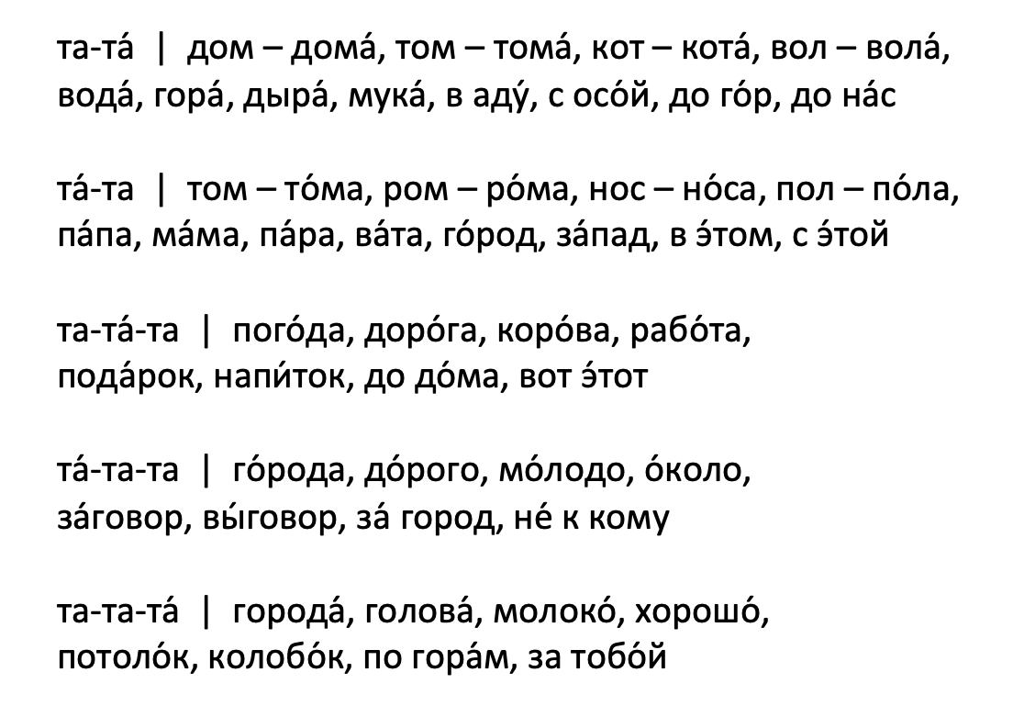
Target Practice: Type I Reduction
∧
∧
∧
∧
∧
1
2
ъ
ъ
ъ
ъ
ъ
3
4
∧
ъ
∧
ъ
∧
ъ
∧
ъ
∧
ъ
5
6
ъ
ъ
ъ
ъ
ъ
ъ
ъ
ъ
ъ
ъ
7
8
ъ
∧
ъ
∧
ъ
∧
ъ
∧
ъ
∧
9
10

Slide 111
Type I Reduction – о/а
Special Condition: Double Wedge (∧∧)
-оо-: ∧∧
-оа-: ∧∧
-ао-: ∧∧
-аа-: ∧∧
зоопа́рк →
наоборо́т →
z∧∧párk
n∧∧b∧rót

Slide 112
Target Practice: Double Wedge (∧∧)
зоопа́рк
наоборо́т
пи́сьма Андре́ю
вообража́ть
зна́ла Анто́на
∧∧
∧∧
∧∧
∧∧
∧∧

Slide 113
Target Practice:
Type I Reduction o/a
молоко́
коро́ва
анана́с
открыва́ют
зоопа́рк
ъ
∧
∧
ъ
∧
∧
∧
∧∧

Slide 114
Target Practice:
Type I Reduction o/a
наоборо́т
красота́
вообража́ть
ро́зовое
Она́ же зна́ла Анто́на.
∧∧
∧
ъ
∧
∧∧
∧
ъ
ъjъ
∧
∧∧
ъ

Slide 115
2 вопроса!

Slide 116
Type I Reduction – o/а
The vowels о and а undergo different types of reduction.
TONIC
first pre-tonic and
word-initial
all other positions
full value, ∧, ъ

Slide 117
Type II Reduction – е/я
The vowels е and я (or a in ча, ща) also undergo different types of reduction.

Slide 118
Type II Reduction – е/я
The vowels е and я (or a in ча, ща) also undergo different types of reduction.

Slide 119
Type II Reduction – е/я
The vowels е and я (or a in ча, ща) also undergo different types of reduction.
TONIC
first pre-tonic and
  word-initial
all other positions
!!!
!!!

Slide 120
Type II Reduction – е/я
The vowels е and я (or a in ча, ща) also undergo different types of reduction.
TONIC
all other positions
full value, i

Slide 121
Type II Reduction – е/я
The vowels е and я (or a in ча, ща) also undergo different types of reduction.
TONIC
all other positions
full value, i

Slide 122
Practice: Type II Reduction е/я
Shazam!!!
TONIC: full value
all other positions: i
Without reduction?
With reduction?
серебро́ →
её →
часы́ →
s’er’ebró
серебро́ →
её →
часы́ →
s’ir’ibró
jejó
jijó
č’asý
č’isý

Slide 123
Practice: Type II Reduction е/я
Shazam!!!
TONIC: full value
all other positions: i
Without reduction?
With reduction?
серебро́ →
её →
часы́ →
s’er’ebró
серебро́ →
её →
часы́ →
s’ir’ibró
jejó
jijó
č’asý
č’isý

Slide 124
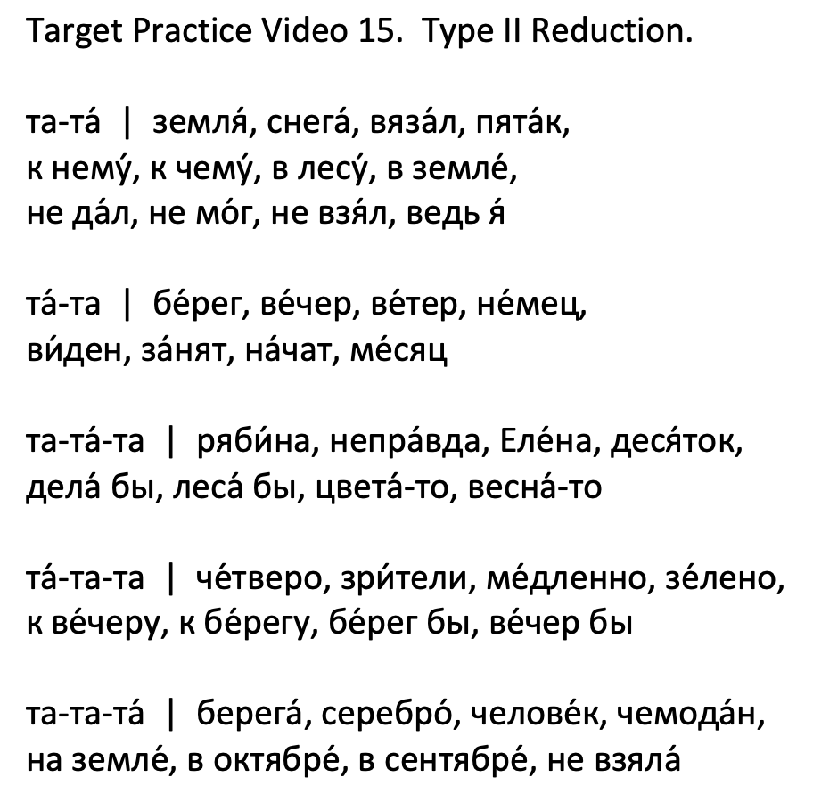
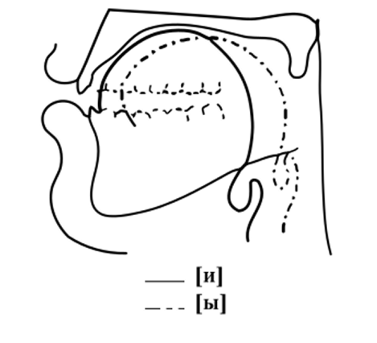
Target Practice: Type II Reduction
i
i
i
i
1
2
3
i
i
i
i
4
5
i
i
Ji
i
6
7
i
i
i
i
8
9
i
i
i
i
i
i
10
11

Slide 125
Target Practice:
Type II Reduction – ща, ча
i
i
i
i
i
часы́, часту́шка, частота́, чайку́, чайку́ бы
щади́ть, щадя́щий
2 часа́, 3 часа́, 4 часа́
5 часо́в, 6 часо́в, 7 часо́в, 8 часо́в, 9 часо́в
i
i
i
i
i
i
i
i
i
i

Slide 126
2 вопроса!

Slide 127
Type I Reduction – o/a
Special Rule for
Grammatical Endings!
full value, ∧, ъ
Type II Reduction – е/я/ча/ща
In grammatical endings,
e, я → ъ
full value, i

Slide 128
Target Practice:
Grammatical Endings → ‘ъ, jъ, ъjъ
большо́е →
чита́ет →
больна́я →
хо́чет →
b∧l’šójъ
č’itájъt
b∧l’nájъ
xóč’ъt

Slide 129
Target Practice:
Grammatical Endings → ‘ъ, jъ, ъjъ
большо́е
чита́ет
больна́я
хо́чет
ро́зовое
прекра́сная
хо́чешь
чте́ние
∧
jъ
ъ
ъjъ
jъ
i
ъjъ
∧
jъ
’ъ
’ъ
jъ

Slide 130
Type I Reduction – o/a
full value, ∧, ъ
Type II Reduction – е/я/ча/ща
full value, i
Grammatical Endings
ъ

Slide 131
библиоте́ка
обозначáют
большо́е
чита́ет
больна́я
хо́чет
серебро́
её
часы́
Multisyllabic
Words

Slide 132
ведь
не
же
что
Particles

Slide 133

Interlude: What Particles Are
Russian
ведь “you know…”
не “not”
же “!!!”
что (in phrases)
Ты ведь лю́бишь её.
i
Я не зна́ю.
Я же знал об э́том.
ъ
Потому́ что мы все здесь.
Не́ за что!

Slide 134

Interlude: What Particles Are
Russian
ведь “you know…”
не “not”
же “!!!”
что (in phrases)
Ты ведь лю́бишь её.
i
Я не зна́ю.
Я же знал об э́том.
ъ
Потому́ что мы все здесь.
Не́ за что!

Slide 135
Interlude: What Particles Are
Russian
ведь “you know…”
не “not”
же “!!!”
что (in phrases)
Ты ведь лю́бишь её.
i
Я не зна́ю.
Я же знал об э́том.
ъ
Потому́ что мы все здесь.
Не́ за что!

Slide 136
Interlude: What Particles Are
Russian
ведь “you know…”
не “not”
же “!!!”
что (in phrases)
Ты ведь лю́бишь её.
i
Я не зна́ю.
Я же знал об э́том.
ъ
Потому́ что мы все здесь.
Не́ за что!

Slide 137
Interlude: What Particles Are
Russian
ведь “you know…”
не “not”
же “!!!”
что (in phrases)
Ты ведь лю́бишь её.
i
Я не зна́ю.
Я же знал об э́том.
ъ
Потому́ что мы все здесь.
Не́ за что!

Slide 138
Interlude: What Particles Are
Russian
ведь “you know…”
не “not”
же “!!!”
что (in phrases)
Ты ведь лю́бишь её.
i
Я не зна́ю.
Я же знал об э́том.
ъ
Потому́ что мы все здесь.
Не́ за что!

Slide 139
Interlude: What Particles Are
Russian
ведь “you know…”
не “not”
же “!!!”
что (in phrases)
Ты ведь лю́бишь её.
i
Я не зна́ю.
Я же знал об э́том.
ъ
Потому́ что мы все здесь.
Не́ за что!

Slide 140
Interlude: What Particles Are
Russian
ведь “you know…”
не “not”
же “!!!”
что (in phrases)
Ты ведь лю́бишь её.
i
Я не зна́ю.
Я же знал об э́том.
ъ
Потому́ что мы все здесь.
Не́ за что!

Slide 141
Target Practice: Particles
Не зна́ю.
Она́ же зна́ла!
Я ведь зна́ла,
потому́ что
она́ сказа́ла!
i
∧
ъ
ъ
i
ъ
ъ
∧
ъ
∧
∧
ъ

Slide 142
Quizlet 10
Choose “Flashcards”
Options: Answer with Definition

Slide 143
2 вопроса!

Slide 144
What should I do before the next class & when?

Slide 145
What should I do before the next class & when?

Slide 146
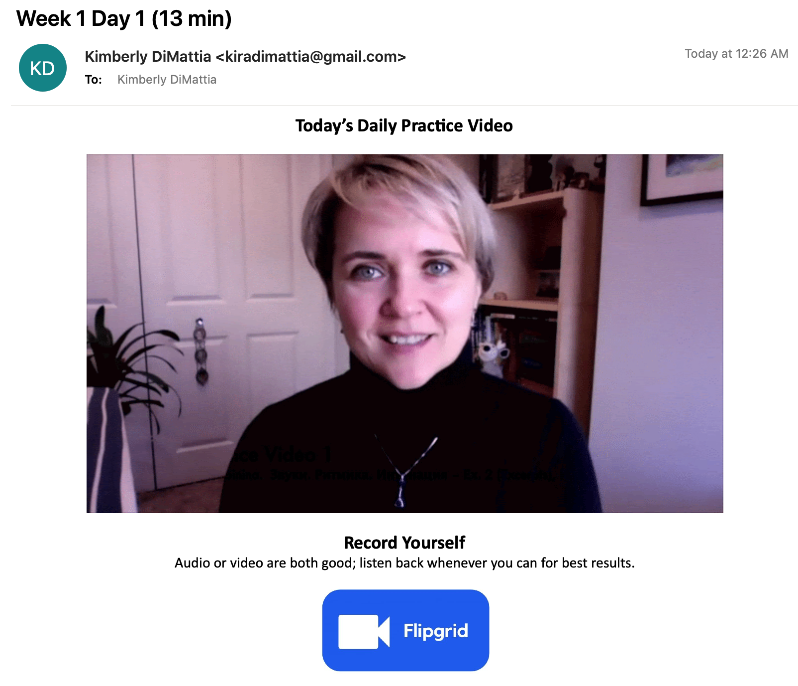
Daily Homework

Slide 147
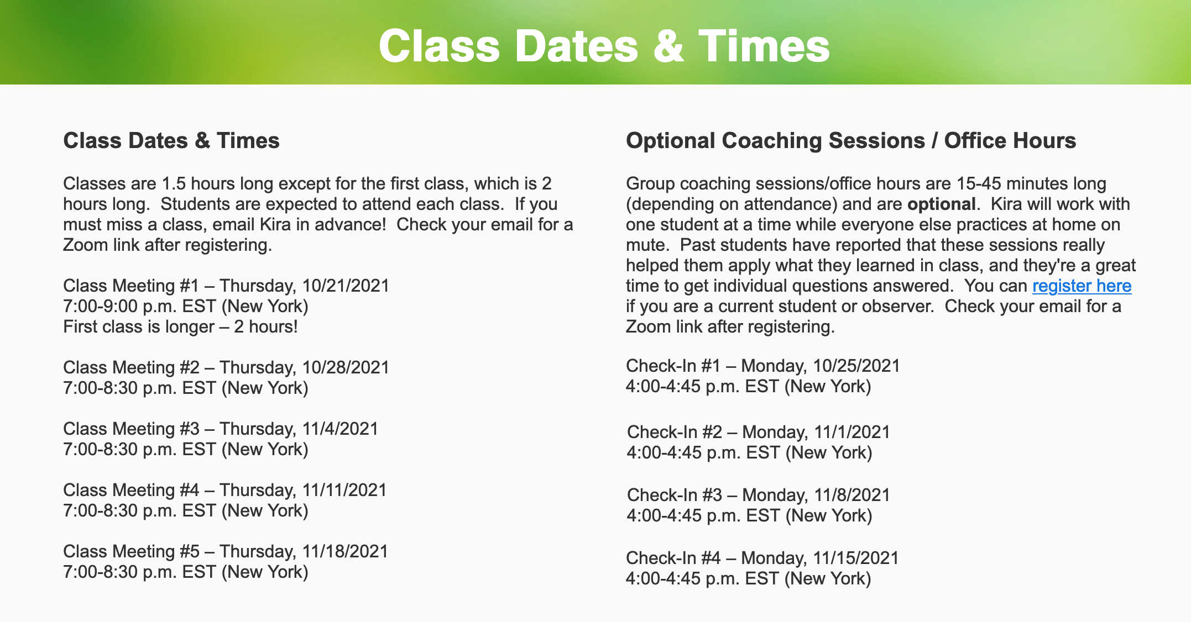
Optional Check-Ins

Slide 148
Next time...!

Slide 149
2 вопроса!

Slide 150
Special
Appearance:
© mindy77/Shutterstock.com

Slide 151
How can I support Kira?
?
Notes:
Sometimes people ask me...

Slide 152



1) Check out Kira’s other stuff
How can I support Kira?
2) Become an ambassador
If you love Kira’s stuff, you could tell:
fellow Russian students
teachers
Reddit!
learnrussianwithkira.com
patreon.com/learnrussianwithkira
learnrussianwithkira.com
3) Become a Patron
4) Buy Kira a coffee : )
At the $5 a month level:
exclusive podcast focused on sounds
library of podcast episodes
optional texts & emails
patreon.com/learnrussianwithkira
buymeacoffee.com/kiradi
Notes:
Sometimes people ask me...

Slide 153

Chat & Sing!
(Kira – stop sharing your screen and remember to use the букс!)

Slide 154
Are you a teacher?
Would you like to use this PPT?
Please do! Take it, tweak it, share it – just please include “based on Unlocking Russian Pronunciation by Kimberly (Kira) DiMattia” in it.
In return, I would love it if you would share these two links with your students:
www.learnrussianwithkira.com
www.patreon.com/learnrussianwithkira
Спасибо!
Kimberly DiMattia, kiradimattia@gmail.com
Notes:
Use real-life hands! Participants can’t see the digital ones.

